Slide 1



What makes a good essay?
Preparing your students for C3

Slide 2
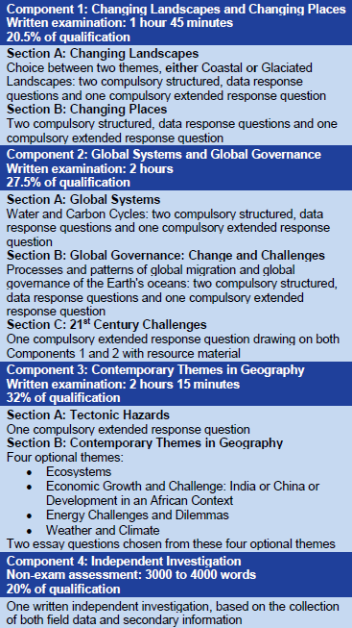
Assessment structure of A level:
C3 examination carries 32% of A level marks – this is the highest weighting of all Components.
The examination comprises three extended response questions
Notes:
NB all three AOs will be rigorously applied. So you will NEED to be aware of this as you plan your essays.

Slide 3
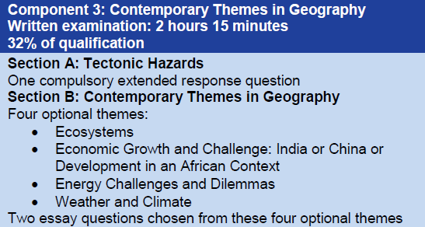
The C3 examination comprises….
One Tectonic Hazards essay from a choice of two - 38 marks
Two Contemporary Themes essays, each from a choice of two – 45 marks

Slide 4
Ensure that your students understand the assessment objectives
Component 3 |  |  |  | TOTAL MARKS = 128
Section A | AO1 | AO2 | AO3
Tectonics | 14 | 20 | 4 | 38
Section B | AO1 | AO2 | AO3
Option 1 | 20 | 20 | 5 | 45
Option 2 | 20 | 20 | 5 | 45
AO1 Knowledge and understanding
AO2 Application of knowledge to interpret/analyse/evaluate
AO3 Use of qualitative skills to construct arguments and draw conclusions
Notes:
The weighting of each AO differs between Section A and Section B but 20 marks are consistently available for the application of knowledge and understanding to interpret, analyse or evaluate geographical information. The quality of the argument constructed is dominant in Section A whereas more in-depth knowledge and understanding of the themes chosen should be displayed in Section B.

Slide 5
Exemplar essay from Student Guide:
‘To what extent is the quality of governance the most important factor in the recovery of countries and communities from tectonic disasters?’ [38 marks]
Section A | AO1 | AO2 | AO3 | Total
Tectonics | 14 | 20 | 4 | 38
AO1 Knowledge and understanding
AO2 Application of knowledge to interpret/analyse/evaluate
AO3 Use of qualitative skills to construct arguments and draw conclusions

Slide 6
Exemplar essay from Student Guide:
‘To what extent is the quality of governance the most important factor in the recovery of countries and communities from tectonic disasters?’ [38 marks]
AO1 Knowledge and understanding
AO2 Application of knowledge to interpret/analyse/evaluate
AO3 Use of qualitative skills to construct arguments and draw conclusions
Notes:
Red identifies the AO1 elements of the question, green the AO2.

Slide 7
Exemplar essay from Student Guide:
‘To what extent is the quality of governance the most important factor in the recovery of countries and communities from tectonic disasters?’ [38 marks]
AO1 Knowledge and understanding
AO2 Application of knowledge to interpret/analyse/evaluate
AO3 Use of qualitative skills to construct arguments and draw conclusions

Slide 8
Exemplar essay from Student Guide:
‘To what extent is the quality of governance the most important factor in the recovery of countries and communities from tectonic disasters?’ [38 marks]
AO1 Knowledge and understanding
AO2 Application of knowledge to interpret/analyse/evaluate
AO3 Use of qualitative skills to construct arguments and draw conclusions

Slide 9
Exemplar essay from Student Guide:
‘To what extent is the quality of governance the most important factor in the recovery of countries and communities from tectonic disasters?’ [38 marks]
AO1 Knowledge and understanding
AO2 Application of knowledge to interpret/analyse/evaluate
AO3 Use of qualitative skills to construct arguments and draw conclusions
Notes:
The AO2 element is largely steered by the command word (stem). This is what will tell candidates how to answer the question, but candidates should remember that key and specialised concepts could give their discussions a framework that will be given credit. Reference to applicable key or specialised concepts (implied or explicit) will be credited.
Key concepts: place, space, scale (temporal and spatial) and environment
Specialised concepts: causality, equilibrium, feedback, identity, inequality, interdependence, globalisation, mitigation and adaptation, representation, risk, resilience, sustainability, systems, and thresholds

Slide 10
Ensure that your students understand each of the four C3 commands
C3 commands
Discuss | Goes beyond knowledge and understanding to offer a considered review that includes a range of arguments. It becomes a written debate, identifying through description and explanation, both positive and negative points and reaches a conclusion from the debate.
Evaluate | Goes beyond knowledge and understanding to evaluate. Requires a judgement about the overall quality or value of the feature(s)/issue(s) in terms of the strengths and limitations. Supporting evidence should be clearly given.
To what extent….? | Goes beyond knowledge and understanding to give possible explanations for and against, and justify a viewpoint(s).
Justify | Goes beyond knowledge and understanding to explain why the choice given is better than other possible options.
Notes:
Definitions from Teacher Guides (pages 5 – 9). These commands ask the student to formulate a debate or an argument. They should use any relevant knowledge and understanding to help them do so.

Slide 11
Exemplar essay from Student Guide:
‘To what extent is the quality of governance the most important factor in the recovery of countries and communities from tectonic disasters?’ [38 marks]
AO1 Knowledge and understanding
AO2 Application of knowledge to interpret/analyse/evaluate
AO3 Use of qualitative skills to construct arguments and draw conclusions
Notes:
AO3 qualitative skills could include the skill of presenting a well-constructed, ordered, logical argument, constructing relevant diagrams or sketch maps in support, or the skill of reaching conclusions. The candidate does not have to include a concluding paragraph to gain full marks for AO3 – conclusions could be ongoing.

Slide 12
Component 3 Band 4 descriptors:
AO1 (14 marks) | AO2 (20 marks) | AO3 (4 marks)
Thorough and accurate knowledge; confident understanding of concepts and principles throughout the response that is wholly relevant to the question Appropriate, accurate and well-developed examples accurate and relevant terminology Well-directed and well-annotated sketch maps | Sophisticated application of knowledge and understanding to analyse, interpret or evaluate to produce a full and coherent response that is supported by wholly appropriate evidence Demonstrates application of knowledge and understanding through the synthesis of the connections between different elements of the question Confident application of the specialised concepts throughout | The response uses wholly relevant quantitative skills to construct clear, coherent and appropriately structured arguments and conclusions
Notes:
These are the requirements for reaching the top band in Section A.

Slide 13
Tackling AO2……..
Students should be able to apply relevant concepts to each essay question. Display these clearly in the classroom and refer to them often – enable the students to identify these as strands that run through their A Level studies
Students should identify the command word and create a debate or argument around it
Identify the command
Identify specialised concepts
Use evaluative language
Synthesise knowledge
Using contrasting and/or evaluative language can help focus students on AO2. ‘However’, ‘on the other hand..’, nevertheless..’, ‘ as opposed to…’ and ‘yet’ are very useful tools
Draw knowledge together to reach rational conclusions to the argument or debate. Use appropriate language e.g. ‘in conclusion…’ ‘in summary…’, ‘therefore…’
Notes:
Candidates will need to develop the toolkit to respond to the AO2 element in each of the three essays in Component 3. Above are some suggestions that could provide a framework for developing this skill.

