Slide 1
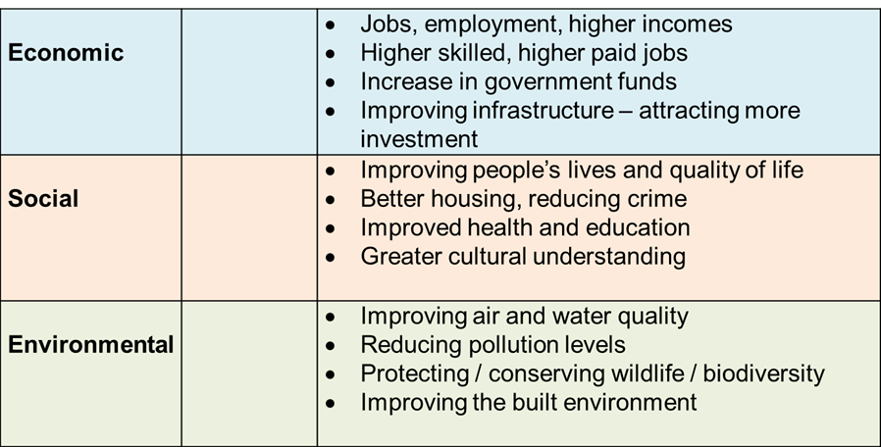
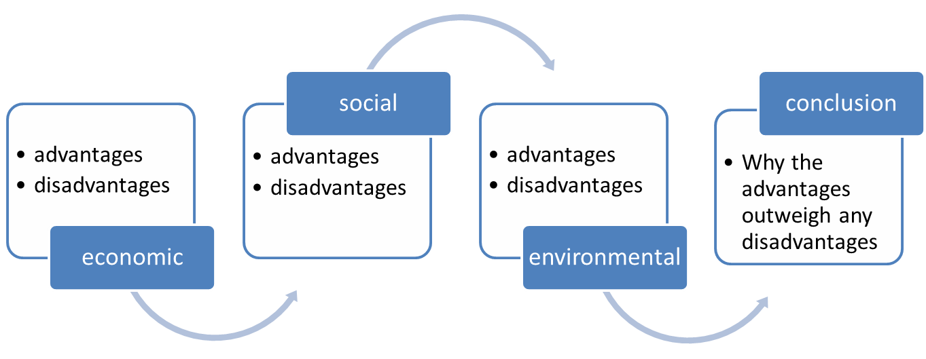
ALL of these questions assess AO3 [Apply knowledge and understanding to interpret, analyse and evaluate geographical information and issues and to make judgements]
Eduqas GCSE Geography B
Component 1: 8 mark questions at the end of each theme
Component 2: one 12 mark question at the end of Part C
Component 3: one 10 or 12 mark question at the end of Part C
Less focus on learning facts related to case studies.
More emphasis on:
Interpretation
Analysis
Appraisal
Making decisions
Justification
Ascribing meaning – layers of inference..
What does the source tell me?
What can I infer (guess)?
What does the source omit?
What other questions should I ask?
Develop Strategies to help prepare for (AO3) extended writing:
Making comparisons
Applying evidence from known examples to compare likely outcomes in a novel situation
Recognising bias
Detecting neutrality or vested interests in evidence. Identifyin limitations in evidence.
Identifying trends/patterns and anomalies
Using current evidence to forecast likely short/long term scenarios/impacts
Ascribing meaning
Identifying layers of meaning – applying understanding to new situations
Recognising costs and benefits
Weighing the positive and negative impacts. Identifying winners, losers and decision makers
Ranking / prioritising
Deciding on best and better options
Weighing impacts / identifying decision makers
Who decides?
Who are making decisions about change – raising questions about the involvement of local communities or the imposition of decisions from above
Social
How will people be affected?
Will the local community benefit?
Economic
Will jobs be created or lost?
Will local people benefit? Skills?
Strategies for planning a response: evaluate, assess, justify
Natural
How will the environment be affected?

Slide 2
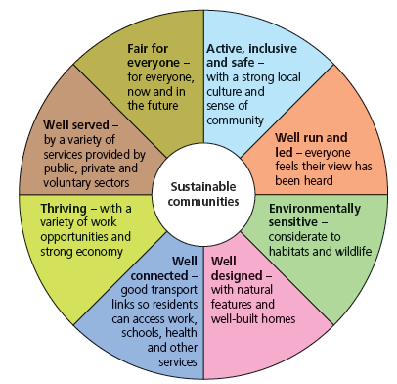
AO3 requires:
Critical thinkers
1 Reduce time spent on case studies
2 Make time to practise the skills of evaluation and decision making
3 Emphasise the process of learning (how did I learn) rather than the end product
4 Provide some simple scaffolding techniques as safety nets for learners who lack confidence
5 Encourage the use of connectives to extend writing
use one or more type of argument
Consider future scenarios and consequences (Probability)
Use evidence to support a reasoned argument (Empiricism)
Analyse claims and opinions held by some stakeholders (Scepticism)
Weigh positives against negatives when considering the likely impacts of change (Pragmatism)
Application of a concept to justify a choice
key concepts can be used as ways into an evaluative answer. For example:
Futures – analysing trends to predict the likely impact of a decision
Sustainability of a choice . Use sectors of Egan’s wheel as memory ‘pegs’ to evaluate sustainability of a decision.
Vulnerability/resilience – how will the local community be affected by your decision?
SIGNPOSTING is used by news broadcasters. They use headlines, then detail, then a summary.
The use of signposts and connectives can help to link together an extended response
I would recommend…
The most important reason…
This is better than other options because..
In conclusion…
Think about who benefits
Benefits for local people would be…
Whereas the benefits for the government/ businesses would be…
Be BALANCED Weigh up advantages and disadvantages – e.g. costs / benefits, good / bad, positive / negative impacts | Use EVIDENCE Give extended and detailed evidence to support a decision. Use hard and soft evidence but do not use vague assertions. | COUNTER-ARGUMENT Be able to explain why some proposals or ideas have been rejected
Be SYNOPTIC Use knowledge and understanding from other topics in Geography, from the news, other subjects | Think about FUTURES Consider the impacts of your decision in the short term and longer term. Is it sustainable? | Reach a JUDGEMENT DECIDE! Be able to put together a logical case that is linked to evidence
Make comparisons
A similar strategy was used at …
It worked well because …
The circumstances here are similar because
So I would expect the consequences to be..
Think about futures
In the short term … the trends suggest that… because…
In the longer term … the evidence suggests that …

