Slide 1
Processes and patterns of global migration
National, temporary, voluntary migration

Slide 2
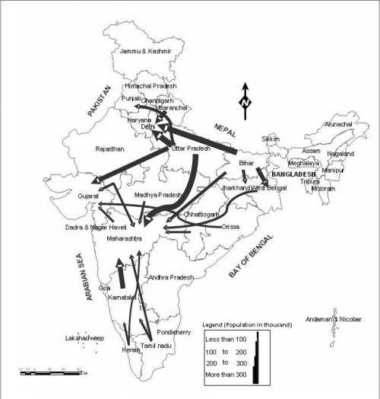
Volume
Major Net Internal Migration Flows in India, 2001
This migration involves the movement of migrants from villages and cities and back.
National Sample Survey estimates that there are 15 million circular migrants in India - but there are other estimates that there are almost 100 million circular migrants.
Most semi-permanent and temporary migrants (in this case migrants who stay for between 60 days and a year) are aged between 16 and 40.
Note: map (right) is for all internal migration in India, not just voluntary and temporary.

Slide 3
Causes
Growing agricultural disasters in rural India and lack of local employment opportunities cause rural-urban migration.
Increased casualisation of labour force and increasing flexibility suited to needs of industry. Of India’s workforce, 92% is in the ‘unorganised sector’ (when used in Indian context this means not incorporated with Govt. so no rules/regulations) and most of the unorganised sector consists of seasonal migrant workers - insecure employment (risk).
Search for employment (above) a particularly significant cause due to age profile of migrants.
Growing imbalances in regional development across India.
70% of internal migrants are women - migrate for marriage.

Slide 4
Examples
Particularly high rates are found in drought prone areas with low agro-ecological potential, estimated 300,000 labourers migrate from drought prone Bolangir District in Western Orissa every year - heavy agriculture.
In the highly drought prone and poor district of Anantapur in Andhra Pradesh, migration increased between 1980 and 2001.
In Jharkhand, a study of twelve villages found that one-third of the households had at least one member migrating.
Short-term migration was higher among poorer groups, involving over 80% of the landless and 88% of illiterate people.
A study in Andhra Pradesh and Madhya Pradesh found that many rural migrant households cultivated one rain-fed subsistence crop and few chose to settle permanently at their migration destination, recognising that keeping a foot in both the rural and the urban economies provides them with greater security

Slide 5
Consequences
Unorganised sector means increased exploitation of workers (no regulations to follow - risk). Withholding of wages, underpayment, lack of compensation after accidents and physical abuse are common.
Basic entitlements (e.g. state health benefits, voting rights) vary across Indian states so migrants are increasingly excluded from social, financial and political systems.
Integration challenges of temporary migrants - for example India has a wide range of languages and cultures.
Migrants often live in illegal settlements, where they have poor access to water, sanitation and electricity and face constant threats of eviction, disease, sexual abuse, underpayment and police harassment (Deshingkar and Anderson, 2004).
Migrants are excluded from the ration system because they cannot use their cards outside their home local authority. This means they spend a considerable proportion of their wages on basic food supplies and rents and when whole families migrate, children often do domestic chores while their parents work, missing out on an education (Deshingkar and Anderson, 2004);
Migrants do not have adequate access to essential services and amenities such as water and sanitation, health care and education (Deshingkar and Grimm, 2004);
Migrants are generally discriminated against, sometimes exploited, are generally paid less than non-migrant workers and conditions of work are poor (Deshingkar and Grimm, 2004; Deshingkar, 2005).

