Slide 1
Hurricane Katrina: National, forced, temporary migration
Dan Pereira and James Kennedy

Slide 2
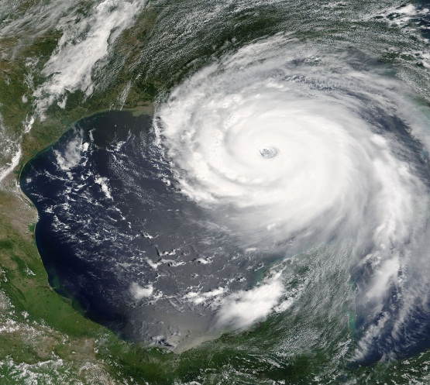
Background
Extremely destructive and deadly tropical cyclone costliest natural disaster, 1 of 5 deadliest hurricanes in the history of the United States.
Originated over the Bahamas on 23/8/05.
Intensified into Tropical Storm Katrina. The cyclone headed westward toward Florida, strengthened into a hurricane only two hours before making landfall at Hallandale Beach and Aventura on 25/8/05.
The storm strengthened to Category 5 hurricane over the Gulf of Mexico, weakened before making its second landfall as a Category 3 hurricane on 29/8/05, in southeast Louisiana.

Slide 3
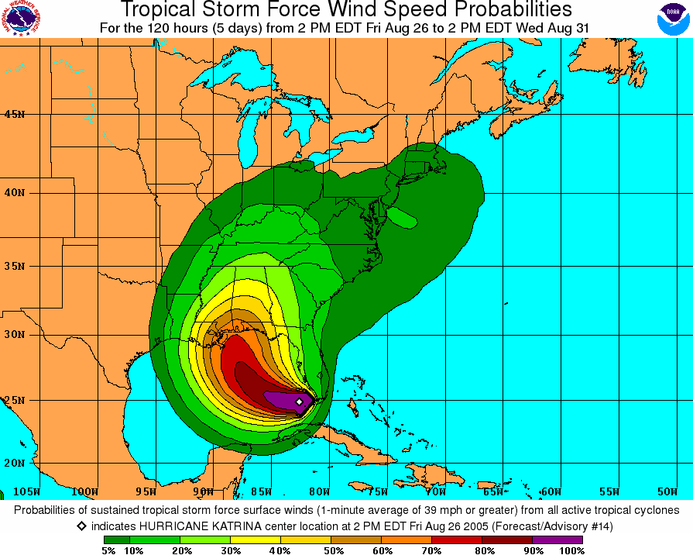
Map

Slide 4
Preparations
On Sunday 28/8/05, New Orleans Major Ray Nagin declared. a mandatory evacuation for all of the New Orleans area (population ≈ 484,000 at the time), supported by President Bush.
The National Weather Service also issued a bulletin predicting ‘devastating’ damage.

Slide 5
Evacuation
People were told to evacuate in whatever way they could; obviously cars were the most common form of transport.
Of the 484,000 estimated population, approximately 230,000 people remained in the city, either because they were unable/unwilling to leave. The National Guard delivered supplies to the Superdome for anyone who could get there before the hurricane hit.
About 254,000 were evacuated from the city, and a million people in the Gulf Coast overall were displaced.

Slide 6
New Orleans population was an estimated 230,000 after Katrina (July 2006) — a decrease of 254,000 people and a loss of over half of the city’s population. By July of 2015, the population was back up to 386,000 — 80% of what it was in 2000.
Many people did return as soon as it was possible and in some cases within days, but ‘temporary’ is a subjective term and for some people it took months/years to come back.

