Slide 1

International, voluntary, temporary migration
UK, China and Australia to New Zealand
To find work

Slide 2
Net migration gain of 73,000 non-New Zealand citizens in the past year.
New Zealand has been experiencing record levels of net migration in recent years as economic growth outpaced Australia’s
14% increase in work visas granted in the year

Slide 3
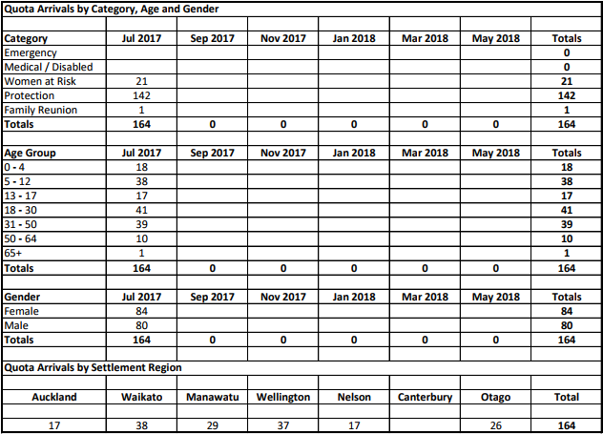

Slide 4
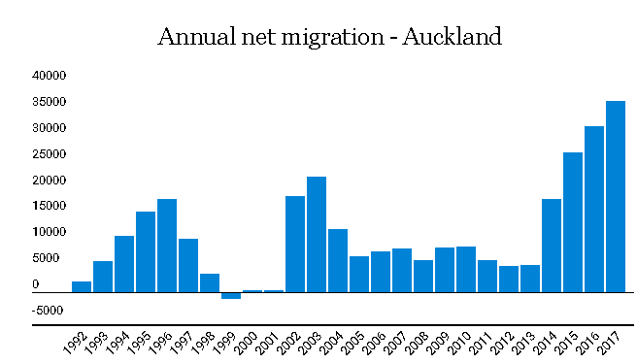

Slide 5
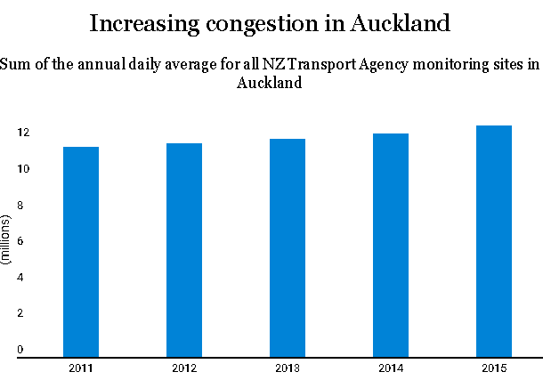
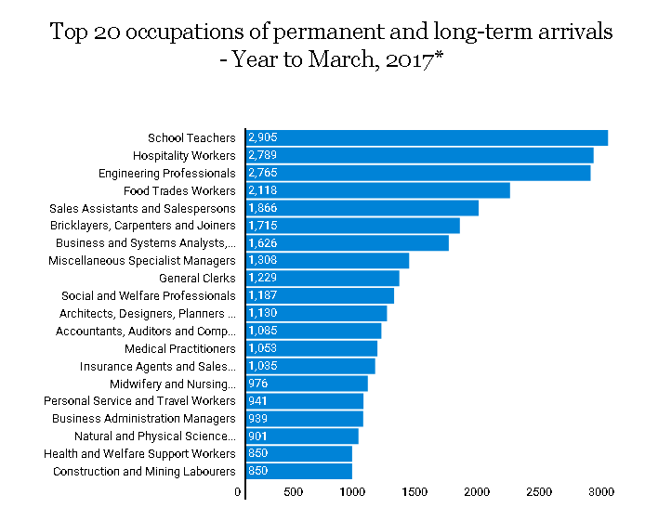
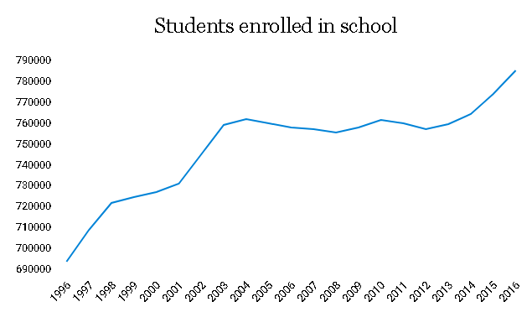
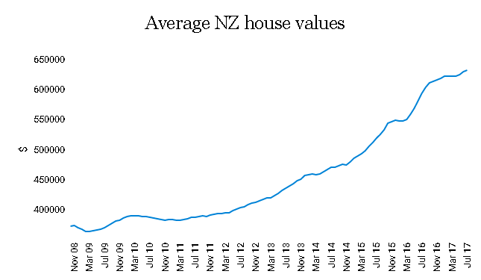
Auckland's motorways are jammed, schools are overcrowded and housing supply is in crisis

Slide 6
Effects of migration:
Overcrowding- the record number of people who have migrated to New Zealand has caused overcrowding. There are too many children for the places available in schools and all major motorways across Auckland and Wellington are constantly jammed because of the increased volume of people.
Increased demand for houses- the increase in the population of New Zealand has meant that houses are in demand. This has caused house prices to increase which has meant that young people and first time buyers are finding it almost impossible to afford a house.
Effect on economy- due to the volume of people who are migrating from Australia, England etc., they are losing a big percentage of their working population which means there is increased pressure on the smaller number of the working population when it comes to paying taxes etc. Furthermore, this causes these countries to develop an ageing population with the majority of people who have migrated are working class and sometimes with children.

