Slide 1
Selected data collection techniques

Slide 2
Data collection methods
Likert Scale
“Likert (1932) developed the principle of measuring attitudes by asking people to respond to a series of statements about a topic, in terms of the extent to which they agree with them.”
(https://www.simplypsychology.org/likert-scale.html - 18/04/18)
Strongly agree
Strongly disagree
I would like to spend more time here
Agree
Undecided
Disagree

Slide 3
Data collection methods
Environmental Quality Assessment – bipolar
It can be difficult to decide on appropriate opposite descriptions
Always make sure you have the descriptions on the correct side of the scale!

Slide 4
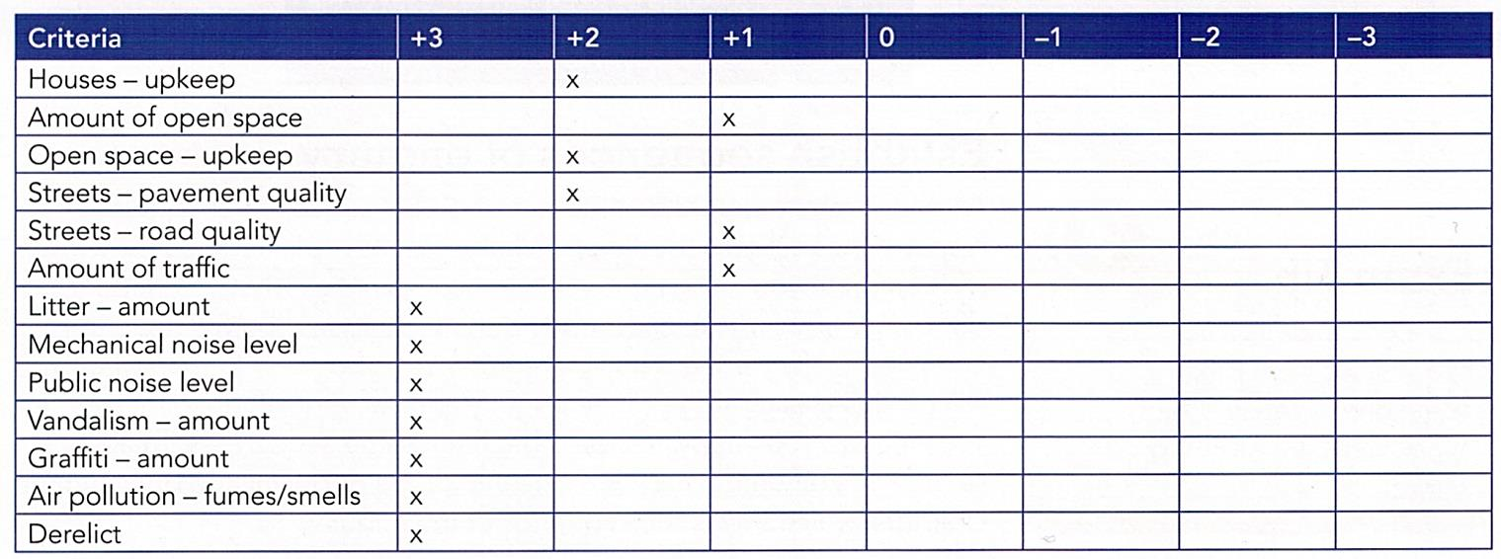
Data collection methods
Environmental Quality Assessment – scoring

Slide 5
Data collection methods
Coding – for land use surveys
You may need to have sub-groups in order to identify more meaningful patterns…
…but having too many could make it difficult to see any patterns at all!
Collecting raw data with a view to encoding later might be the best option…

