Slide 1
Glaciated Landscapes
Revision

Slide 2
Specialised concepts
causality (landforms processes and landscapes)
equilibrium (a condition of balance within the glacial system which, when established, perpetuates itself unless controlling conditions change markedly)
feedback (within the glacial system)
interdependence (the relationship between human activity and the glacial landscape system)
risk (in the context of water supply)
systems (especially the glacial mass balance system)
threshold (a factor that complicates the self-regulation of the glacial system: when crossed, it sets irreversible changes in motion).

Slide 3
The operation of a glacier as a system
The glacial system including inputs, outputs, stores and transfers of energy and materials
Change in the inputs to and outputs from a glacier over short- and long-time scales
The glacial budget including glacier mass balance and equilibrium
Positive and negative feedback in the glacier system

Slide 4
Climate change and the glacier budget over different time scales
Causes of climate change through the Quaternary Ice Age including glacials, interglacials and stadial periods and thresholds for change
Causes of changes in the glacier budget through historical time including the Little Ice Age
Seasonal changes and their impact on the glacier budget

Slide 5
Glacier movement
Differences between cold- and warm-based glaciers, their locations and rates of movement
Glacier ice movement including internal deformation, basal sliding, sub-glacial bed deformation, surge conditions, compressional / extensional flow

Slide 6
The range of glacial environments and their distribution
Types of ice mass at a range of scales including cirque glaciers, valley glaciers, highland ice field, piedmont glaciers and ice sheets and sea ice
Past distribution of valley glaciers and ice sheets during the Quaternary Ice Age
Present day distribution of ice masses including valley glaciers and ice sheets

Slide 7
Processes of glacial weathering, erosion and the characteristics and the formation of associated landforms and landscapes
Freeze-thaw weathering
Erosional processes of abrasion, plucking and sub-glacial fluvial erosion
Factors affecting glacial erosion including basal thermal regime, ice velocity, ice thickness, bedrock permeability and jointing
Characteristics of glacial erosional landforms and landscapes both for and beyond the UK at:
macro-scale including cirques, pyramidal peaks, arêtes, glacial troughs, ribbon lakes, hanging valleys and truncated spurs;
meso-scale including roches moutonnees, crag and tail;
micro-scale including striations

Slide 8
Processes of glacial and fluvioglacial transport and
deposition and the characteristics and formation of associated landforms and landscapes
Processes of glacial and fluvioglacial transport including supraglacial, englacial and sub glacial transfers and their resultant sediment characteristics (size, shape and sorting)
Landforms and landscapes of glacial deposition including types of till (ablation, lodgement and deformation) and types of moraine (terminal, recessional, lateral, medial and push) and drumlins
Processes of fluvioglacial transport and deposition both for and beyond the UK leading to:
ice-contact features including eskers, kames and kame terraces
proglacial features including sandurs, varves, kettle holes and kettle lakes

Slide 9
Suites of landforms within glacial landscapes
Variations in glacial landscapes between highland and lowland
Variations in glacial landscapes between ice sheets and valley glaciers

Slide 10
Periglacial processes and the formation of associated features
Ground ice formation and associated features, including ice lenses, ice wedge polygons, patterned ground, pingos and thermokarst landscape
Frost weathering and mass movement can lead to features including nivation hollows, blockfields and scree slopes, pro-talus ramparts, solifluction terraces and head deposits
Periglacial action of water and wind and associated landforms of dry valleys (water) and loess plateaux (wind)

Slide 11
Variations in glacial processes, glacial landforms and landscapes over different time scales
Process and landform changes in seconds: rapid mass movement processes causing changes in glacial valley profiles
Seasonal process and landform changes: landform changes associated with seasonal variations in fluvioglacial transport and deposition
Process and landform and landscape changes over millennia: post glacial reworking of glacial deposits, infilling of glacial lakes and creation of misfit streams by fluvial processes

Slide 12
Glacial processes are a vital context for human activity
Impacts of glacial processes and landforms and landscapes on human activity including glacial lake outburst floods (GLOFs)
Impacts of human activity on glacial processes and landforms and landscapes including extraction of sands and gravels and creation of reservoirs
(Case study of one) management strategy to manage either the impacts of glacial processes / landforms / landscapes on human activity or human activity impacts on glacial processes / landforms / landscapes
Permafrost degradation through human activity

Slide 13
Types of glaciers at different scales
Cirque glaciers
Valley glaciers
Highland ice fields
Piedmont glaciers
Ice sheets
Sea ice

Slide 14
Glaciers as systems
How does a glacier operate as a system?
Examples of positive and negative feedback?
What is the glacial budget and why does it change – or stay the same?
How and why do inputs and outputs change seasonally?
How and why have glacial budgets changed
over the medium term (historical time)?
over the longer term (geological – Quaternary)?

Slide 15
Ice movement
How do glaciers move?
What controls their movement?
Key terms/concepts associated with this topic?

Slide 16
Glacial processes
How do glaciers erode/transport/deposit?
What weathering process operates in glacial environments?
How are these processes related to other topics in this unit?
Key terms/concepts associated with this topic?

Slide 17
Glacial landforms
Cirque
Esker
Glacial trough
Meltwater channel
Arête
Lateral moraine
Group these in a suitable way
Drumlin
Pyramidal peak
Hanging valley
Roche moutonnée
Kame

Slide 18
Glacial landforms
For each of the following photos:
Identify the landform(s)
Describe their features/characteristics (incl. dimensions)
What would conditions have been like when they were formed?
Explain their formation (sequence/processes/time scales)

Slide 19
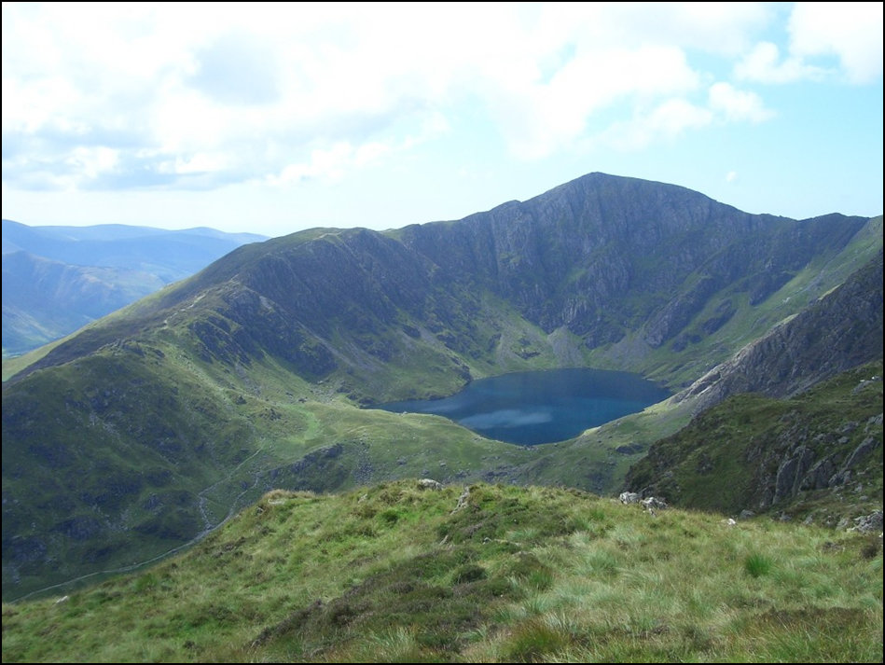

Slide 20
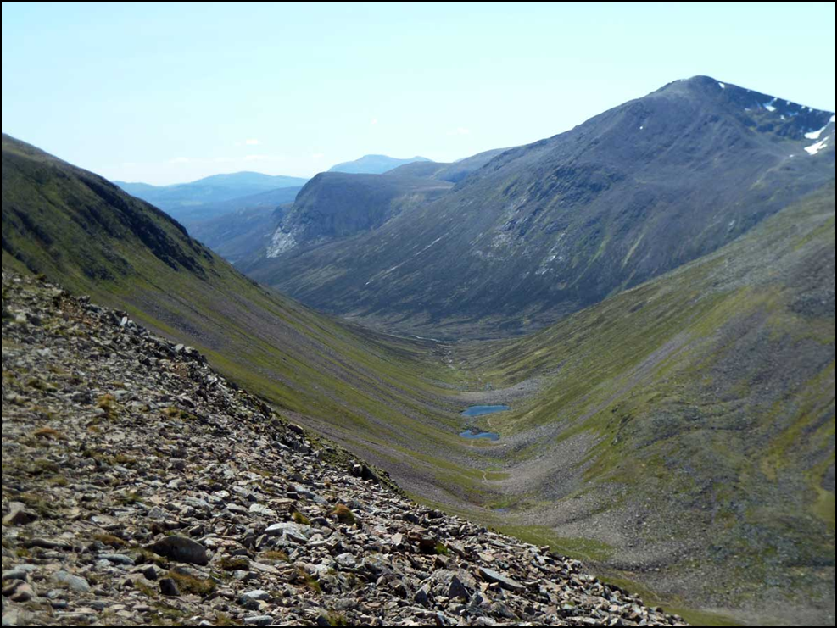

Slide 21
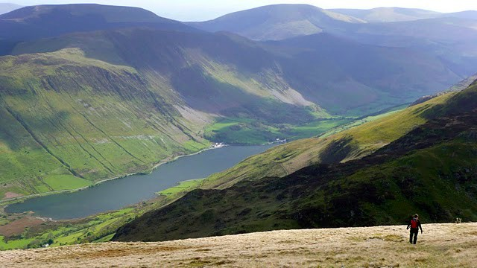

Slide 22
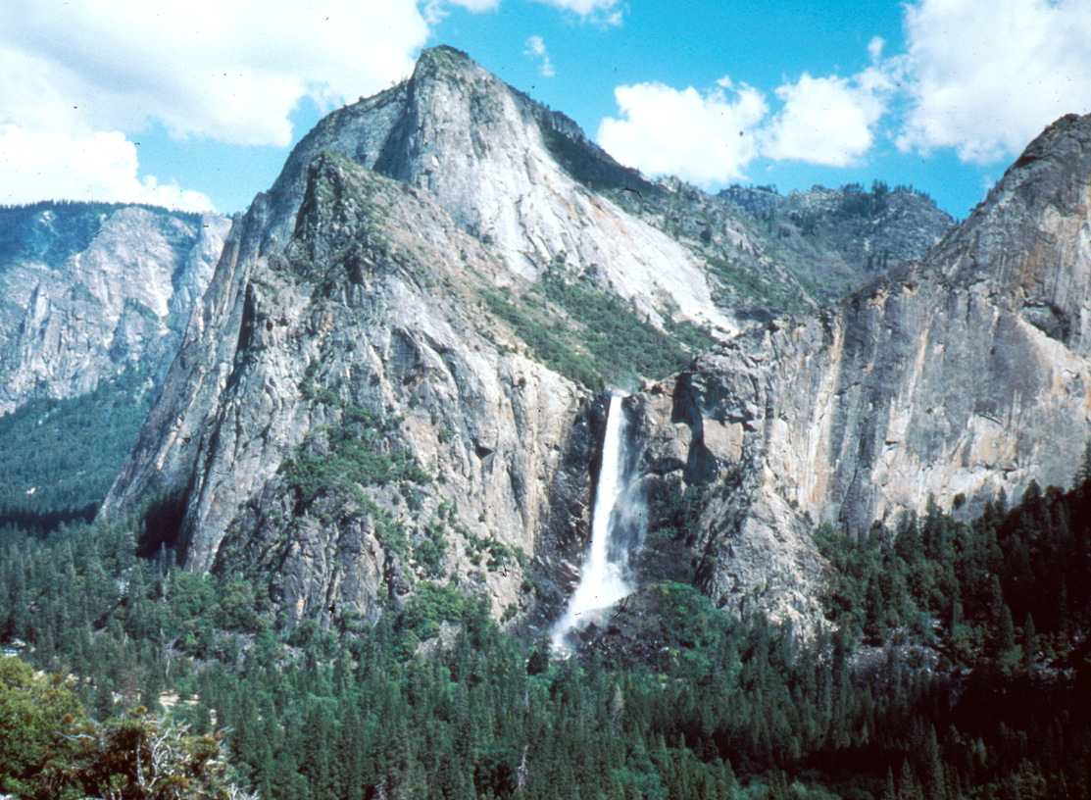

Slide 23
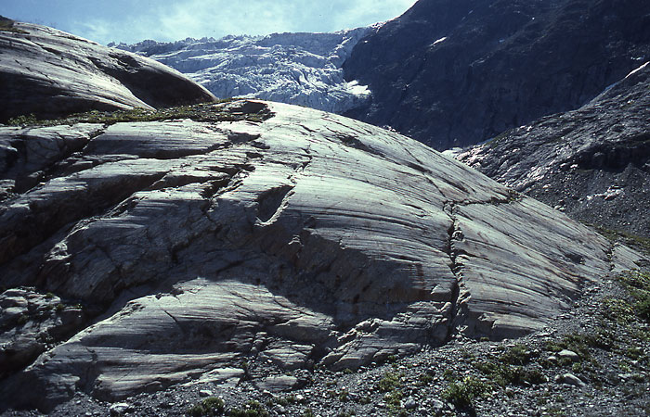

Slide 24
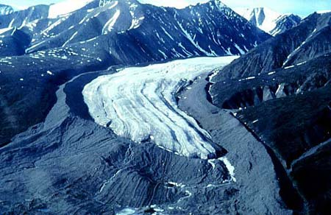

Slide 25
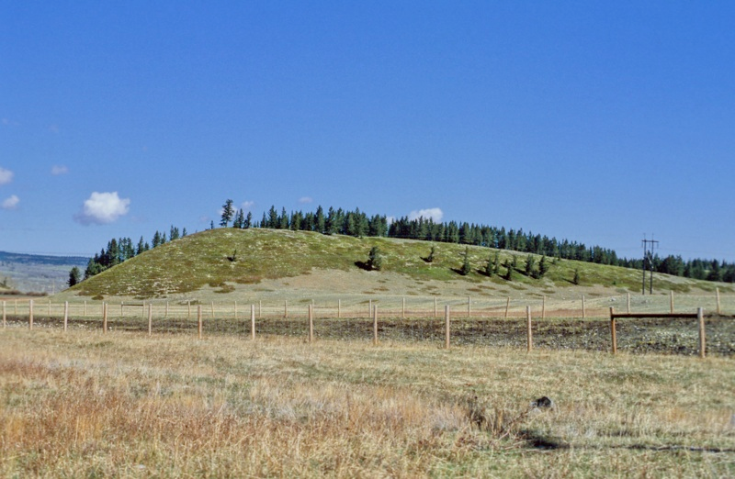

Slide 26
Fluvioglacial processes and landforms
How are fluvioglacial sediments different from glacial ones?
How is meltwater important?
How does meltwater erode and deposit?
For each of the following photos:
Identify the landform(s)
Describe the features/characteristics (incl. dimensions)
What would conditions have been like when they were formed?
Explain their formation (sequence/processes/time scales)

Slide 27
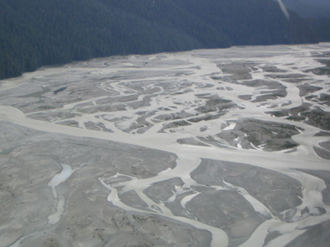

Slide 28
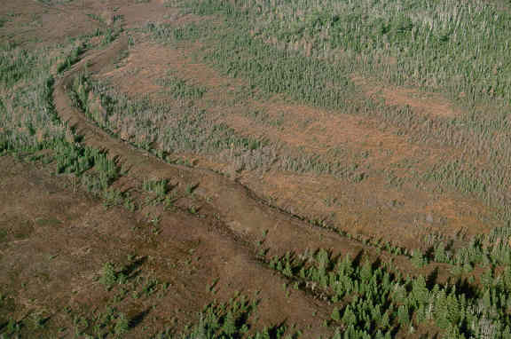
Notes:
http://www.novascotia.ca/natr/meb/field/vista2.asp – photo of cross bedding too

Slide 29
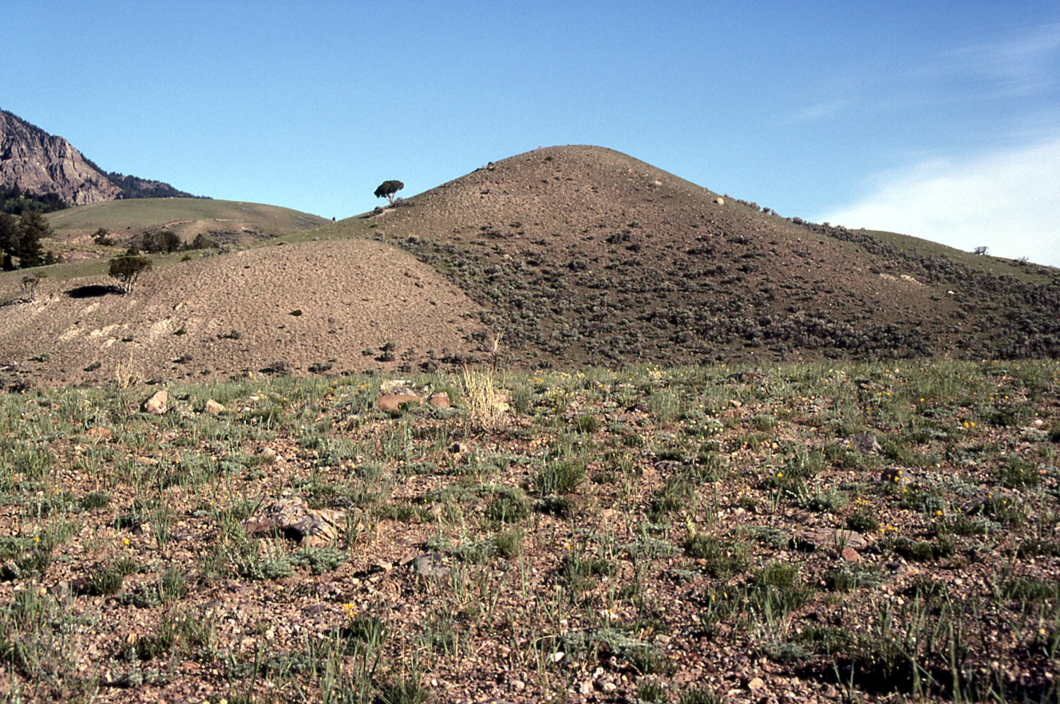

Slide 30
Periglacial processes
How are periglacial environments different from glacial ones?
What are the key features of permafrost?
How and why does the active layer change over a year?
Why is this seasonal cycle important?
Describe and explain periglacial processes

Slide 31
Periglacial landforms
For each of the following photos:
Identify the landform(s)
Describe the features/characteristics, incl. dimensions
What would conditions have been like when they were formed?
Explain their formation (sequence/processes)

Slide 32
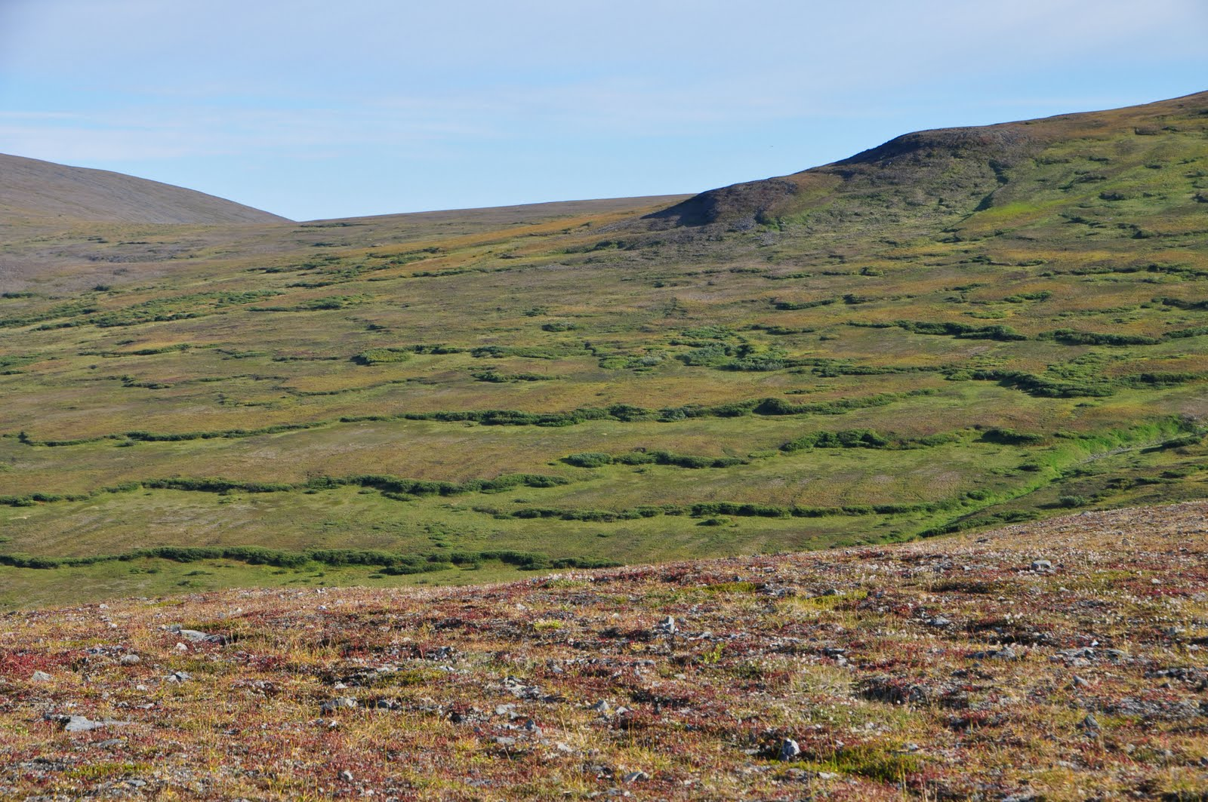

Slide 33
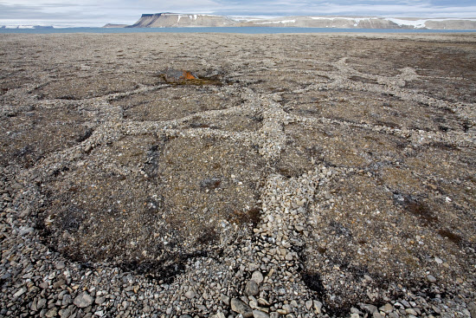

Slide 34
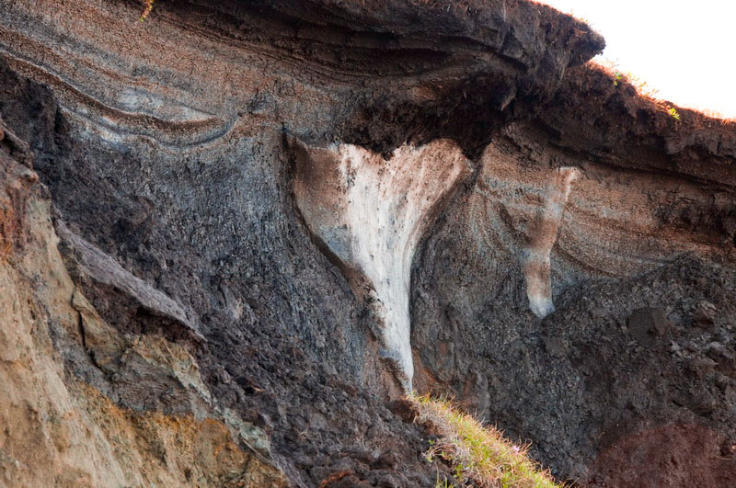

Slide 35
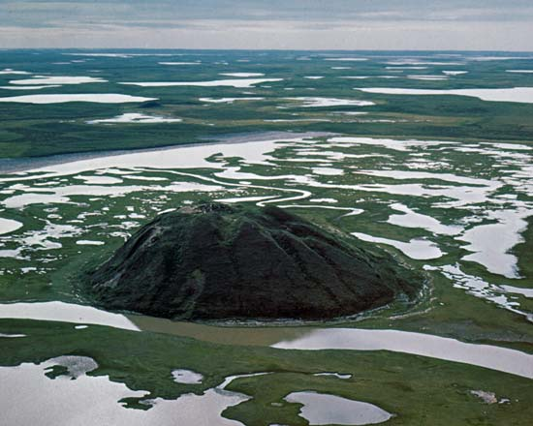

Slide 36
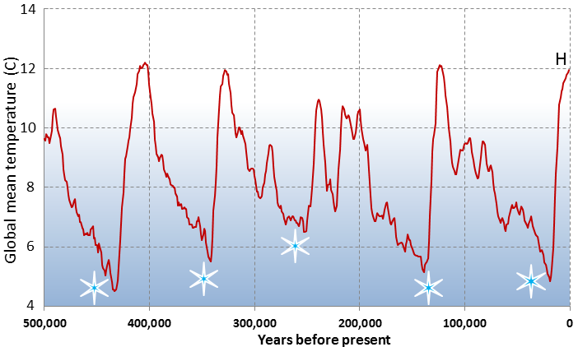
https://opentextbc.ca/geology/chapter/16-1-glacial-periods-in-earths-history/
What does this graph tell us about the climatic changes over the last 500,000 years?

Slide 37
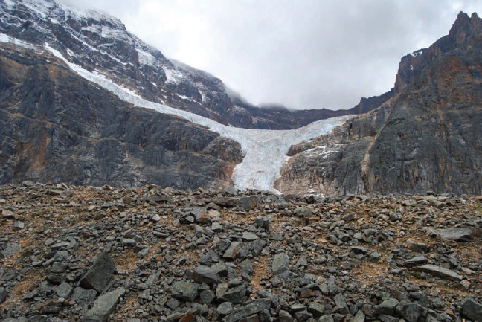
To what extent does this photograph (taken at the edge of a Canadian glacier) illustrate how glacial processes operate at different time scales?

Slide 38
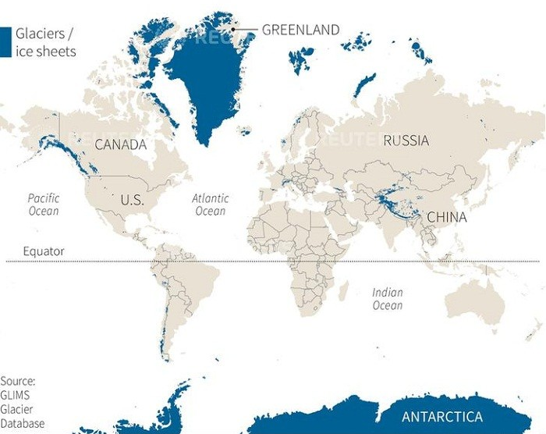
Discuss the extent to which the present-day distribution of glaciers and ice sheets (above) differs from that during the Quaternary Ice Age

Slide 39
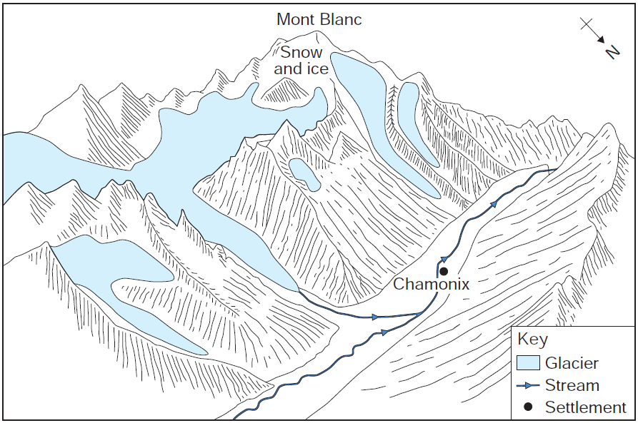
Explain how the area around Chamonix in the French Alps (sketch above) has been changed through glacial processes.
Assess the impact that this landscape will have had on human activity in this area.

Slide 40
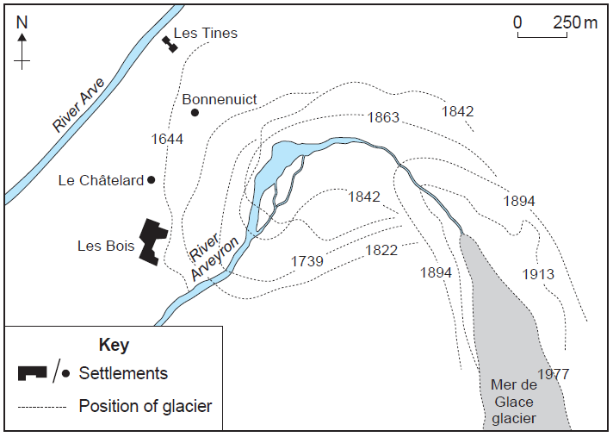
The map above shows changes in the position of the Mer de Glace glacier near Chamonix, France. Explain how this illustrates changes in the glacier’s budget.
Suggest reasons for these changes.

Slide 41
Assess the role of meltwater erosion and deposition in the formation of fluvioglacial landforms.
Discuss the view that highland glacial landscapes are the result of erosion processes whilst glacial lowland landscapes are the result of deposition processes.
How and why do glacial erosion processes vary between different areas?
To what extent does the systems model help our understanding of glaciers and ice sheets?
How important is the method of formation of glacial deposition landforms in explaining their subsequent characteristics? Justify your answer.
Assess the impact of human activity on areas of permafrost.
With reference to a case study, explain how can management strategies help reduce the impact of human activity on glacial processes and/or landforms and/or landscapes.
To what extent have periglacial processes played a role in the development of glaciated landscapes in the UK and beyond?

