Slide 1
‘Our City’ 20/20 Vision
Salisbury Schools Challenge
2018/19

Slide 2
‘Our City’ 20/20 Vision
Your City
Your Ideas
Your Vision

Slide 3
‘Our City’ 20/20 Vision
What is good or not so good about Salisbury?
What are the problems the city is facing?
What are your ideas and solutions?

Slide 4
‘Our City’ 20/20 Vision
Think of ideas that can make a difference and.......
enhance Salisbury’s image across the country and globally
give visitors of all ages a very positive experience
improve life for all its residents

Slide 5
‘Our City’ 20/20 Vision
Here are some areas you might like to look at........
But you will have other ideas too!

Slide 6
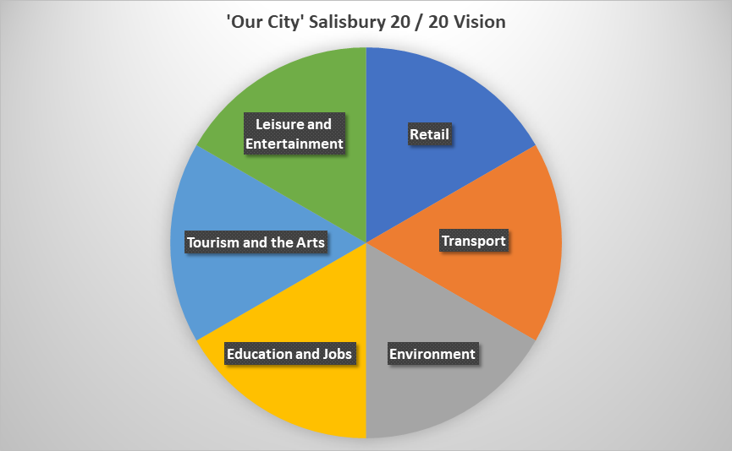

Slide 7
‘Our City’ 20/20 Vision
We’re looking for your ideas through text, photos, maybe even video.
You could do online research, interview or email people and organisations
Your Choice

Slide 8
‘Our City’ 20/20 Vision
There will be trophies and cash prizes to win
Also vouchers to spend in Salisbury
Plus vocational visits

Slide 9
‘Our City’ 20/20 Vision
Over to you!

