Slide 1
What is a microclimate?
A microclimate is the distinctive climate of a small-scale area, such as a garden, park, valley or part of a city. The weather variables in a microclimate, such as temperature, rainfall, wind or humidity, may be subtly different from the conditions prevailing over the area as a whole.

Slide 2
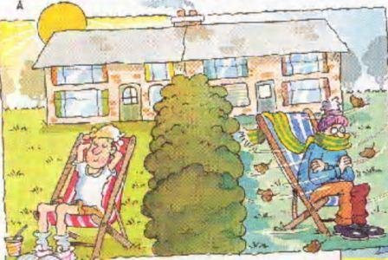

Slide 3
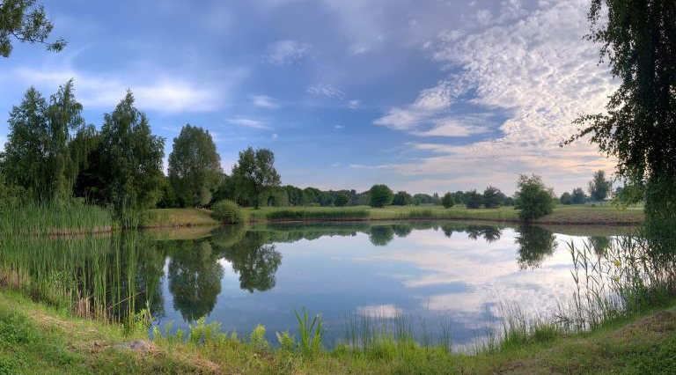

Slide 4
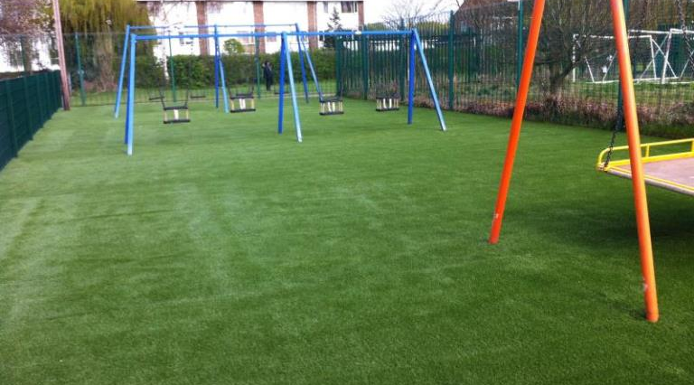

Slide 5
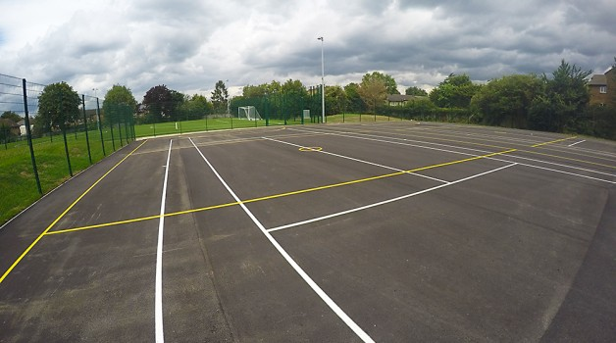

Slide 6
The Study
Mr Toner, Mr Harmsworth and Mrs Jones like to eat their lunch in a warm, sunny and sheltered location at BWS. Your task is to decide the most suitable location at BWS for a Geography department picnic table and report your findings in a brief letter to the governors.
You will have the following equipment to help you make and justify your decision:
Map of the BWS site
Thermometer
Compass
Anemometer
Light meter App (optional )

Slide 7
The Recorded Information
Site Number | Temperature | Aspect | Wind | Sun/shade | shelter | Surface cover
Other useful information

Slide 8
The decision
You should consider…
The direction/aspect – where will be warmer/cooler during the day. Where will the sun be shining during lunch time. Mrs Jones does not like too much sun in her eyes.
Shelter and wind – which areas of the site will be more sheltered (to avoid sandwich wrappers blowing away)
Surface cover – how could this affect play, making the area warmer or cooler?
time of day

Slide 9
The Letter
Your letter to the governors must include the following:
Why you are carrying out a microclimate study.
An explanation of the methods used and a description of your findings.
A decision on where to place the picnic table.
Justification for your decision.
A brief explanation of the limitations of your study.
NO MORE than 400 words.

Slide 10
The Understanding
 | ☺ | 😐 | ☹
I understand the term ‘microclimate’
I can use a variety of equipment to study the microclimate of an area.
I know what each piece of equipment is called and what it is used for.
I can describe the key terms: temperature, aspect, shade, shelter, wind
I can explain how each of the above affects the microclimate of an area.
I understand how to carry out a microclimate investigation around BWS
I can use my findings and my own knowledge to make a decision
I can justify a decision made using primary data I have collected.
I understand the possible limitations of a microclimate investigation.

Slide 11
Homework
For next lesson:
What problems did you have in collecting the data? Why?
What could you have done to get round these problems? How would these have helped?
How representative of each site do you think your data is? Why do you think this?
What could you do to get a more representative set of data to help make your decision? Why would these be helpful?

