Slide 1
Tectonic Activity
Earthquakes:
Global distribution; why they happen and what their impacts can be

Slide 2
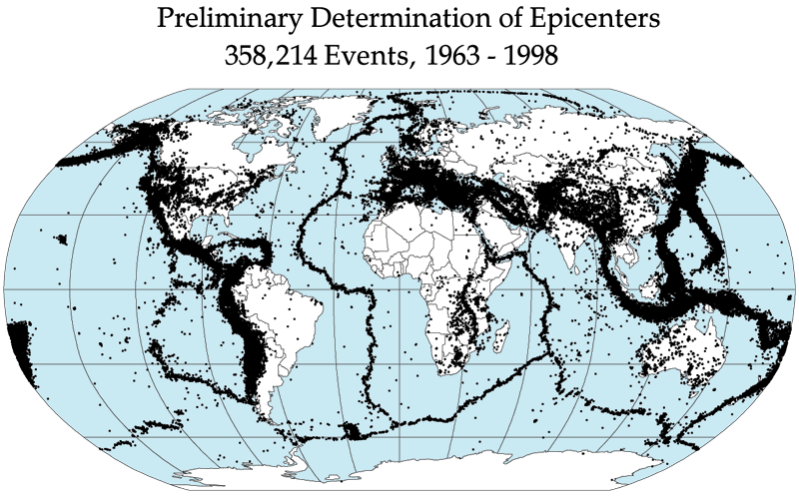
What is the global distribution pattern?
Locations of earthquakes that have occurred between 1963 and 1998
Image: http://denali.gsfc.nasa.gov/dtam/seismic/
Referring to your map showing plate boundaries, state 3 things you notice about the distribution of earthquakes.

Slide 3
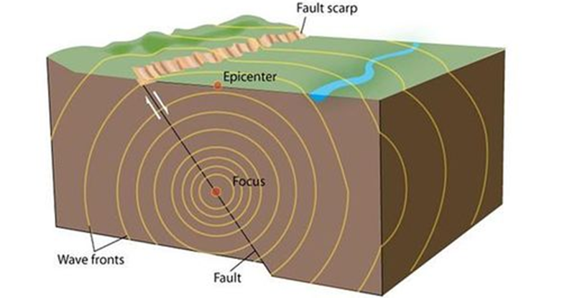
Earthquake features
re
Seismic waves
Focus: point underground where the initial slip occurs – often many kilometres deep
Epicentre: point on Earth’s surface directly above the focus where seismic waves first arrive
http://www.calstatela.edu/faculty/acolvil/quakes/focus_epicenter.jpg

Slide 4
What causes earthquakes?
Watch the short video clip carefully – listen for information about:
  relative plate movement
  what happens deep in the crust compared to what happens at the surface
  what causes the earthquake to eventually happen
Draw a series of diagrams to help you explain what causes earthquakes.
Why do earthquakes happen mostly at destructive and conservative plate boundaries?
Notes:
Video (9.16)

Slide 5
How are earthquakes monitored and measured?
The sudden, violent movement at the focus send out seismic waves in all directions.
It is these waves that cause the ground to move – and so cause damage.
The ground movements are measured using seismometers.
The recorded movement is then displayed as a trace on paper (or on a screen) called a seismograph
Notes:
Video (9.16)

Slide 6
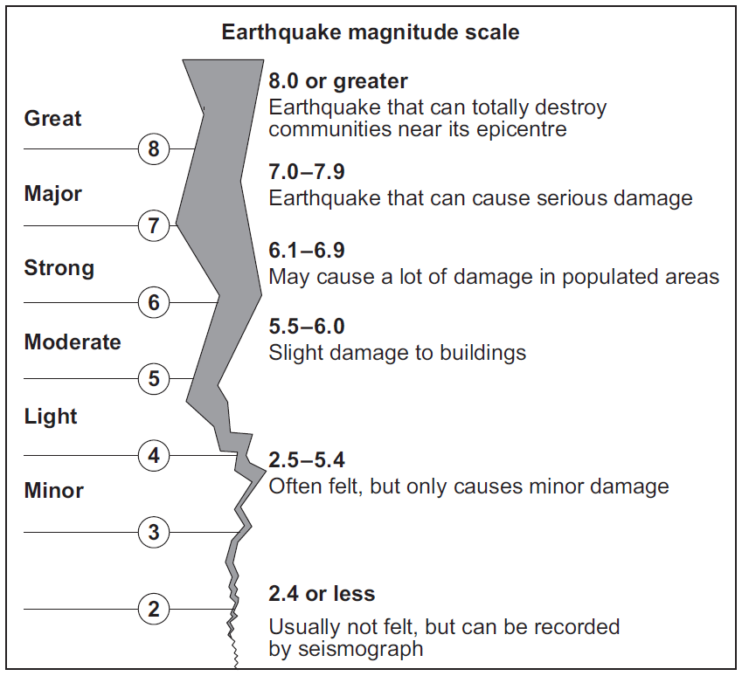
Measuring earthquakes – Richter Scale
… is based on the amount of energy released by the earthquake
… is a logarithmic scale – each whole number increase in magnitude represents about 31 times more energy released

Slide 7
Measuring earthquakes – Richter Scale
What does this table tell you about the relationship between the size of an earthquake (magnitude) and how often they occur (frequency)?
Magnitude | Earthquake effects | Frequency of occurrence
Less than 2.0 | Micro earthquakes, not felt. | Continual
2.0–2.9 | Generally not felt, but recorded. | 1,300,000 per year (est.)
3.0–3.9 | Often felt, but rarely causes damage. | 130,000 per year (est.)
4.0–4.9 | Noticeable shaking of indoor items, rattling noises. Significant damage unlikely. | 13,000 per year (est.)
5.0–5.9 | Can cause major damage to poorly constructed buildings over small regions. At most slight damage to well-designed buildings. | 1,319 per year
6.0–6.9 | Can be destructive in areas up to about 160 kilometres (99 mi) across in populated areas. | 134 per year
7.0–7.9 | Can cause serious damage over larger areas. | 15 per year
8.0–8.9 | Can cause serious damage in areas several hundred kilometres across. | 1 per year
9.0–9.9 | Devastating in areas several thousand kilometres across. | 1 per 10 years (est.)

Slide 8
What are the effects of an earthquake?
Read p10 in Complete Geography and then complete the following tasks:
What is the difference between primary and secondary effects of an earthquake? Give some examples of each – make it clear what type they are!
Homework:
There are many different reasons (factors) to explain why the impacts of earthquakes vary.
  Produce a list (you should be able to come up with at least 5)
  Choose two of these factors and for each one, write a paragraph to explain why they can affect the impacts of earthquakes.
Why do you think people live in areas that suffer from earthquakes?

