Slide 1
Globalisation
ABF in Zambia

Slide 2
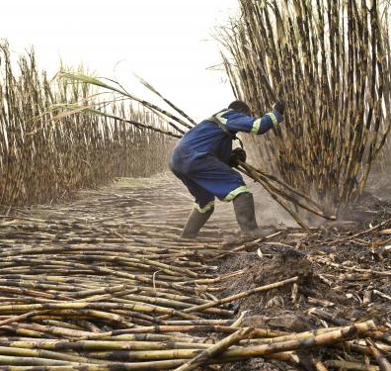
TNCs – how can they affect the host country?
Divide an A4 sheet of paper into four. In each quarter draw a picture to illustrate each of the following people, and give them a speech balloon to show what they are likely to think about Zambia Sugar’s tax-avoidance:
A cane-cutter at Mazabuka
A director of ABF in the UK
A Zambian government minister
A Zambian taxpayer
In each case make sure they justify their thoughts.
Harvesting sugar cane at a Zambia Sugar plantation
Photo: Jason Larkin/Panos Pictures/ActionAid

