Slide 1
Globalisation
Impacts on the UK

Slide 2
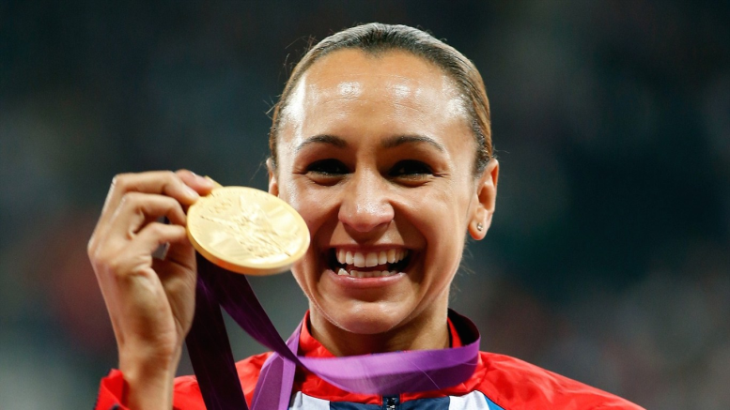
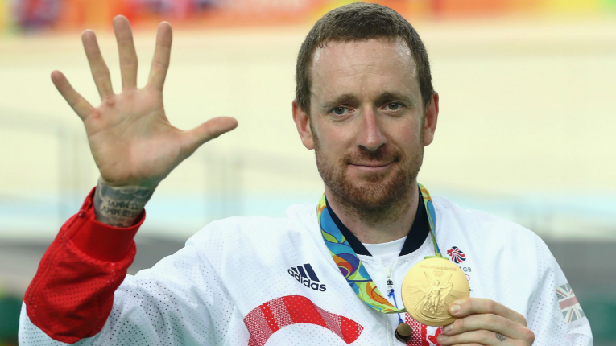
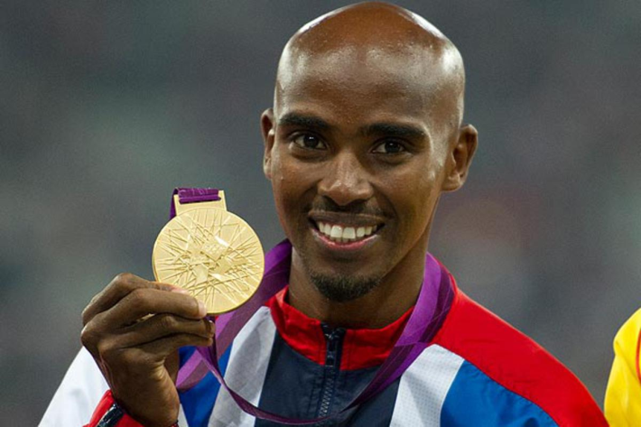
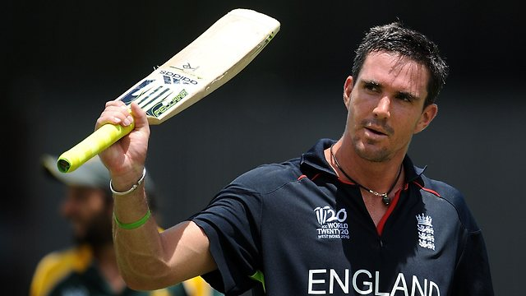
Who are they and what do they have in common?
Dame Jessica Ennis-Hill – born UK (English mother, Jamaican father)
Sir Bradley Wiggins – born Belgium (English mother, Australian father)
Sir Mo Farah – Somalia
Kevin Pietersen – South Africa
Notes:
1 Sir Bradley Wiggins – born Belgium: Australian father, English mother; 2

Slide 3
Impacts on the UK’s population
Draw a graph of this data to show how the % of the UK’s population born overseas has changed with time:
Year | % of UK population born overseas
1951 | 4.2
1961 | 4.9
1971 | 5.8
1981 | 6.2
1991 | 6.7
2001 | 8.3
2011 | 12.7
2014 | 15.0
Describe the changes shown by your graph.

Slide 4
Impacts on the UK’s population
Most of migrants to the UK have come seeking work and are aged 18-35. They have helped the UK’s population to increase through:
Net immigration: more people entering than leaving the country
Natural increase: a higher birth rate and a lower death rate, caused by
the immigration of young women of child-bearing age having children here (British-born women are also having more children)
the increase in proportion of young people in the country.
There are good and bad aspects to this:

Slide 5
Impacts on the UK’s population
Sort these following into Good and Bad impacts of globalisation's impacts on the UK’s population:
A growing population means more people pay more taxes which helps pay for schools, hospitals and pensions
Migrants can contribute to the UK’s sporting and cultural history
More children means more pressure on schools – class-sizes can increase
More people means more houses need to be built which puts pressure on land around towns and cities
More people means there’s more demand for services so more jobs are needed
More people means more pressure on housing causing rents/house prices to rise

Slide 6
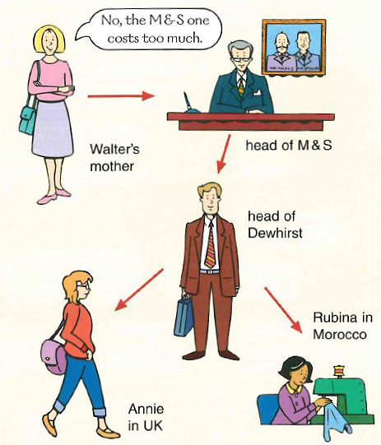
Economic impacts on the UK
Read the handout then complete the following:
This diagram helps to illustrate Annie’s story. What do you think the arrows mean?
Make a copy of this using stick people. Add thought bubbles to the other four people. Make these big enough so you can write what they are thinking…and so help to tell Annie’s story.
Give your diagram a suitable title to explain what it shows about how globalisation can affect the UK’s economy.
This diagram shows a negative impact of globalisation on the UK’s economy. Suggest one way in which this impact can be a good thing for the UK.

Slide 7
Economic impacts on the UK
Use the handout to draw simple diagrams (e.g. spider diagrams) to show the economic benefits to the UK of:
Skilled migrants
Unskilled migrants

Slide 8
Is globalisation a good or a bad thing?
YouTube videos to watch (you may need to copy and paste these into your browser):
Benefits: https://www.youtube.com/watch?v=5SnR-e0S6Ic
Costs: https://www.youtube.com/watch?v=s_iwrt7D5OA

Slide 9
Is globalisation a good or a bad thing?
Copy and complete the following table using the handout and your classwork:
 | For globalisation | Against globalisation
Social argument
Economic argument
Environmental argument

