Slide 1
Nunton Farm changes

Slide 2
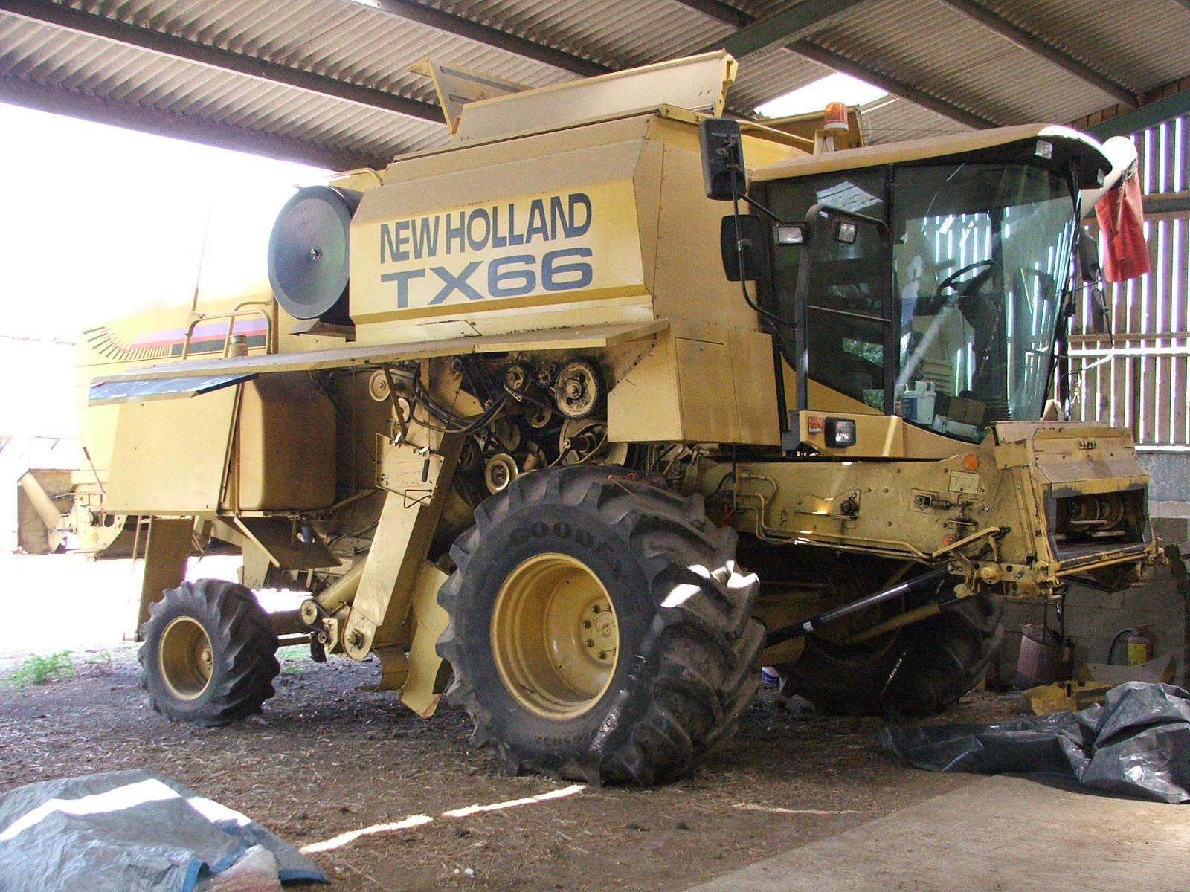
Machinery – 2006

Slide 3
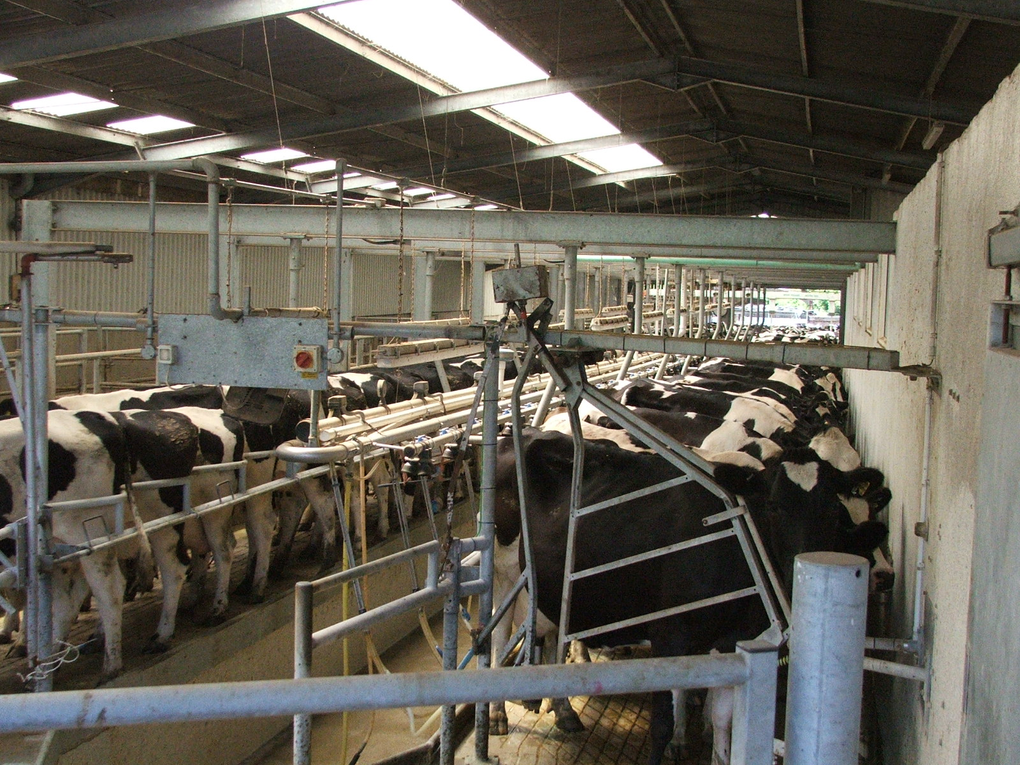
The herringbone milking parlour - 2006

Slide 4
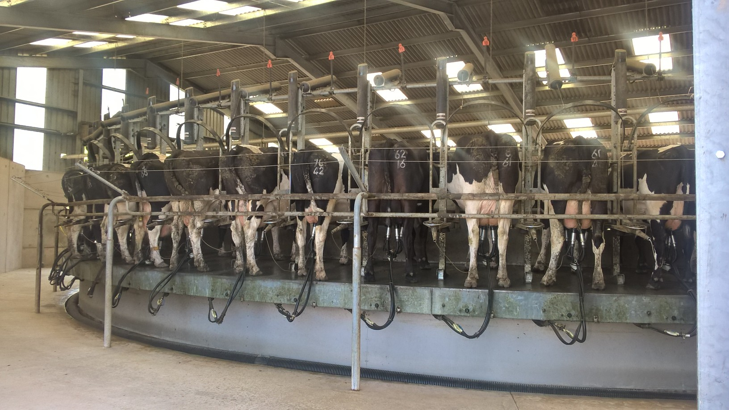
The rotary milking parlour - 2018

Slide 5
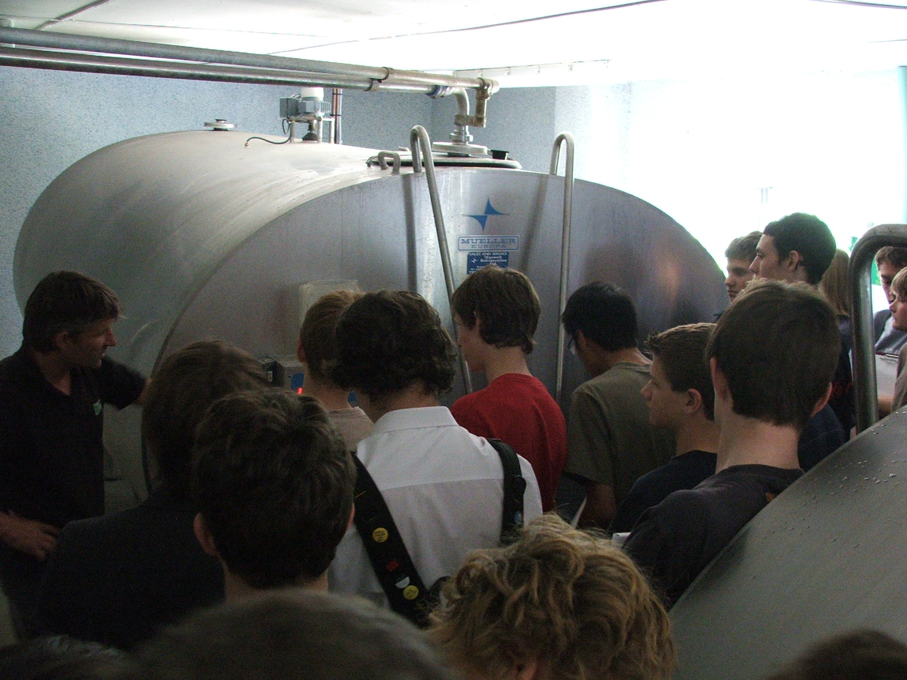
The milk storage tank – 2006

Slide 6
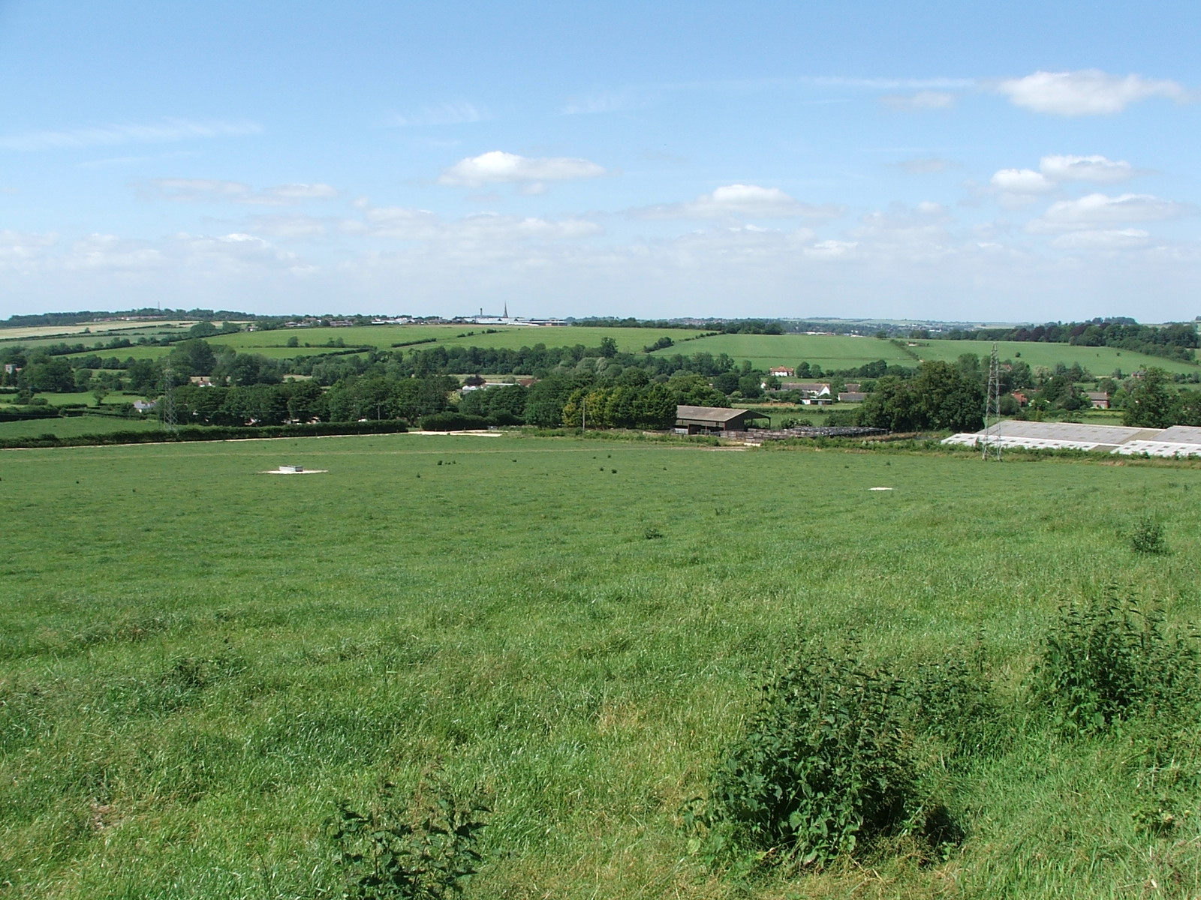
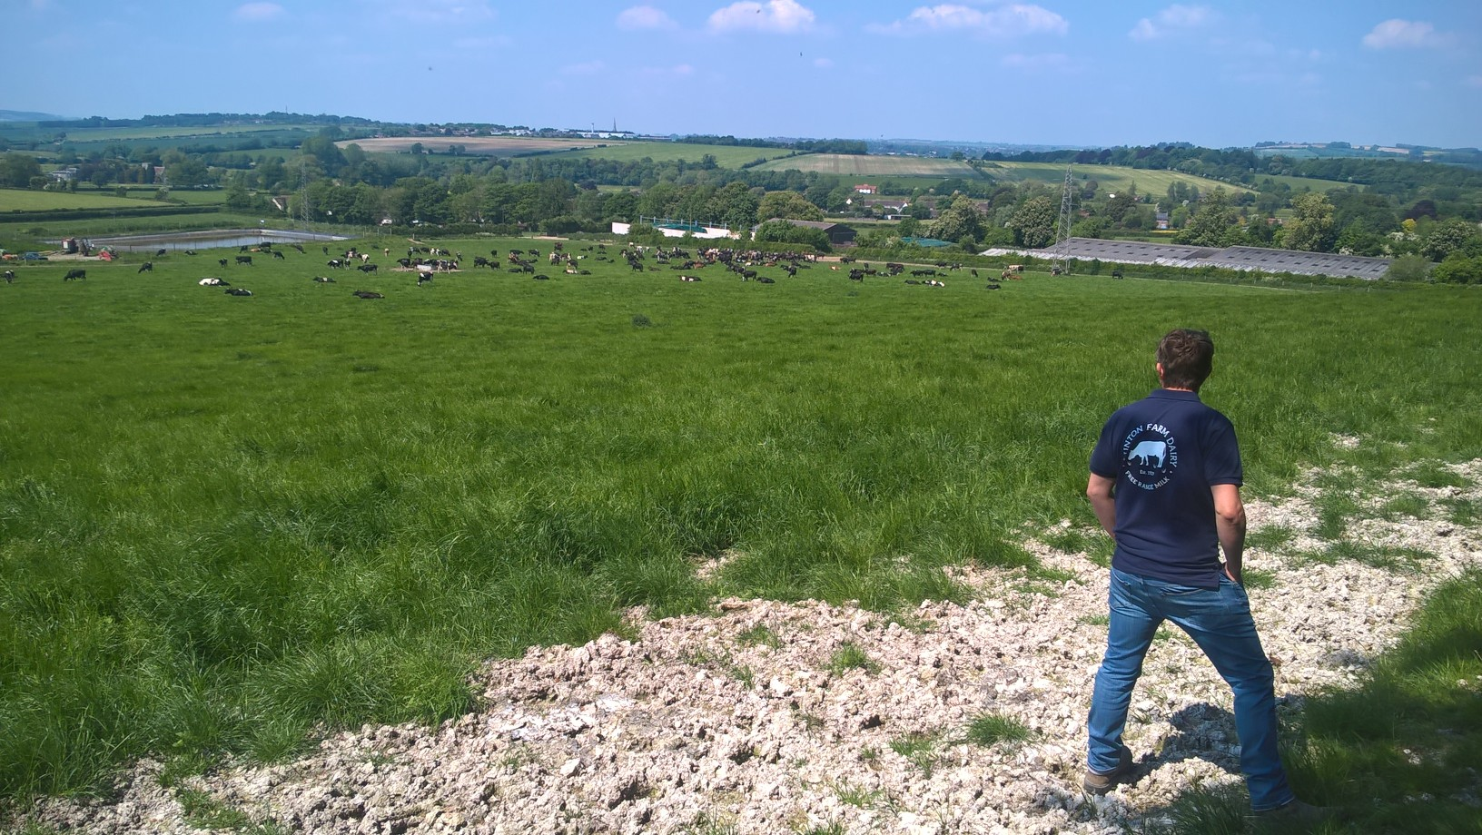
The view above the dairy
2006
2018

