Slide 1
Nunton Farm Field Study

Slide 2
Nunton Farm Field Study
AIMS & OBJECTIVES
You will all be able to…
Outline the systems of a dairy farm
Describe the range of jobs carried out at a dairy farm
Describe and explain how Nunton Farm has changed in order to maximise its potential as a business

Slide 3
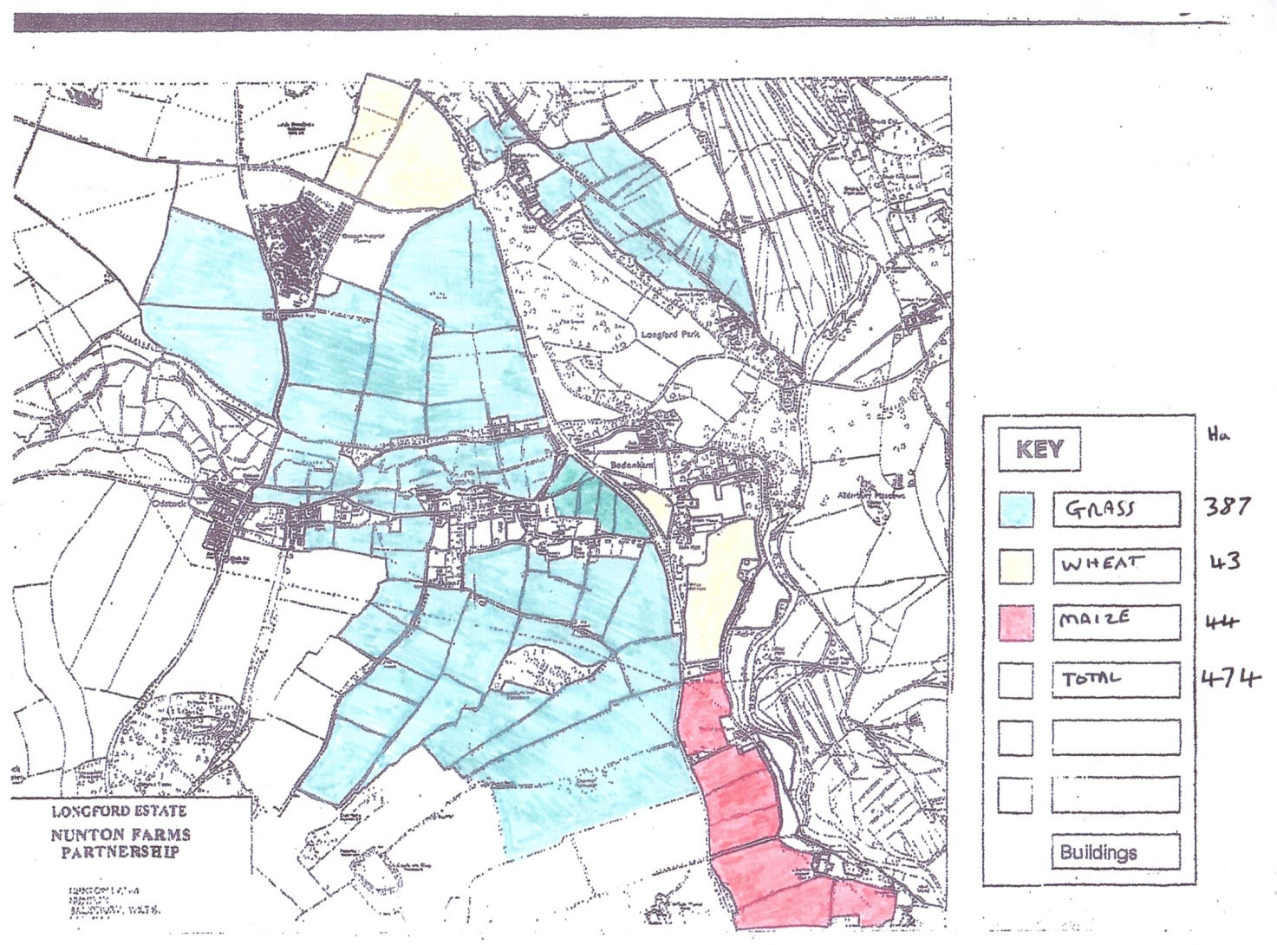
Nunton Farm cropping 2017

Slide 4
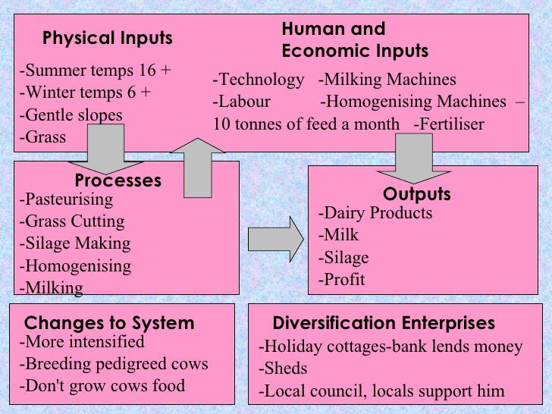
An example of a Dairy Farm I,P,O

Slide 5
You should be able to answer these questions following the farm visit:
What are the inputs, processes and outputs?
Which crops are grown on the farm? Why?
How has the farm changed over time?
Why have these changes occurred?
What machinery is used on the farm?
How has this changed over time?
Who buys the milk produced on Nunton Farm?
Are all dairy farms the same?

Slide 6
TASK:
Present your findings on one side of A4.
You must include the following:
The Inputs, processes and outputs of a Dairy Farm
What makes Nunton Farm business different from other dairy farms?
What do you think has contributed to the the success on Nunton Farm?
Any other relevant information/ pictures/diagrams

