Slide 1
Economic Activity
Changes in the UK

Slide 2
What has happened?
Stick the graph into your book.
Give it a suitable title.
Add a key to match the terms used on the graph to the ones we’ve used in previous lessons, i.e. Primary, Secondary and Tertiary.
Why is a line graph a suitable way to show this information?
Describe the changes that have happened from 1841 to 2011, by:
  taking each sector in turn
  dividing the lines into sections where change has been similar
  including absolute (remember these are %) and relative figures (simple multiples/fractions will suffice)
Construct a table using data from the graph to show the % in each sector for the following years: 1841, 1911, 1951, 2011. Data must add up to 100%!
Plot this data onto the triangular graph – wait for an explanation of how to do this!

Slide 3
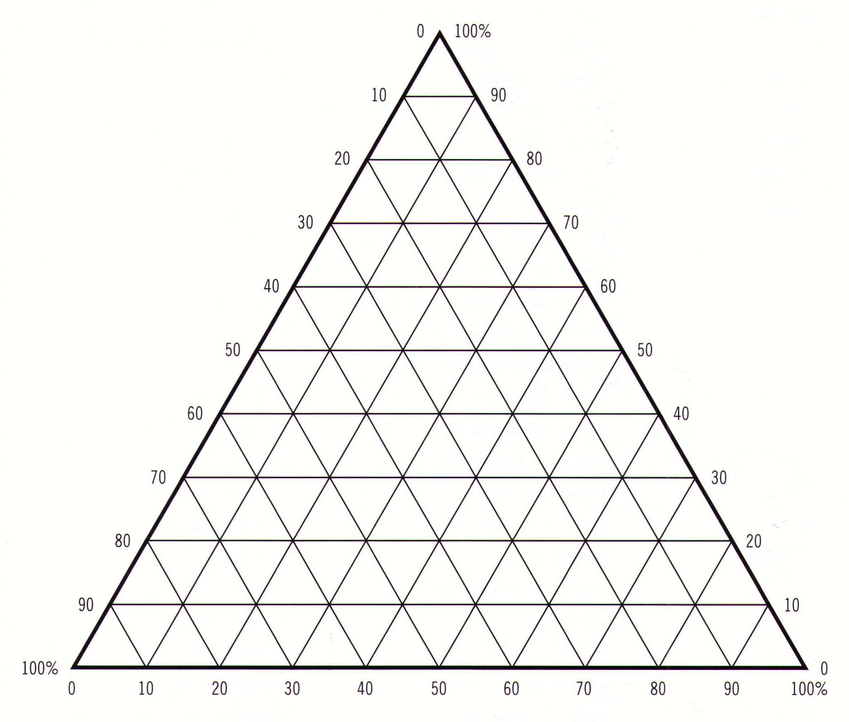
How to plot data onto a triangular graph
1841
24% Primary
39% Secondary
37% Tertiary
% Tertiary
% Secondary
% Primary

Slide 4
Why has this happened?
Reasons for the decline in % employed in the Primary Sector
There are four main reasons:
  Mechanisation
  Depletion of resources
  Cheaper (and better) imported raw materials
  Social change
For each one, explain what it means and how it has resulted in the need for fewer jobs in the primary sector.

Slide 5
Why has this happened?
Reasons for decline in % employed in the Secondary Sector
Read p214 in Complete Geography
What is meant by the term ‘deindustrialisation’?
Why has it happened in the UK? (Try and make a link here between this topic and the last one on Globalisation)
What is meant by the term ‘reindustrialisation’? How is reindustrialisation different from manufacturing in the past?

Slide 6
Why has this happened?
Reasons for increase in % employed in the Tertiary Sector
Main reasons:
Decline in employment opportunities in other sectors
Desire to have jobs that have better working conditions
Increase in population living in urban areas
Increasing complexity of modern life

Slide 7
Regional variations in the employment sector
Have these changes been the same across the whole of the UK?
Calculate the percentage change of people employed in each region of the UK for primary, secondary and tertiary jobs between 1981 and 1995. Complete the figures in each table (slide 8 – instructions on how to do it there, too).
For each sector, work out a suitable key to group the data into 3-5 groups and assign each group a shade of one colour – darkest being the greatest value, e.g.
  0-9% 10-19% 20-29% 30-39%
  You will need different groups for each sector and may have different numbers of groups for each one.
Use these to complete three choropleth maps using the outline maps (slide 9).
Make sure each map has an appropriate title and key.
Describe what the maps show about the changing employment structure across the UK.
How might deindustrialisation and reindustrialisation help explain these patterns?

Slide 8
Regional variations in the employment sector
To calculate the % change in each case:
Subtract the 1981 number from the 1995 number. This will give negative values for the Primary and Secondary data – which is correct!
Divide this by the 1981 number
Multiply by 100 – round up/down to the nearest whole number

Slide 9
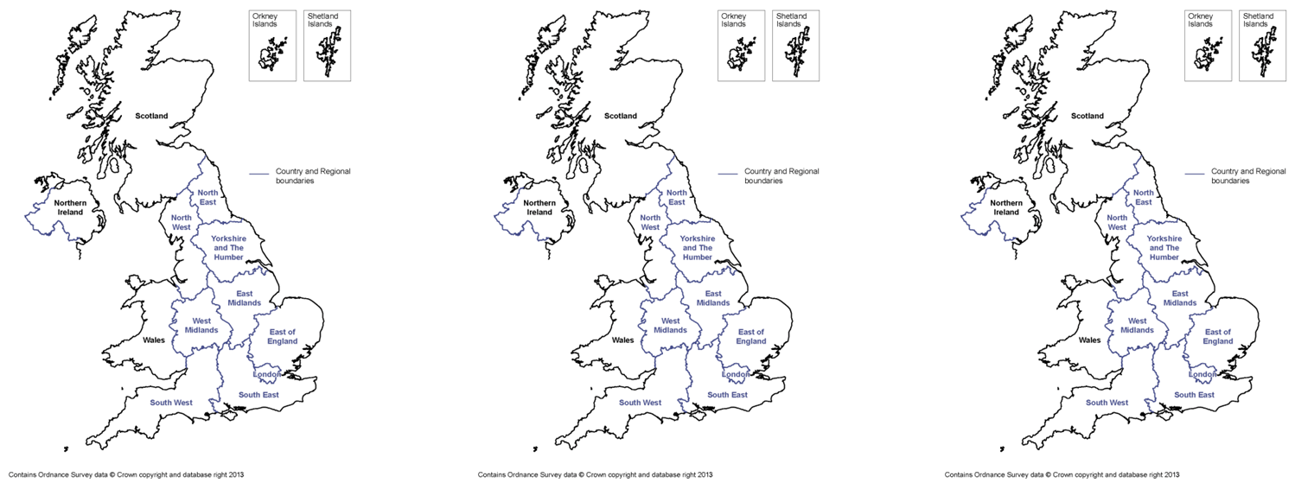
Regional variations in the employment sector
Make sure to give each map a title and a key.

Slide 10
Tata Steel Diamond Nine Exercise
Task 8 – Tata Steel Diamond Nine template
Most important
Least important

Slide 11


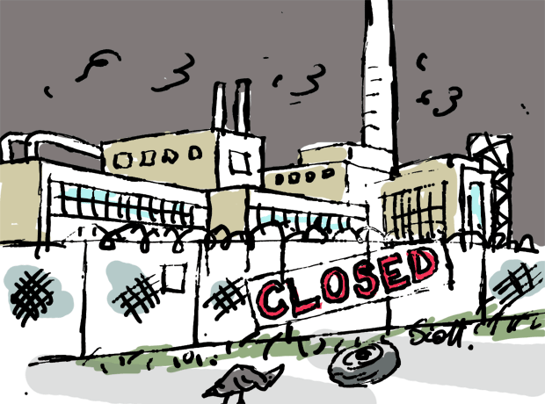


Impacts of deindustrialisation

