Slide 1
Using GIS – Datashine website
Instructions and tasks

Slide 2
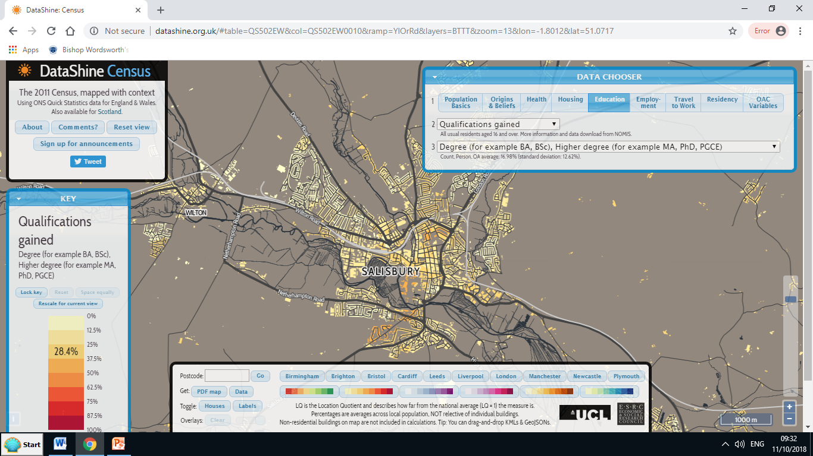
Datashine is GIS software that uses census data to map different groups of people in England and Wales

Slide 3
How to use the website - 1
Go to the website: www.datashine.org.uk
The starting view is of London so to find another place, either:
  Enter the postcode in the box at the bottom of the screen, or
  Drag the map around – use the scroll wheel to zoom in or out
The Data Chooser box (top right hand corner) allows you to change what data is mapped
Each of the 9 categories can then be broken down into subcategories to show even more detailed information using the other drop-down lists.
  For example, you can produce a map showing the pattern of 3 three-people households: Housing – Household size – 3 people in household

Slide 4
How to use the website - 2
The website uses data from the 2011 census presented in small neighbourhoods called Lower Layer Super Output Areas (LSOAs)
The key in the bottom left hand corner shows the Location Quotient, which describes how far from the national average (LQ 1) the data is.
The darker the colour the bigger the difference from the average
The next slide shows a map of the ‘General Health’ data for Salisbury.
  The areas shaded red are below average (LQ 1), in other words, on average, the people who live in those areas suffer more poor health than other people in Salisbury.
It is important to recognise that this is an average for the neighbourhood and doesn’t use individual home or street data.

Slide 5
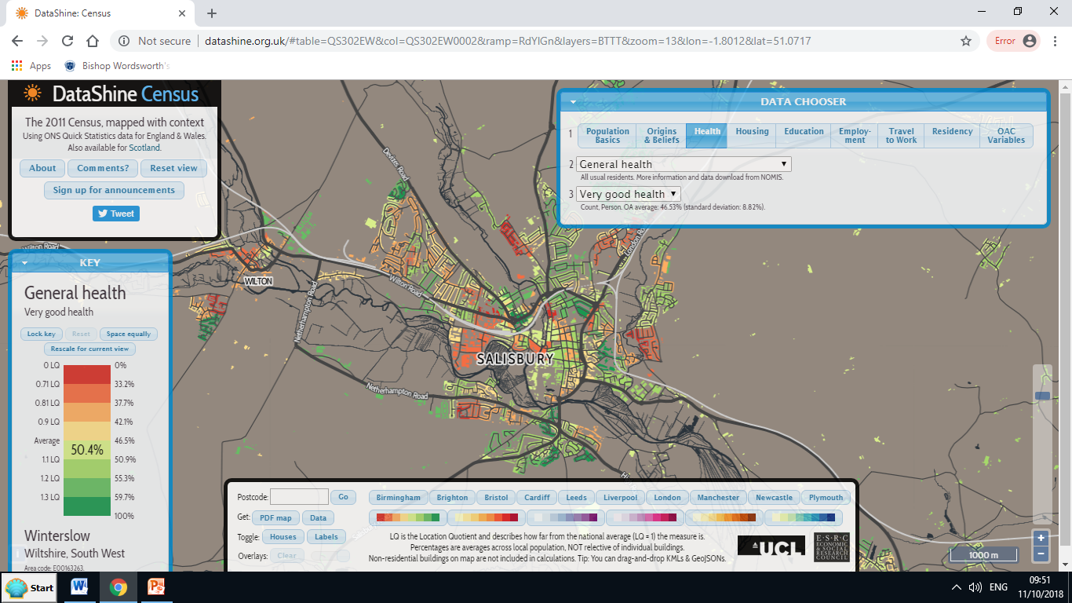
General health data for Salisbury

Slide 6
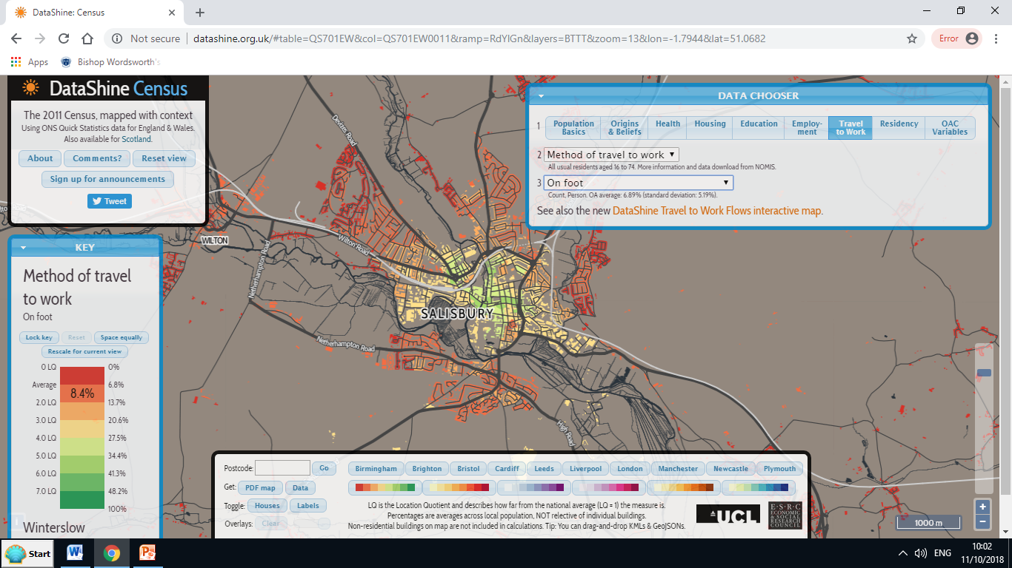
The map below shows how many people in Salisbury travel to work ‘on foot’ – mostly people who live near the centre of town

Slide 7
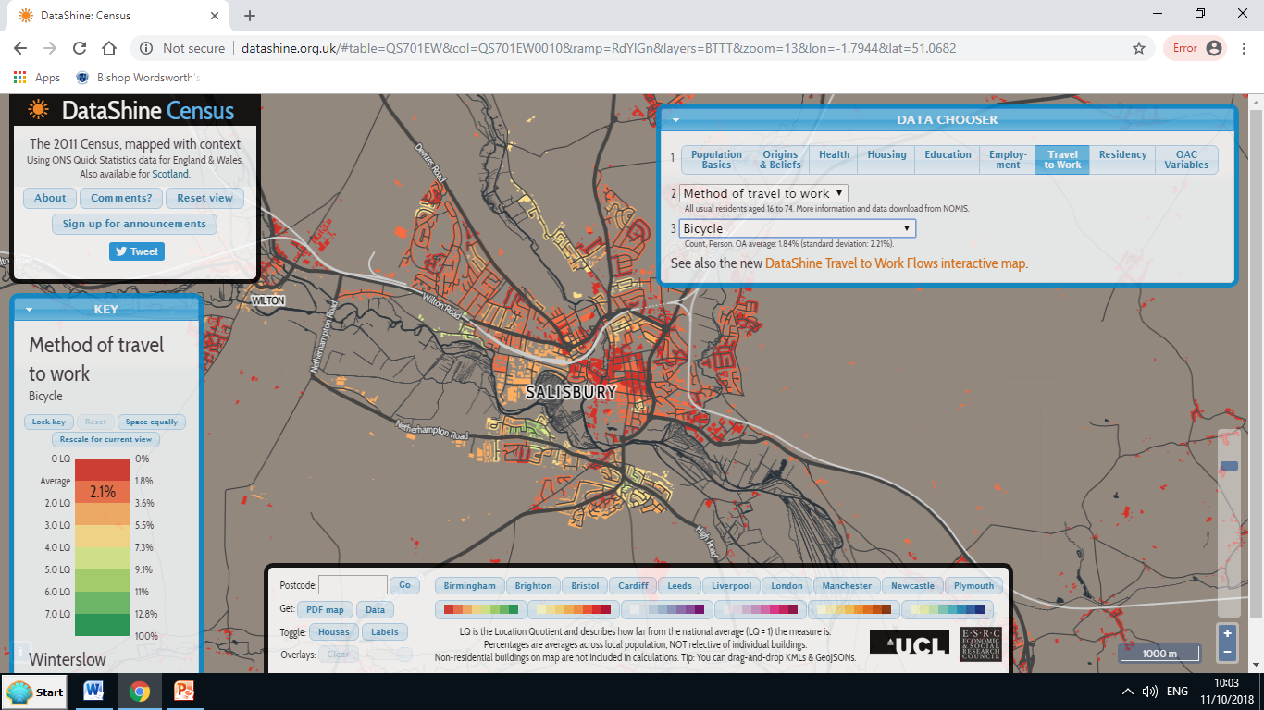
However, cyclists tend to travel to work from further away (presuming that the majority work in the centre of town)

Slide 8
How do Salisbury and Winchester compare?
In this exercise, you will comparing two similar-sized cities in southern England.
Choose 4 sets of data to analyse. These should be the finest level of detail (e.g. the pattern of three-person households). Do not choose all of them from the same major category (e.g. Health).
For each data set:
  Produce a map of each city and take a screenshot (using the Print Screen button on the keyboard or the Snipping tool)
  Paste these into either a Word document or a PowerPoint slideshow.
  Describe the main similarities and differences between them.
  Try and suggest reasons for the similarities and differences you have described. This is quite difficult, but you may notice particular patterns or groupings in different parts of the towns. For example, the general health statistics may be linked to the average age of people in these areas.
Your homework is to complete these tasks, print off your work and bring it to the next lesson.
If you complete all of this in the lesson, then compare Salisbury and Southampton – which is a much larger city.

