Slide 1
Data Presentation Methods

Slide 2
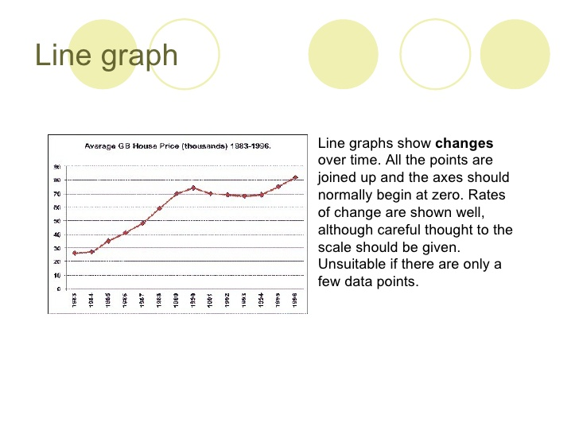
Line Graphs – are used to present continuous data

Slide 3
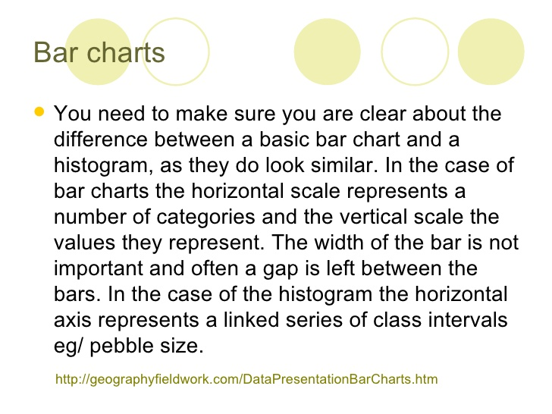
Bar Charts – are used to present discrete data

Slide 4
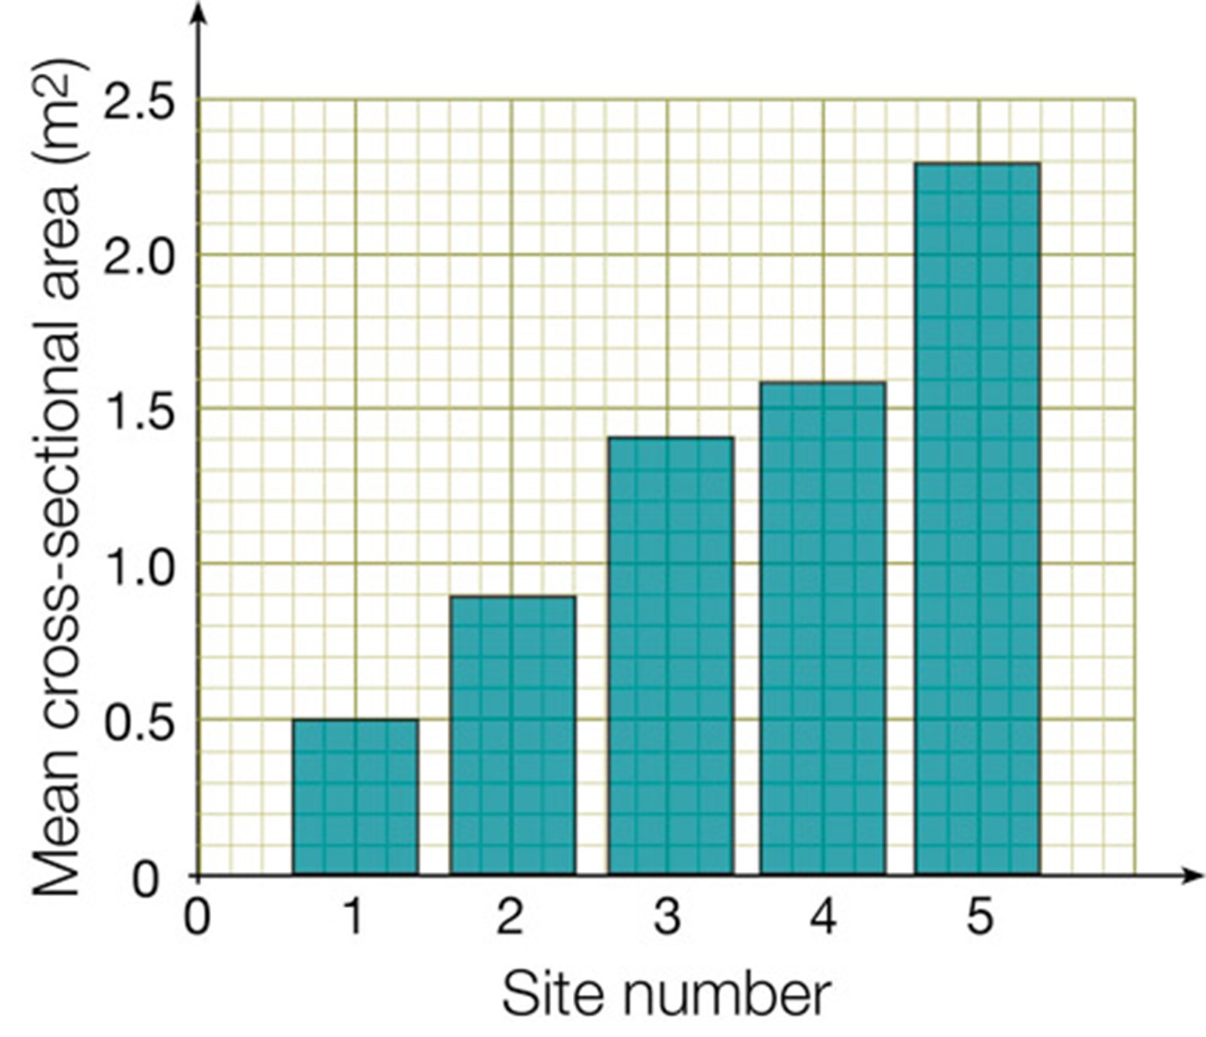

Slide 5
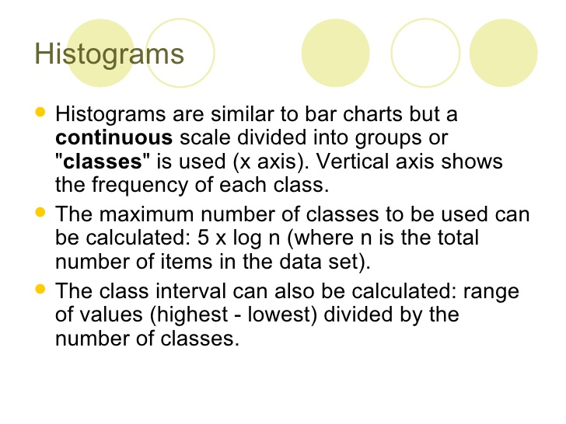
Histograms

Slide 6
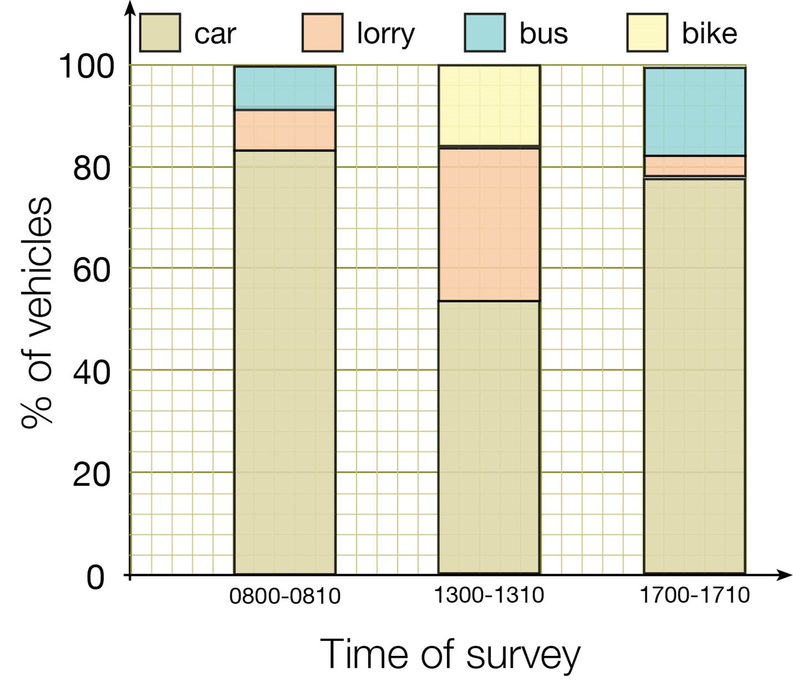

Slide 7
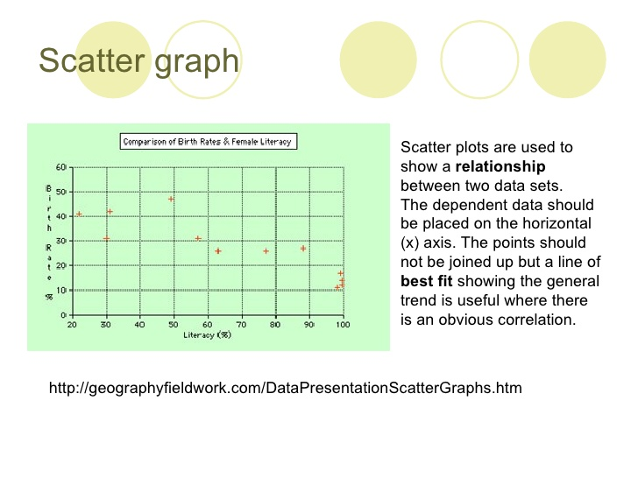

Slide 8
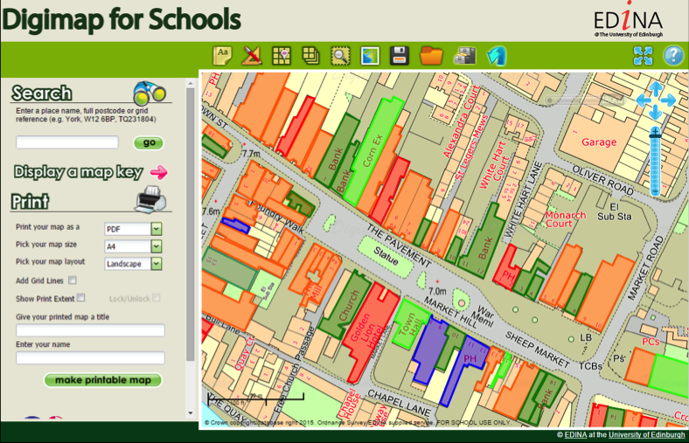
Digimaps can use simple GIS to show different types of land use

Slide 9

This film will show you how to use GIS on a Digimap

Slide 10
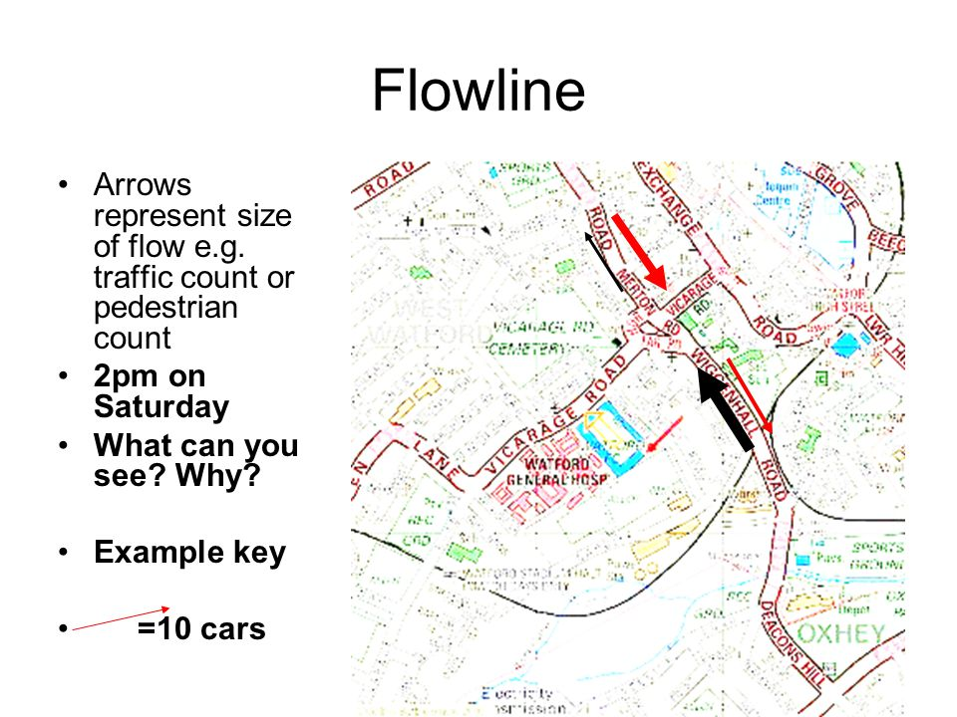
Flow line maps show flows or movement between places

