Slide 1
Analysing and interpreting

Slide 2
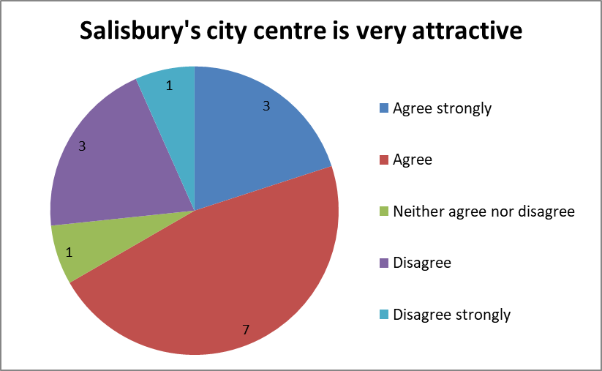
3 people I asked agreed strongly with this statement. 7 people agreed.
Most people I asked agreed with this statement.
10 people I asked agreed with this statement .
10 out of 15 people I asked agreed with this statement.
2/3 of people I asked agreed with this statement.
3 people I asked agreed strongly with this statement and 3 other people disagreed with it.
The same number of people I asked agreed strongly with this statement as disagreed with it.

Slide 3
Overall, 2/3 of people I asked agreed or agreed strongly with this statement, with the majority of them (70%) simply agreeing. Though the same number of people agreed strongly with this statement as disagreed with it, only 1 person strongly disagreed.
If I compare the answers to Q1, I see that most of those people who thought Salisbury’s city centre is very attractive (4/5) had only visited once or twice before. People who shopped more frequently thought Salisbury’s city centre was not very attractive.
This is a very interesting result. It might suggest that…

