Slide 1
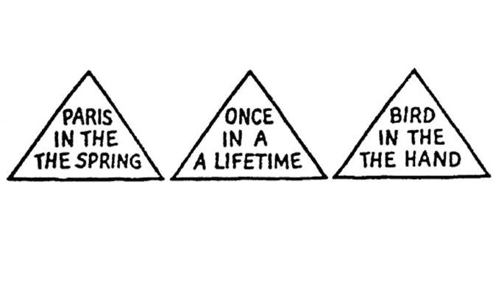
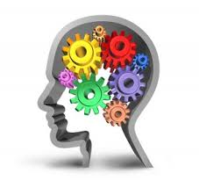
What do the words say in the triangles?
Lesson Objectives –
To outline the cognitive approach
To apply the cognitive approach
To evaluate the cognitive approach
Notes:
https://www.youtube.com/watch?v=FHG2oizTlpY

Slide 2
The Cognitive Approach: Basic assumptions
Focuses on how people perceive, store, manipulate and interpret information.
Cognitive psychologists look at internal mental processes to understand behaviour.
Thought processes can and should be studied scientifically. Well controlled laboratory studies can investigate what we are thinking.
Mental processes are ‘private’ and can’t be observed. Cognitive psychologists study them indirectly by making inferences about what is going on inside people’s head.

Slide 3
Inference/inferring
The process whereby cognitive psychologists draw conclusions about the way mental processes operate on the basis of observed behaviour.
Making a logical conclusion on the basis of evidence and reasoning.
What does it mean to infer something?

Slide 4
Inference/inferring: try it!
Blood cholesterol used to be thought of as a problem only for adults.
Blood cholesterol is no longer a problem for adults.
(B) Only children have a problem with blood cholesterol.
(C) Blood cholesterol affects both adults and children.
A: Look at the long line! Do you think we’ll get in?
B: I think so. Some of these people already have tickets.
A: How much are the tickets?
B: Only nine dollars for the first show. I’ll pay.
A: Thanks. I’ll buy the popcorn.
Where are these people?
What are they talking about?

Slide 5
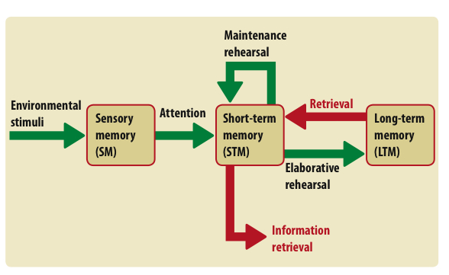
Key aspects of cognitive approach:
The role of schemas
The role of theoretical and computer models
The emergence of cognitive neuroscience

Slide 6
1. Schemas
A ‘package’ of beliefs & expectations on a topic that come from prior experience.
They are useful by helping us to take shortcuts in thinking
Born with basic ones then develop from experience
But can lead to faulty conclusions & unhelpful behaviour
Notes:
Print out pictures of men and rodents

Slide 7
Japan

Slide 8
Instagram

Slide 9
Zombie

Slide 11
Schema:
Packages of ideas developed through our experiences.
They are a mental framework that speeds up the processing of incoming information (e.g. something that has 4 legs and a seat can be sat on and is called a ‘chair’)
As we get older (and experience more) our schemas become more detailed and sophisticated- as babies we only know how to grasp and suckle.
Schema enable us to process lots of information quickly
They stop us being overwhelmed by environmental stimuli
They can distort our interpretations
They can lead to judgemental, bias or irrational thinking.

Slide 12
The role of Schemas

Slide 13
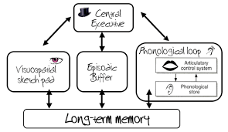
2. Theoretical Models
These models help psychologists to be able to understand mental processes, without actually seeing them!
These are simplified representations based on current research evidence (usually around 1960s to 1980s). There are often in picture form represented by boxed and arrows that represent flow direction and stages.

Slide 14
2. The role of computer models
The development of computers and computer programming led to a focus on the way that sensory information is passed through the system. Using a computer analogy information is passed through the senses, encoded into memory and then combined with previously stored information to complete a task.

Slide 15
Information Processing Model
Input
Processing
Output
From the environment via the senses
Info is encoded and processed eg using schema
Observable behaviour

Slide 16
Information Processing Model
Input
Processing
Output
Remember that dogs can be scared of fireworks and infer that the dog saw the firework
Hear your dog bark outside at night and see a firework
Bring the dog into the house

Slide 17
Information Processing Model
Input
Processing
Output
Recall that you did not do any revision and went out with friends the night before
Do badly in a test
?

Slide 18
Information Processing Model
Input
Processing
Output
See your friend across the road, wave at her and see no response from her
?
?

Slide 19
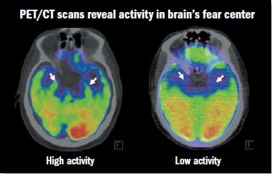
3. Cognitive neuroscience
In the last 25 years (1995+) advances in technology have allowed us to study the brain scientifically and actually look at the internal neurological basis of mental processes.
Cognitive Neuroscience is the scientific study of the influence of brain structure (neuro) on mental processes (cognition).

Slide 21
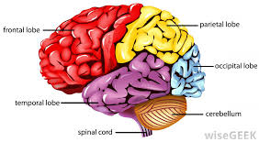
3. Cognitive neuroscience
Some of the things that psychologists have learnt from cognitive neuroscience:
The different locations of episodic and semantic memory (right and left pre-frontal cortex)
The location of language centres in the brain (Broca and Wernicke’s areas)
A link between OCD and the parahippocampal gyrus.

Slide 22
Scientific
Highly controlled lab experiments used to make inferences.
It has produced reliable and objective data.
Also the emergence of cognitive neuroscience has enabled two fields cognitive and biological to work together and establish a scientific basis.

Slide 23
Application to Real Life
Cognitive psychology has been applied to many real wold fields.
E.g. artificial intelligence
E.g. Development of machines that can ‘think’ (Robots)
E.g. The treatment of depression through correcting negative thought patterns.
E.g. Eye witness testimony in court

Slide 24
Less Deterministic
It is founded on ‘soft determinism’
This means that we are free to think about a stimulus- but we can only operate on what we know from the environment!

Slide 25
Machine Reductionism
As the human mind is likened to a computer it ignores human motivation and emotions.
Research has shown that emotion (e.g. anxiety/fear) does impact how well we process information. This is not considered in the cog approach.

Slide 26
Problem with Lab Experiments
Much of the research in cognitive psychology comes from lab experiments.
The stimuli used to test mental processing e.g. word lists lack mundane realism and are artificial.
This means the approach lacks external validity.

Slide 27
Apply it [2 marks]
Apply It! [2 marks]

Slide 29
The Cognitive approach
Lesson Objectives –
Hot – To outline the cognitive approach
Hotter – To apply the cognitive approach
Sizzling – To evaluate the cognitive approach

Slide 30
Real life application
In social psychology, research in social cognition has helped psychologists better understand how we form impressions of other people.
The cognitive approach to psychopathology has been used to explain how much of the dysfunctional behaviour shown by people can be traced back to faulty thinking processes.
Cognitive psychology has made contributions in the field of artificial intelligence and the development of thinking machines (robots)

Slide 31
Machine – reductionism
The computer analogy has been criticised as machine reductionism ignores the influence of emotion and motivation on the cognitive system and how this affects our ability to process information.
For example, research has shown that human memory may be affected by emotional factors such as the influence of anxiety on eye witnesses.

Slide 32
External validity
Cognitive psychologists are only able to infer about mental processes from the behaviour they observe during research. As a consequence, cognitive psychology occasionally suffers from being to abstract and theoretical.
Also experimental studies on cognitive processes often carried out using artificial stimuli such as tests on memory using world lists which may not represent real life.

Slide 33
Soft-determinism
Recognises that our cognitive system can only operate within the limits of what we know, but that we are free to think before responding to a stimulus.
This is a more interactionist (middle ground approach) than the hard determinism suggested by some other approaches.

Slide 34
Plenary
I have not mentioned double-whoppers whilst completing our evaluation (it was hard, you know how much I LOVE a double whopper).
Complete a double whopper grid.

Slide 35
Home Learning -
Outline and evaluate the cognitive approach in psychology (16 marks)
Must – Include a double whopper
Should – Complete without notes
Could – Complete in timed conditions and without notes
Please write on top if it is with no notes and in timed conditions.

