Slide 1
Give a ‘modern’ definition of psychology
Give two positive supporting evaluation points for Wundt’s methods
Explain what is meant by introspection and how it was tested in the 1880s
What did Wundt first set up in Germany?
Give two limitations/criticisms of Wudnt’s methods
Can you name all 6 approaches in psychology?

Slide 2

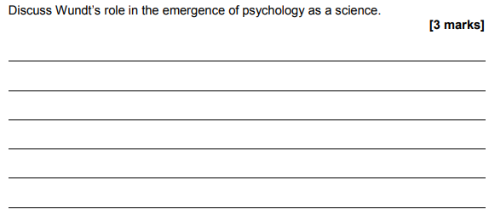


Slide 3

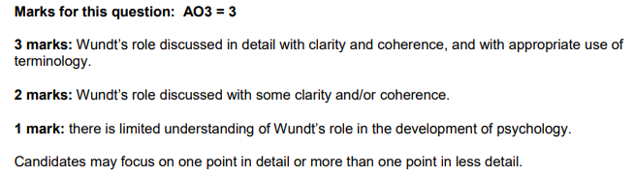
Possible Points:
First to open a lab specifically designed to study psychology under controlled conditions
Attempted to use scientific methods such as controlled conditions and standardised instructions and procedures
Moved psychology away from the study of philosophy or biology
He paved the way for other psychologists to build on his work and improve his methods.
Introspection is still used today in areas such as therapy and it is useful in understanding mental states.

Slide 4
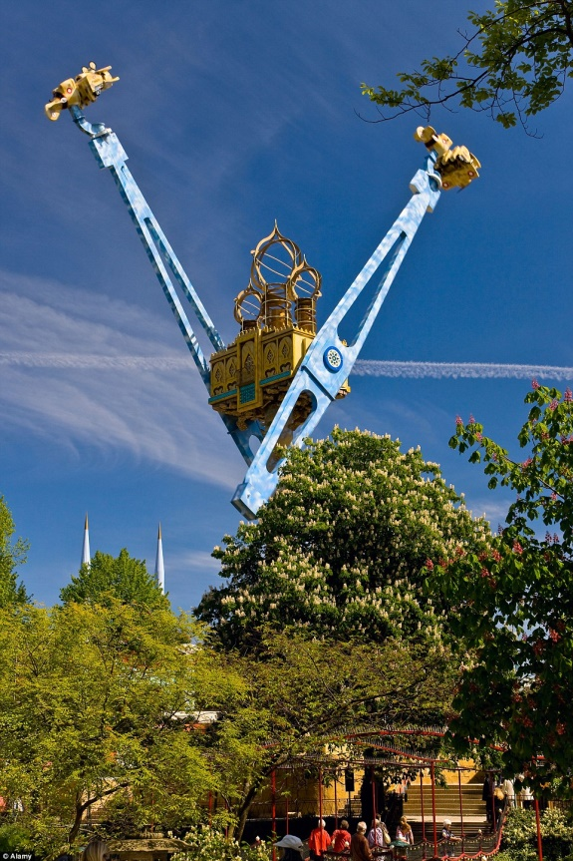
Approaches in Psychology
The Tivoli Gardens is an amusement park in Copenhagen. It is the second oldest amusement park in the world. It features the world’s tallest carousel at 80 metres high, and Vertigo, a looping plan ride where the rider is able to control the plane himself.
https://www.youtube.com/watch?v=zSXiO932Xks
What is your reaction to this ride?
Why do people react differently?

Slide 5

‘We are born as a tabula rasa (blank slate)’
What do you think this means?
Which Psychological approach do you think said this and why?

Slide 6

John Watson

Slide 7

Approaches: Behaviourism
The Behaviourist Approach
(The Learning Approach)
5 Key Assumptions:
Behaviourist reject the vagueness of introspection and instead focus on observable behaviour that can be tested scientifically (usually in the lab)
Behaviour is learned from experience.
The behaviourist approach is only concerned with behaviour that can be observed and measured scientifically.
It is therefore not concerned with what goes on in the mind
They usually use laboratory experiments.
Animals are often studied as they share the same principles of learning as humans.

Slide 8
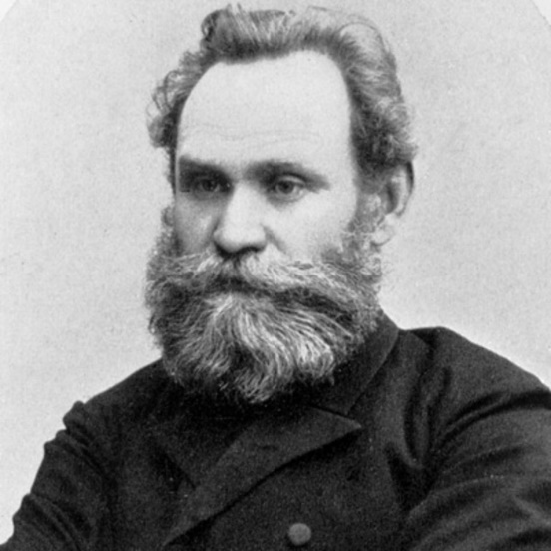
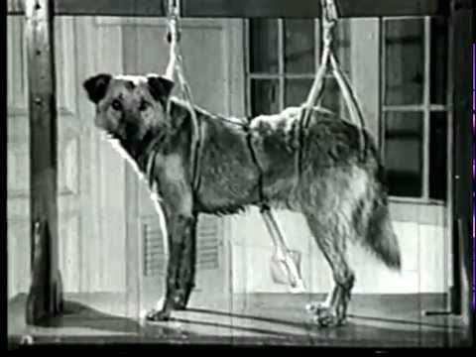
Approaches: Behaviourism
Classical Conditioning- Pavlov
(learning by association between a neutral stimulus and a reflex response)
Ivan Pavlov (1849- 1936)
Born: Russia

Slide 9
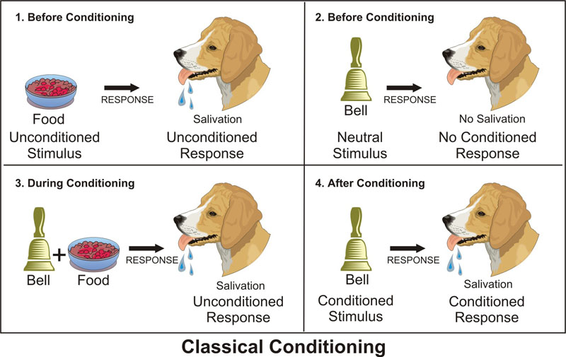
Approaches: Behaviourism

Slide 10
Approaches: Behaviourism

Slide 11
Approaches: Behaviourism

Slide 12
Approaches: Behaviourism

Slide 13
Approaches: Behaviourism

Slide 14
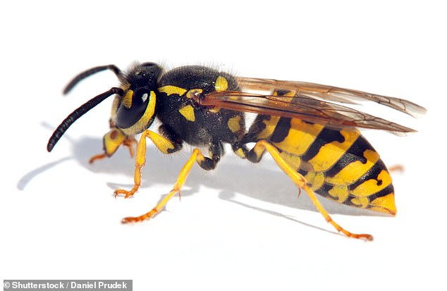
Approaches: Behaviourism
Neutral Stimulus x2
No conditioned response
Conditioned Response
Unconditioned Stimulus x2
Unconditioned Response x2
Conditioned Stimulus
Can you think of examples of when this might apply to human behaviour?

Slide 15
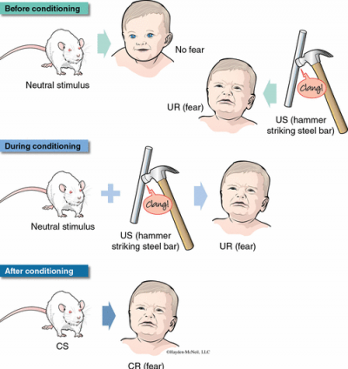
Approaches: Behaviourism
Watson & Rayner (1920) – Little Albert
Can Classical Conditioning explain how…?
Dogs learn to give paw?
We respect our parents rules e.g. a bedtime?
We wait patiently in long queues?

Slide 16
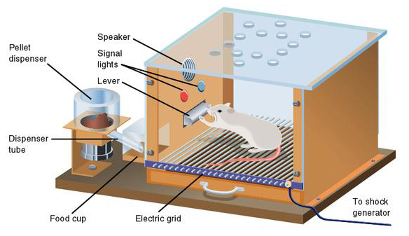
Approaches: Behaviourism
Operant Conditioning
(a form of learning in which behaviour is shaped by its consequences)
SKINNER!
How do you think this rat has been taught to perform certain behaviours?

Slide 17



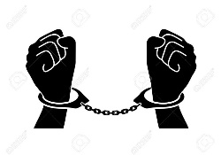

Approaches: Behaviourism
3 Types of Consequences:
Positive reinforcement: receiving a reward for performing a certain behaviour.
Negative reinforcement: avoiding something unpleasant/ having something unpleasant taken away.
Punishment: an unpleasant consequence to performing a behaviour.
Can you think of examples for each one?!

Slide 18
Apply it… which is positive and which is negative reinforcement?
Lisa always complains of a headache when it is time to start doing her homework. Her parents allow her to go to bed without doing her homework.
A mother gives her son biscuits for cleaning up his toys.
Anna receives £5 for every ‘A’ she earns on her report.
Billy hates when his dad nags him to do the dishes. He starts to do the dishes immediately after finishing a meal to avoid this.
SoR

Slide 19
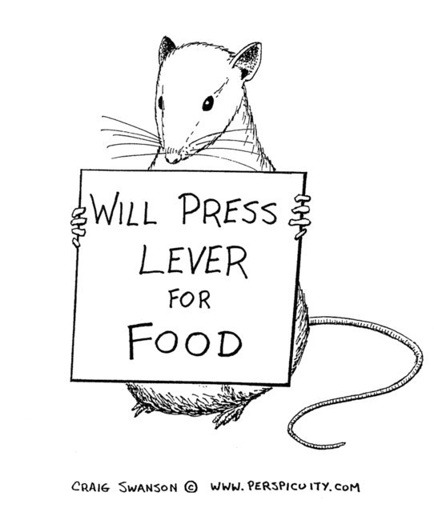
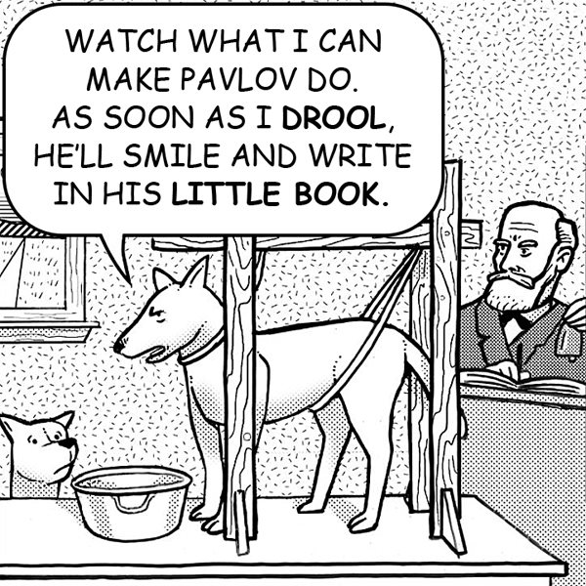
Approaches: Behaviourism
Explain the psychological research that these images represent!

Slide 20
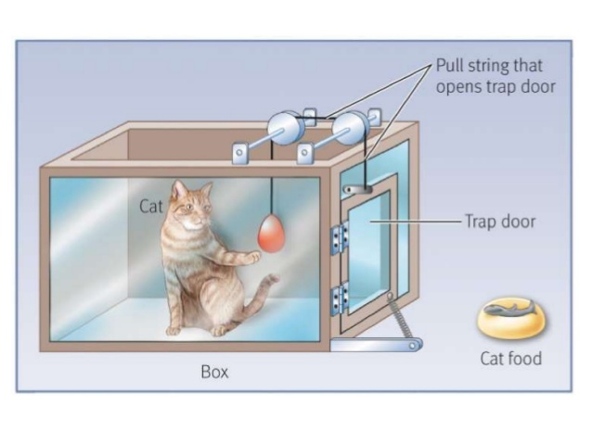
Approaches: Behaviourism
THORNDIKE!
https://www.youtube.com/watch?v=H6LEcM0E0io&t=1s difference cc and oc
https://www.youtube.com/watch?v=teLoNYvOf90 bigbangtheory

Slide 21

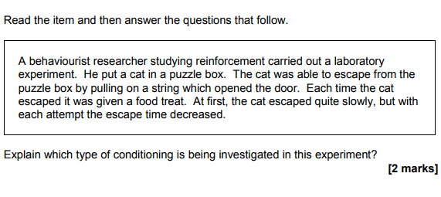


Approaches: Behaviourism
1
3. Sarah is terrified of lifts because she was trapped in one for 5 hours. She cannot go in a lift now.
How can her behaviour be explained by the behaviourist approach? (3 marks)

Slide 22
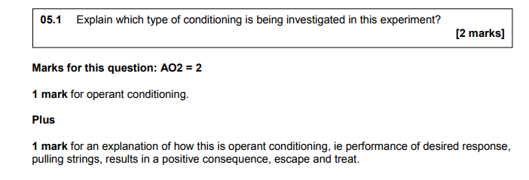
Approaches: Behaviourism

Slide 23
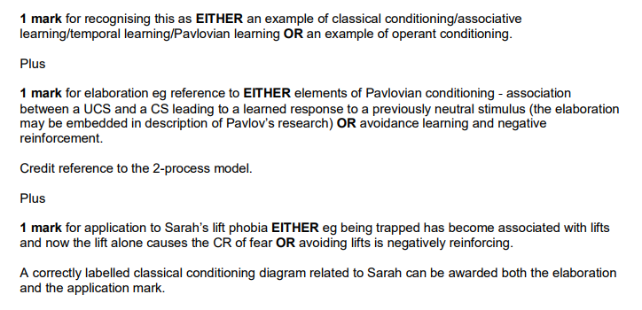
Approaches: Behaviourism

Slide 24

Evaluation in Psychology
You are now owners of a sweet shop.
You have one last space on your shelf to place a chocolate bar and you need to find the best one to maximise sales.
Each group will have one chocolate bar that they must analyse and present for 5 minutes on.
You must consider:
What are the best things about/ benefits of choosing your bar?
What are the limitations/ negative things about your bar?
3. How does your bar compare to other similar products out there?
4. Overall, what is your recommendation for stocking this bar??

Slide 25





Approaches: Behaviourism
Summarise your evaluation point into a few succinct bullet points/sentences.
Fruit Speed Dating: Evaluation
Strawbs- scientific credibility
Grapes- mechanistic view
Orange- environmental det.
Watermelon- ethical & practical issues
Round 1: Strawberries & Oranges, Grapes & Watermelons
Round 2: Strawberries & Grapes, Watermelons with Oranges
Round 3: Strawberries & Watermelons, Oranges and Grapes

Slide 26
Summarising Example:
The principles of conditioning have been applied to a broad range of real world behaviours and problems. For instance, operant conditioning is the basis of token economy systems that have been used successfully in institutions, such as prisons and psychiatric wards. These work by rewarding appropriate behaviours with tokens that can then be exchanged for privileges. Classical conditioning has been applied to the treatments of phobias through flooding and systematic desensitisation. Treatments such as these have the advantage of requiring less effort from a patient because the patient does not have to think about their problem therefore such therapies are also suitable for patients who lack insight. (107) (8 mins!!)
Behaviourist principles have many useful real world applications. For example operant conditioning is used in institutions (e.g. prisons) to reward inmates for positive behaviours. Also classical conditioning has successfully been used as a therapy to treat phobias. Therefore this approach has been used to improve people’s lives. (47) (3.5 mins)

Slide 27
Quiz!
Put these approaches in the order of earliest to most recent: Humanistic, social learning theory, behaviourist, cognitive.
Who suggested that the mind and the body were separate and independent of one another? Darwin, Wundt, Descartes or Locke?
In Pavlov’s conditioning what was the neutral stimulus?
In Pavlov’s conditioning, what was the unconditioned response?
Which consequence(s) in operant conditioning make the behaviour more likely to occur?
If you got your phone taken away for getting a bad report, what kind of conditioning would that be?
Briefly give the definition of ‘environmental determinism’
Notes:
Behav, human, SLT, cog, Descartes, bell, salivating, positive & negative reinf, punishment, all our experiences shape our future behaviour- no free will.

Slide 28

You are the Researcher:
How could you test reinforcement in humans as opposed to animals?
Can you design a simple study to test which form of reinforcement/ punishment is most effective at getting students to ensure they complete homework to the best ability they can?
How would you do it ethically?
How would you select your participants?
In pairs/ threes plan out your experiment!

