Slide 1
Origins of Psychology
Miss MESNARD

Slide 2
The Blind Men and the Elephant
Read the parable of the blind men and the elephant.
What does this suggest and how do you think it links to psychology?

Slide 3
The 6 main psychological approaches
Behaviourist
Social Learning Theory
Cognitive Approach
Biological
Psychodynamic
Humanistic

Slide 4
Psychology & Science?
What is Science?
What is the classification for a Science?
Should Psychology be classed as a science?

Slide 5
Psychology as we know it today…

Slide 6
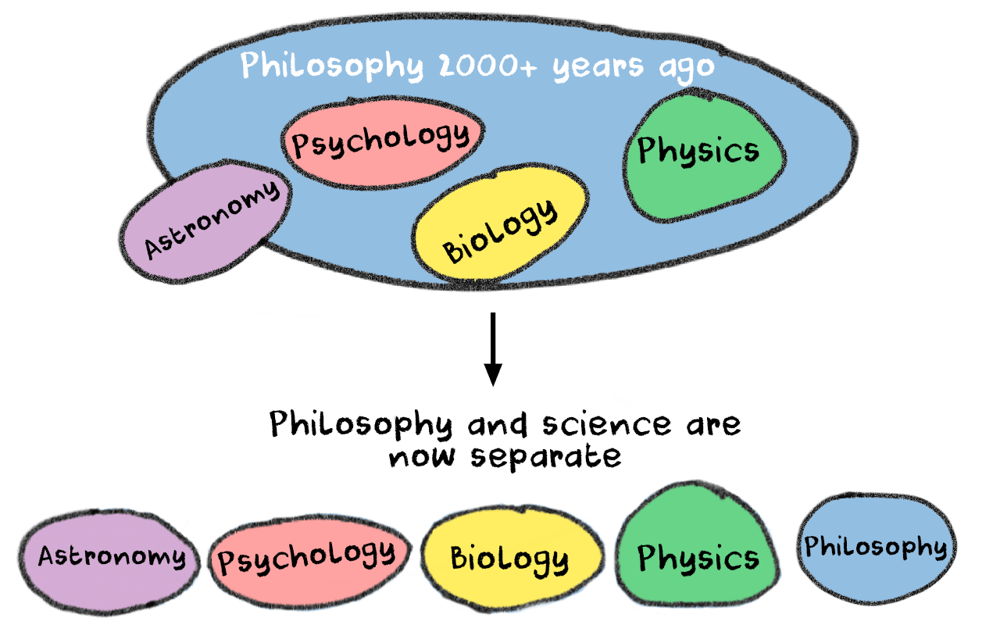
The beginning…
In contrast to the natural sciences (physics, chemistry and biology), Psychology is a relatively new scientific discipline.
It has its roots in 17th and early 19th century philosophy and was indeed once known as experimental philosophy.
Early influences included Rene Descartes, and his concept of Cartesian dualism, which simply means that the mind and body are separate entities.
This is a clear starting point for psychology.

Slide 7
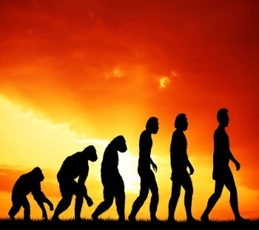
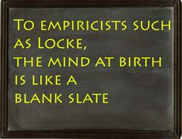
The beginning?
Then came the work of John Locke and his concept of empiricism, the belief that all knowledge is derived from sensory experience and can be studied using the scientific method. Locke also had an influence on the emergence of psychology as a science.
Finally, the evolutionary theories of Charles Darwin set the stage for the emergence of psychology (from a biological stance) as we know it today.

Slide 8
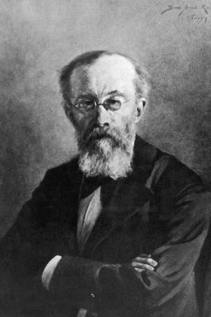
Wilhelm Wundt
In 1873 Wilhelm Wundt published the first book on psychology ‘Principles of Physiological Psychology’ and in 1879 opened the first psychology laboratory in Leipzig, Germany.
He is often considered to be ‘the father of psychology’

Slide 9
Wilhelm Wundt
Wundt’s approach became known as structuralism because he used experimental methods to find the basic building blocks (structures) of thought and investigate how they interacted. To do this, he studied sensation and perception, breaking participants’ observations of objects, images and events down into constituent parts in the same way that an anatomist would study a body trying to find its constituent parts and how they interact.
At first he did this by studying reaction time - systematically changing the stimuli he presented to participants and measuring how long it took them to respond - inferring that the longer it took to respond, the more mental processes must be involved.
Later, he adapted and developed a process called introspection to infer more about the nature of the processes involved.

Slide 12
Wilhelm Wundt
Wundt’s approach became known as structuralism because he used experimental methods to find the basic building blocks (structures) of thought and investigate how they interacted. To do this, he studied sensation and perception, breaking participants’ observations of objects, images and events down into constituent parts in the same way that an anatomist would study a body trying to find its constituent parts and how they interact.
At first he did this by studying reaction time - systematically changing the stimuli he presented to participants and measuring how long it took them to respond - inferring that the longer it took to respond, the more mental processes must be involved.
*** Later, he adapted and developed a process called introspection to infer more about the nature of the processes involved.

Slide 13
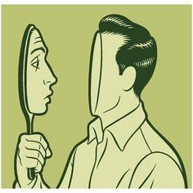
Introspection
Introspection is the examination of one's own conscious thoughts and feelings.
Wundt used introspection to investigate the human mind. Introspection comes from Latin and means ‘looking into’. Basically, participants were asked to reflect on their own cognitive processes and describe them.
Wundt established psychology as a science by using the scientific method – his ideas would lead to multiple different psychological perspectives.
https://www.youtube.com/watch?v=vo4pMVb0R6M 2 mins 20

Slide 14
Introspection: Have a go yourself.
Origins of Psychology
Write down absolutely anything that you think of, your thought processes as you hear these sounds. There are no right or wrong answers, just write down what you are thinking for each one.
https://www.youtube.com/watch?v=5ns8B31n3V0
https://www.youtube.com/watch?v=jX6kn9_U8qk

Slide 15
A03
What’s good about wundt?

Slide 16
A03
What’s good about wundt?
Contribution to psychology?
Methods used?
Scientific elements?

Slide 17
A03
What’s good about wundt?
Wundt’s contribution to Psychology:
Wrote first textbook of psychology (Principles of Physiological Psychology, 1873-4)
Set up first laboratory of experimental psychology (1879)
Used the scientific method to study the structure of sensation and perception
All of his introspections were conducted under strictly controlled conditions, using the same stimulus for everyone, with standardised instructions.
This means it is easy to replicate (repeat).
His work marked the separation of modern psychology from philosophy.

Slide 18
A03
What’s not so good about wundt?

Slide 19
A03
What’s not so good about wundt?
Scientific?
Reliable?

Slide 20
A03
What’s not so good about wundt?
Introspection is still used today but it lacks scientific rigour. Looking inwards, attempting to understand our conscious thought processes is difficult enough. Trying to explain them to others, even for the most intelligent and eloquent observer is almost impossible.
Introspection relies primarily on non-observable responses and therefore introspection produced data that was subjective (varied greatly from person to person), so it became very difficult to establish general principles. This means that introspective experimental results are not reliably reproduced by other researchers.
Following Wundt’s theories came the behaviourist approach which used highly controlled, laboratory experiments to test hypothesis. This was considered a much more reliable and scientific way of studying human behaviour.

Slide 21
Rogers and Maslow develop a humanistic approach to psychology (1950s)
Cognitive neuroscience brings together the cognitive and biological approach (2000s)
Sigmund Freud establishes the psychodynamic approach (1900s)
Bandura proposes the Social Learning theory (1960s)
Origins:
Descartes, Locke & Darwin (1596- 1882)
With the development of technology comes the cognitive approach (1960s)
Watson and Skinner establish the behaviourist approach (1913)
The biological approach becomes a dominant scientific perspective in psychology (1980s)
Wundt opens the first psychology lab in 1879

Slide 22
Homework Task
You are going to design and construct an illustrated psychology timeline to go on the first page of your folder
For each entry on the timeline, you need to:
You may select/draw an appropriate illustrations for each one.
Use the timeline on pages 104-105 of your text book as guidance.
Understand | Find out some brief information about the key psychologist and their school of psychology Describe their assumptions/methods of study
Evaluate | Add in evaluation or counter arguments for each assumption
Notes:
Can do using a variety of materials
Pipe cleaners
String
Strawberry laces etc

Slide 23
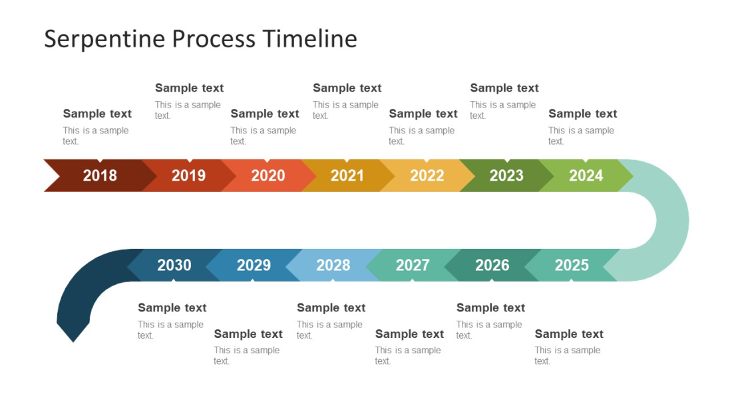
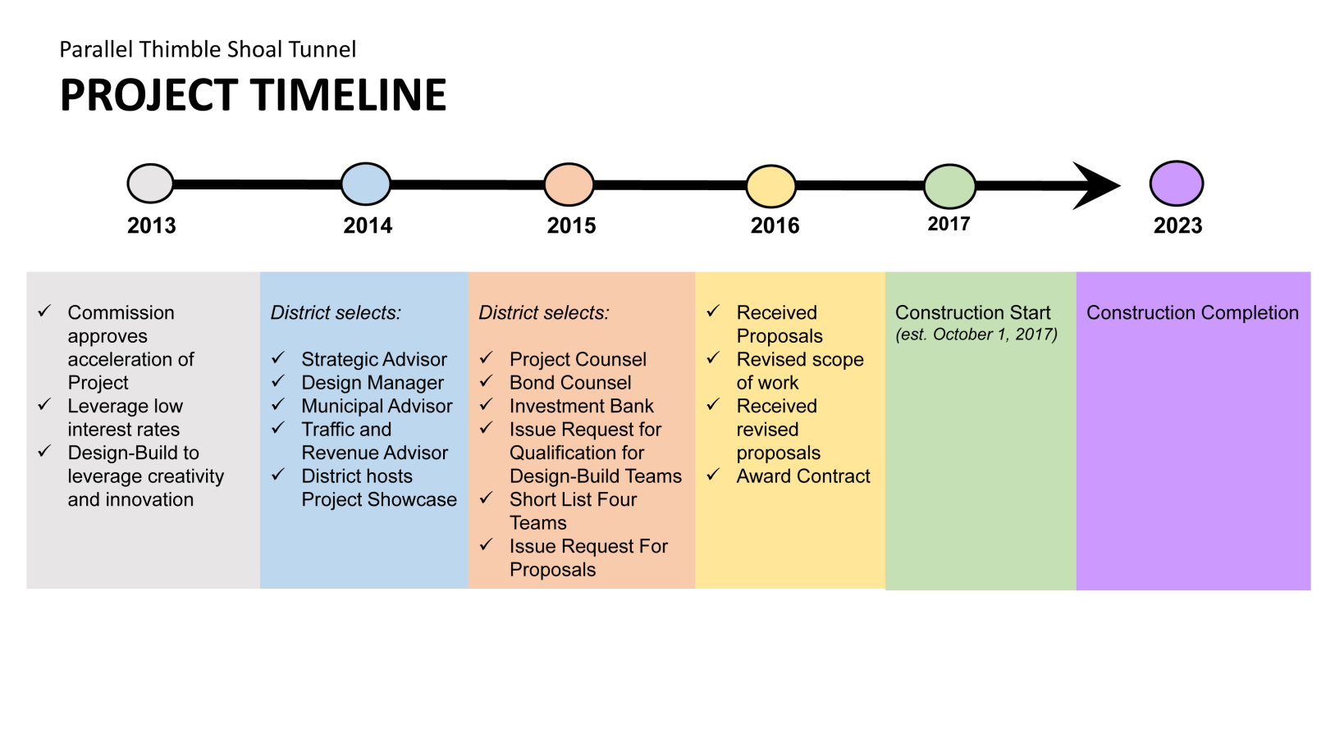

Slide 25
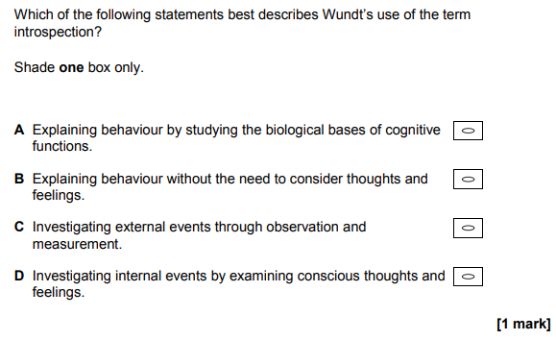

Slide 26
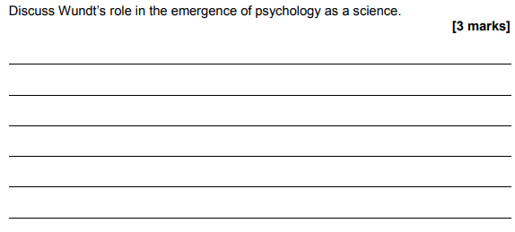

Slide 27
Possible Points:
First to open a lab specifically designed to study psychology under controlled conditions
Attempted to use scientific methods such as controlled conditions and standardised instructions and procedures
Moved psychology away from the study of philosophy or biology
He paved the way for other psychologists to build on his work and improve his methods.
Introspection is still used today in areas such as therapy and it is useful in understanding mental states.

