Slide 1
Social effects on performance
Performance Psychology

Slide 2
Overview
Reflect on practical task
Your experiences
What are social effects?
Who contributes to social facilitation/inhibition?
Key theories
My experiences

Slide 3
Practical Task
Reflect on the practical before/during/after performance
Cognitive/somatic anxiety
Arousal levels
Perceived impact on performance
Other experiences

Slide 4
Social facilitation
Increased level of performance due to the presence of others
Social inhibition
Decreased level of performance due to the presence of others

Slide 5
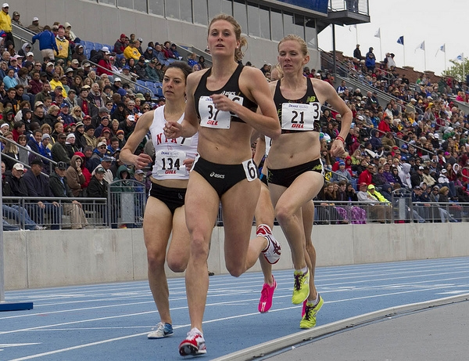
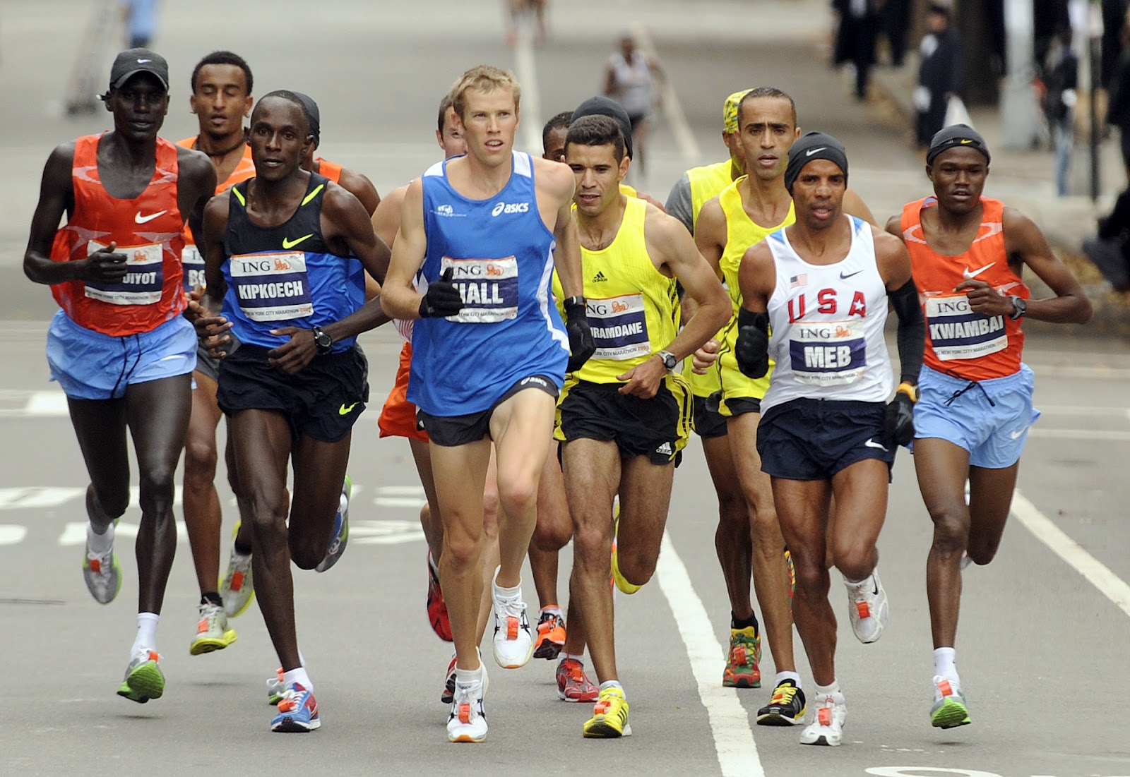
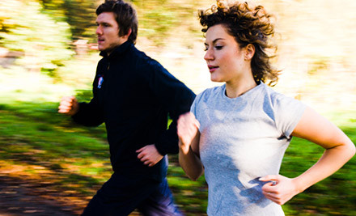
Why?

Slide 6
Why?
The presence of others can increases an athletes arousal level
Arousal levels impact an athletes performance
This is not a simple linear relationship, sometimes performance increases, sometimes it decreases
There are many contributing factors
How the athlete perceives the people present
The athletes stage of learning
The athletes optimum arousal for a task

Slide 7
Why?

Slide 8
Current knowledge
What do we currently understand by
Social facilitation?
Social inhibition?
Why does this happen?

Slide 9
Who can cause this to happen?

Slide 10
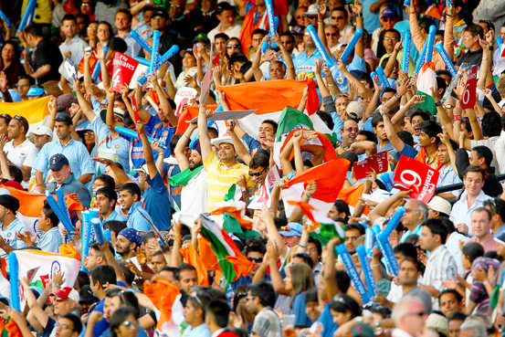
Home audience

Slide 11
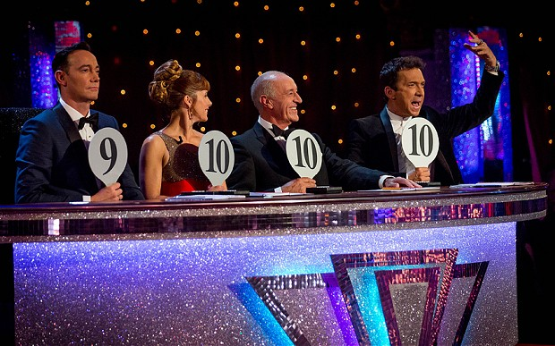
Significant observer, e.g. scout/assessor

Slide 12
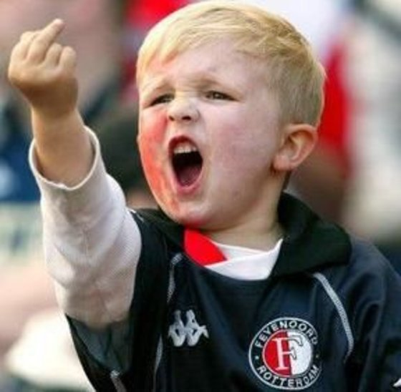
Hostile audience

Slide 13
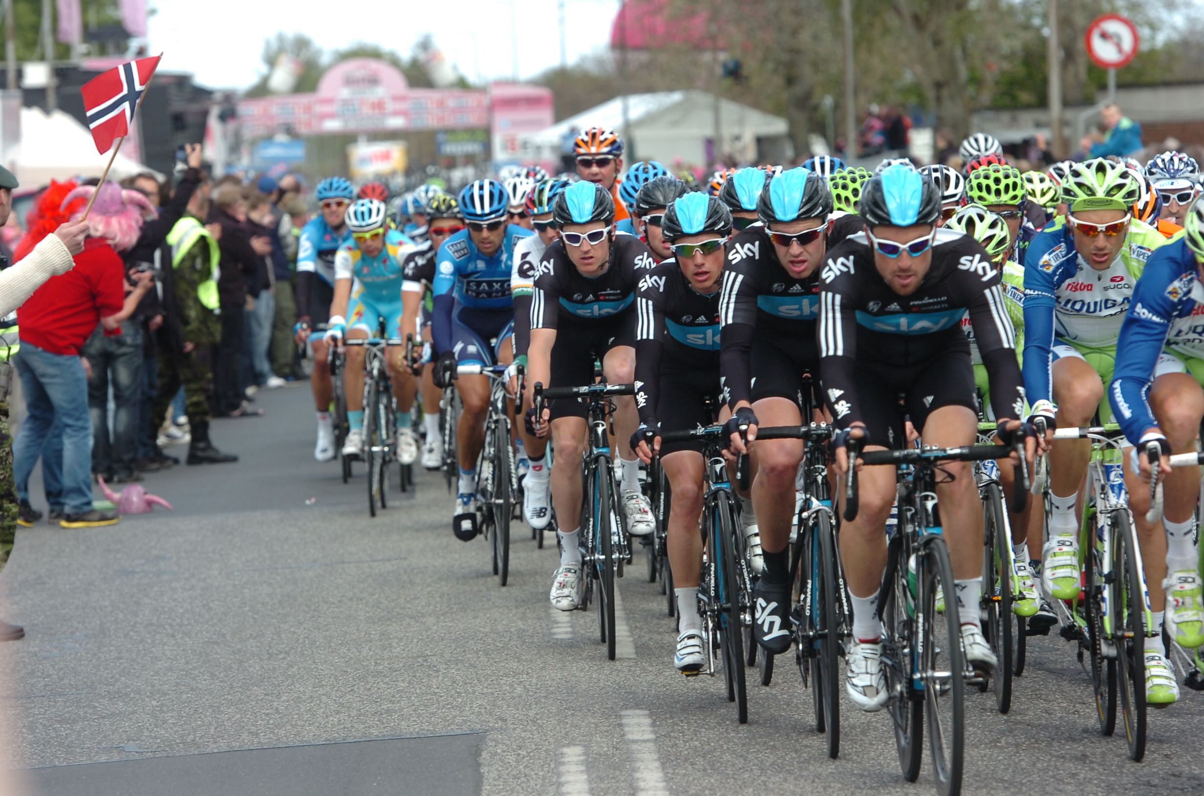
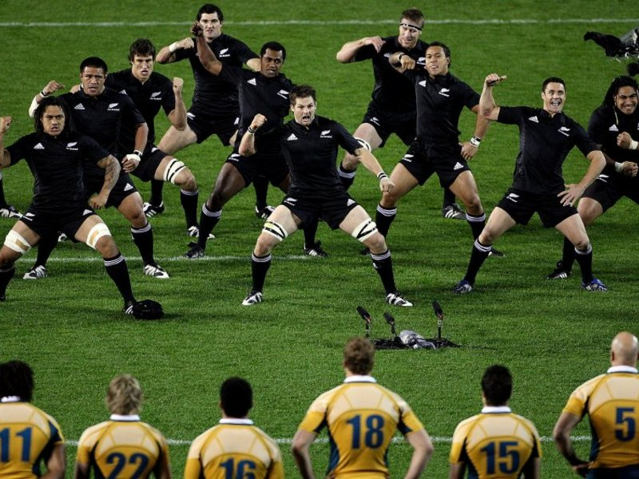
Co-actors (team mates or opposition)

Slide 14
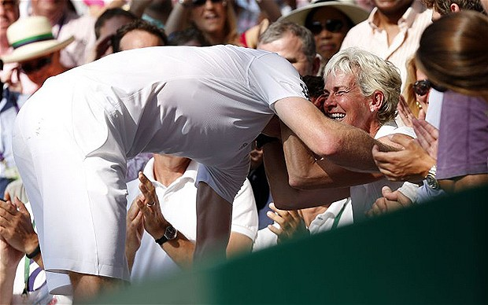
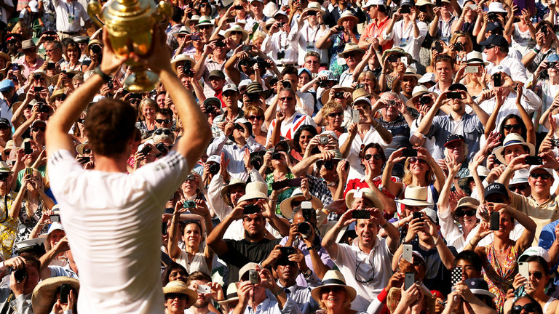
Emotionally relevant observer, e.g. parent

Slide 15
Co-actors (team mates or opposition)
Significant observer, e.g. scout/assessor
Home audience
Hostile audience
Emotionally relevant observer, e.g. parent

Slide 16
Drive theory (Zajonc, 1965)
Zajonc simply stated that the presence of others, even passive observers, increased an athletes arousal
The higher the arousal level, the more likely the athlete was to revert to their dominant response – their most learned and natural behaviours
Expert performers had the correct dominant response, so increased arousal had positive effects
Novice performers were more likely to have an incorrect dominant response, so increased arousal had negative effects

Slide 17
Drive theory
Some assumptions that are made from Zajonc and other key research
Increased arousal facilitates performance of:
Easy tasks
Well learnt task
Highly skilled athletes
Increased arousal inhibits performance of:
Difficult tasks
Tasks not yet learnt properly
Less skilled athletes

Slide 18
Evaluation apprehension (Cottrell, 1968)
Cottrell added a perceptive element to the theory – how an athletes perceives the presence of others
If they are judging your performance (strictly come dancing) then this would lead to heightened arousal

Slide 19
Other theories to explore
Home advantage
Proximity effect
Distraction – conflict theory
Arousal theories (Inverted U, IZOF, Catastrophe Theory)

Slide 20
Demonstration
Social effects on simple and complex tasks

Slide 21
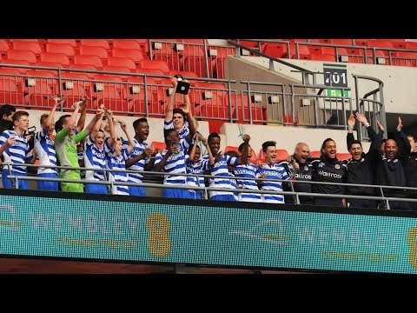
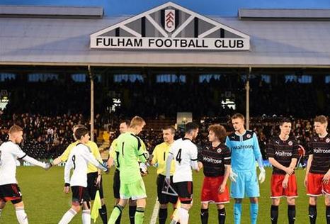
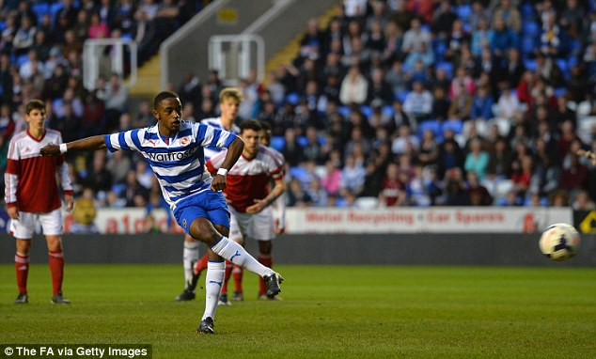

Slide 22
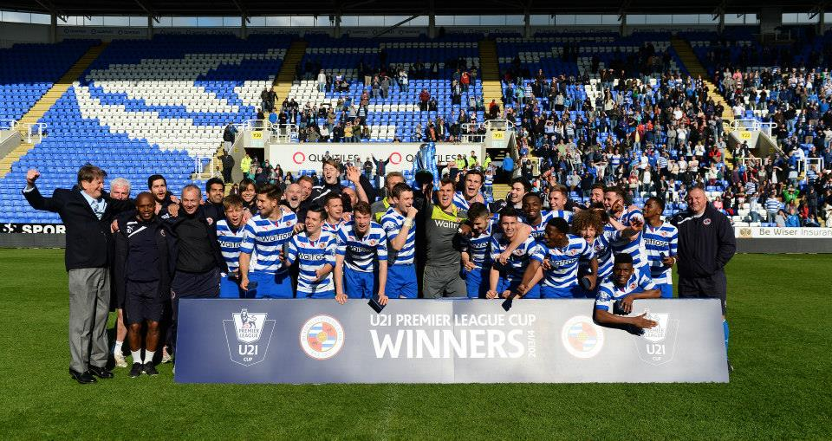
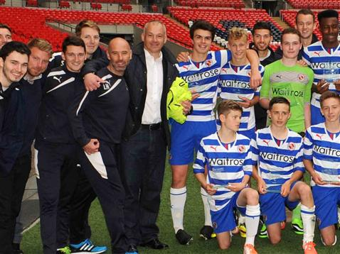
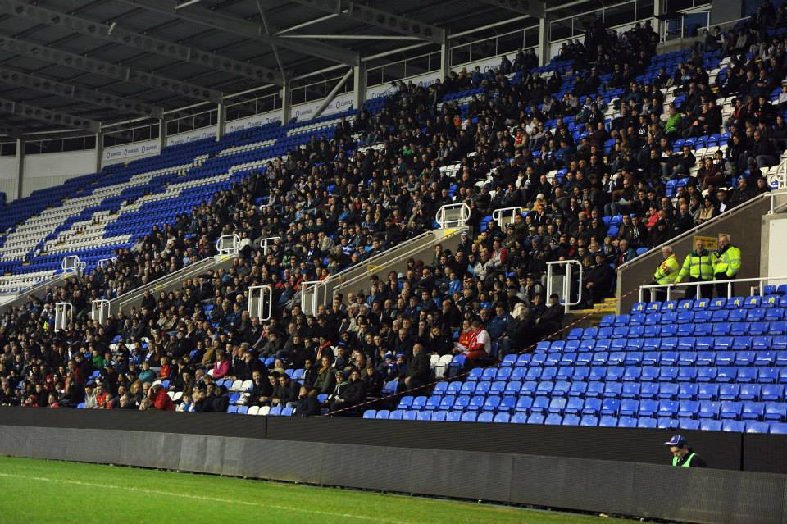
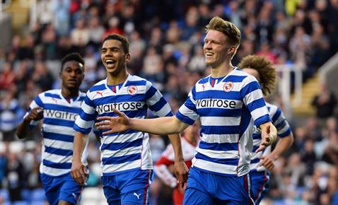

Slide 23
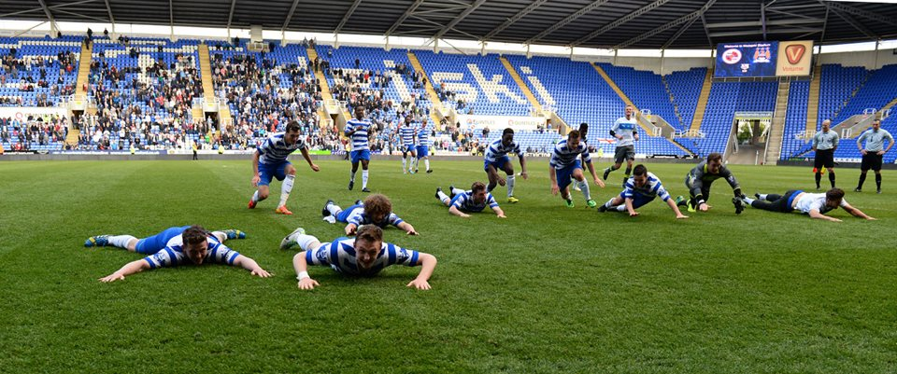
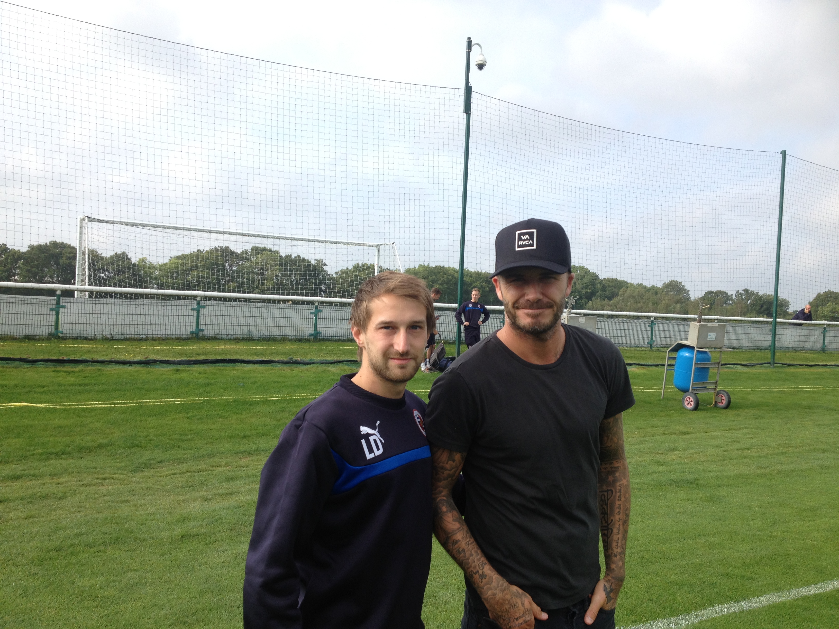
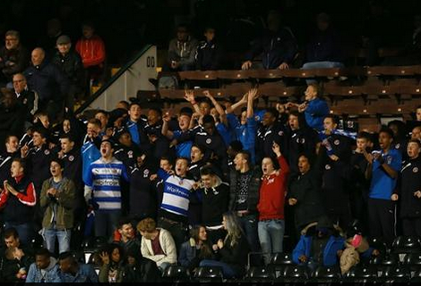
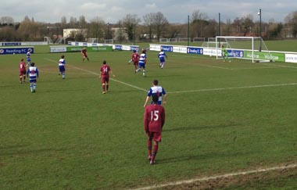

Slide 24
Key terms
Social facilitation
Social inhibition
Arousal
Dominant response
Drive theory
Evaluation apprehension

Slide 25
Social Facilitation and Inhibition – Effects of an audience and other participants and performance and Lifestyle behaviours
Topic Outline | Learning Outcomes | Suggested Teaching/Homework | Suggested resources | Points to note
Social facilitation and inhibition – the effects of an audience and other participants on performance and lifestyle behaviours. | Demonstrate knowledge and understanding of the positive (facilitation) and negative (inhibition) effects (audience and co-actors) on performance, participation and lifestyle; Demonstrate knowledge and understanding of links with levels of arousal, and the heightening of the dominant response (Zajonc); Explain causes and effects of evaluation apprehension; Demonstrate knowledge and understanding of strategies to combat the effects of social inhibition in practical activities (the use of selective attention and mental rehearsal) and in following a balanced, active and healthy lifestyle. | Students to carry out a series of brief experiments on sports performance in isolation and with an audience and with competitive and non-competitive co-actors e.g. standing broad jump for gross actions and aiming activities for complex fine actions. The effects of an audience to be experienced and reflected upon by students. Visiting speaker / or interviews with a sports performer who reflects on coping with an audience. Make links to arousal theories from AS unit. Students to draw out arousal graphs in relation to the effects of an audience. Identify other effects such as proximity and audience size. Students to identify coping strategies for different types of sports performer. | Advanced PE and Sport - Honeybourne, Hill and Moors OCR Advanced PE A2 – various Sport Psychology a self help guide – Bull Sport Psychology: Concepts and Applications – Cox | Illustration of the effects of an audience on the performance of complex fine skills can be shown through card sorting into suits. A number of different conditions can be simulated for example with hostile crowd or supportive crowd – results will provide discussion points about the link between arousal / attentional control and performance. If card sorting or the like is used it is important to relate findings eventually to sports activities. Students must not use card sorting as a practical example in a written examination response.

