Slide 1
Weiner’s Attribution Theory
Lucy Crossley

Slide 2
Attribution theory
Identifies the reasons given by performers to explain success and failure

Slide 3
Weiner (1971)
The theory looks at reasons given for success and failure
It has shown to have powerful implications for achievement-related behaviour
There are strong links between attribution and achievement motivation

Slide 4
The Model has two dimensions, locus of causality and Stability.
The locus of causality dimension shows whether the attribution comes from internal or external factors.
The stability dimension refers to whether the attribution is permanent and hard to change or whether it is temporary and easy to change

Slide 5
Weiner’s Attribution Theory
Locus of causality
Internal External
Ability | Task Difficulty
Effort | Luck
Stable
Stability
Unstable

Slide 6
Locus of Causality
Indicates whether factors are internal or external
Effort and ability represent internal factors
Task difficulty and luck represent external factors
External factors are also known as environmental variables

Slide 7
Attribution = identifies the reasons given by performers to explain success or failure
From Weiner’s theory it shows strong links between attribution and achievement motivation
According to him, the most important factors affecting attributions are ability, effort, task difficulty, and luck. Attributions are classified along dimensions:
- locus of causality = identifies the perceived cause of success/failure (external cause is outside of performer’s control while internal cause is within their control)
This dimension shows whether the attribution
relates to factor which are internal/external to
the performer. Eff0rt and ability represent
internal factors while task difficulty and luck are
external, known as environmental variables
Locus of causality
Internal External
Ability | Task difficulty
Effort | Luck

Slide 8
Stability
Indicates whether attributions are stable or unstable.
A stable factor is one that is considered permanent and unchangeable such as ability.
An unstable factor is temporary and can be changed for example luck.

Slide 9
Stability = indicates whether attributions are stable or unstable
It refers to the degree of permanence associated with an attribution factor, a stable factor = permanent and unchangeable i.e. ability
An unstable factor is temporary and can be changed i.e. Luck
- Control
Attribution retraining (improving performance) involves focusing the reason for failure onto internal, unstable and controllable factors
Stable
Stability
Unstable
Ability | Task difficulty
Effort | Luck

Slide 10
Attribution Theory
Locus of causality
Attribution = Attribution theory identifies the reasons (attributions) given by performers to explain success and failure.
Locus of causality = identifies the perceived cause of success or failure (external/internal).
Stability = refers to the degree of permanence associated with the attribution factor.
Control is also in the theory (3rd)
Internal
External
Ability
Task difficulty
Effort
Luck
Stable
Stability
Unstable

Slide 11
An important assumption of attribution theory is that people will interpret their environment in such a way as to maintain a positive self-image. That is, they will attribute their successes or failures to factors that will enable them to feel as good as possible about themselves. In general, this means that when learners succeed at an academic task, they are likely to want to attribute this success to their own efforts or abilities; but when they fail, they will want to attribute their failure to factors over which they have no control, such as bad teaching or bad luck.
The basic principle of attribution theory as it applies to motivation is that a person's own perceptions or attributions for success or failure determine the amount of effort the person will expend on that activity in the future.
There are four factors related to attribution theory that influence motivation in education: ability, task difficulty, effort, and luck. In terms of the characteristics discussed previously, these four factors can be analyzed in the following way:
Ability is a relatively internal and stable factor over which the learner does not exercise much direct control.
Task difficulty is an external and stable factor that is largely beyond the learner's control.
Effort is an internal and unstable factor over which the learner can exercise a great deal of control.
Luck is an external and unstable factor over which the learner exercises very little control.
Note that it is the learner's perception that determines how attributions will influence future effort. A learner may believe that he is a "lucky person" - and for him luck would be an internal and stable characteristic over which he exercises little control. In other words, for this person "luck" is really what the preceding list calls an "ability" or personality characteristic. Likewise, a person may believe that she expended a great deal of effort, when in fact she did not, or that an objectively easy task was difficult. The basic principle of attribution theory as it applies to motivation is that a person's own perceptions or attributions for success or failure determine the amount of effort the person will expend on that activity in the future.

Slide 12
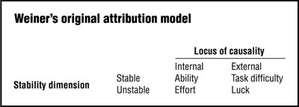
Control is considered a third dimension in the attribution model but does not play a role until attribution retraining

Slide 13
The out come of a skill will cause a performer to make an attribution of why it failed or succeeded.
The reason for failing or succeeding could be internal (e.g. ability) or external (e.g. the environment)
Perosnality will play a part in whether failing demotivates or motivates them to do it again. (e.g. low or high NAF).
Also if the skill was out of the performers control or not will affect how motivated or unmotivated they are.

Slide 14
Success or Failure?
Coaches often put failure down to external causes (opposition were lucky), this helps maintain confidence, self-esteem and reassurance that achievement is a realistic expectation in the future.
Internal attributions more commonly used to reinforce success (ability), this elevates confidence and higher achievement
High achievers adopt attribution bias (internal- success, external- failure)
Low achievers adopt avoidance behaviour (internal-failure, external- success)
This affects participation levels as low achievers then tend to avoid activities where as high achievers who develop attribution bias persevere in the face of failure

Slide 15
Coach:
We didn't lose the game; we just ran out of time. Vince Lombardi
High Achievers:
‘If you even dream of beating me you'd better wake up and apologize’ Muhammad Ali

Slide 16
Reasons for success and failure
External factors take away the responsibility of the loss from the players, help to maintain
Self esteem
Sustain motivation
Restore pride & confidence
Internal attributions should be used to reinforce success
Elevate confidence
Endorse future expectation of high achievement
High achievers or people who adopt approach behaviour tend to attribute their success to internal factors and failure is put down to external factors = temporary setback (attribution bias) ‘promote HABL’
Low achievers or people who adopt avoidance behaviour tend to attribute a lack of success to internal factors and attribute success to external factors = negative application of attribution ‘drop out of activity’

Slide 17
Attribution retraining
= changing the performers perception of the causes of failure.
INVOLVES FOCUSING THE REASON FOR FAILURE ONTO INTERNAL, UNSTABLE AND CONTROLLABLE FACTORS
Raises confidence
Convert avoidance behaviour into approach behaviour
Encourage mastery orientation within an individual
Promotes HABL and lifelong participation

Slide 18
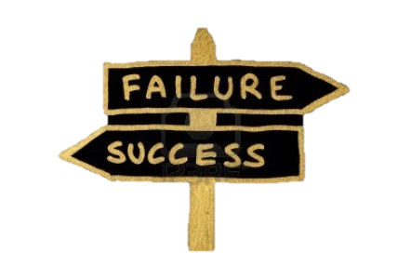
Belief that poor ability is cause of failure is changed to belief that lack of effort is cause.
Ability is a direct reflection of personal competence and cannot be changed by the individual.
Effort, however, is changeable as it is unstable and internal so that an individual can experience pride in any positive changes.
Effort can be controlled by the performer
Focus the reason for failure onto internal, unstable and controllable factors

Slide 19
Definition
Changing the performers perception of the causes of failure.
The belief that poor ability is the cause of failure is changed to a belief that a lack of effort was the most important attributional factor in failure
http://www.youtube.com/watch?v=54Wm1L0kwJk

Slide 20
Reasoning behind it
Ability is an internal and stable attribution and also a direct reflection of personal competence which the individual has no way of changing.
Effort, however, is unstable but still internal. This means it can be controlled and someone can experience pride from any positive changes.
No control over failure underpins learned helplessness so attribution training focuses on failure being down to internal, unstable and controllable factors.

Slide 21
Interpretation using weiners model
Ability isn't the problem as the individual has no way of changing it.
Effort is changeable as it is unstable. But it is key as the performer can ultimately control it.
It is a fear of having no control over failure that underpins learned helplessness.
This retraining is therefore focuses on internal unstable and controllable factors as a reason for failure.

Slide 22
Why use it?
Can help raise confidence
Convert avoidance behavior into approach behavior and encourage mastery orientation.
This will therefore promote lifelong sport participation.

Slide 23
Attribution Retraining
Involves changing a performers perception of the causes of failure from lack of ability to lack of effort
Ability is a direct reflection of personal competence and therefore the individual cannot change it, whereas effort is changeable because it is unstable
Effort is valuable as it can be controlled by the performer
Focuses the reason for failure onto internal, unstable and controllable factors
This process can help raise confidence and convert avoidance behaviour into approach behaviour

Slide 25
Effect of failure or success.
Feelings such as shame and pride will increase or decrease depending on failure and success.
In the future the performer may expect failure or success which could be good or bad depending on personality.
Ultimately it will decrease or increase motivation, and so affect future behaviour.

Slide 26
Sporting example:

Slide 27
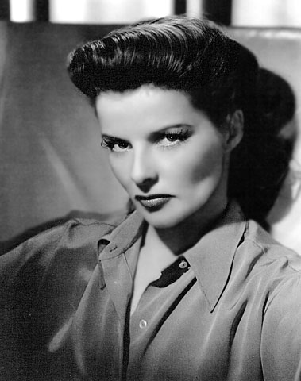
We are taught you must blame your father, your sisters, your brothers, the school, the teachers - but never blame yourself. It's never your fault. But it's always your fault, because if you wanted to change you're the one who has got to change.
Katharine Hepburn

Slide 28
Shallow men believe in luck. Strong men believe in cause and effect.
Ralph Waldo Emerson

