Slide 1
attribution
By GABY (and Millie)

Slide 2
Attribution
In social psychology, attribution is the process by which individuals explain the causes of behavior and events.
Attribution theory is the study of various models that attempt to explain those processes

Slide 4
Reasons for success and failure
High Achievers | Low Achievers
Adopt ‘approach behaviour’ tend to attribute their success to internal factors such as high-ability level | Adopt ‘avoidance behaviour’ tend to attribute a lack of success to internal factors e.g lack of ability
Failure is therefore down to external factors e.g. bad luck | Attribute success to external factors e.g. luck
Failure = temporary setback and this is known as self serving bias | This type of attribution takes away confidence and leaves a reduced expectation of future achievement
High achievers tend to remain persistent in the face of failure | NEGATIVE APPLICATION OF ATTRIBUTION
POSITIVE APPLICATION OF ATTRIBUTION | Repeated failure and negative application of attribution would cause athlete to experience learned helplessness
Constant achievement and positive application of attribution promotes mastery orientation. | This condition may cause an individual to avoid an activity.

Slide 6
Effect of failure or success.
Feelings such as shame and pride will increase or decrease depending on failure and success.
In the future the performer may expect failure or success which could be good or bad depending on personality.
Ultimately it will decrease or increase motivation, and so affect future behaviour.

Slide 7
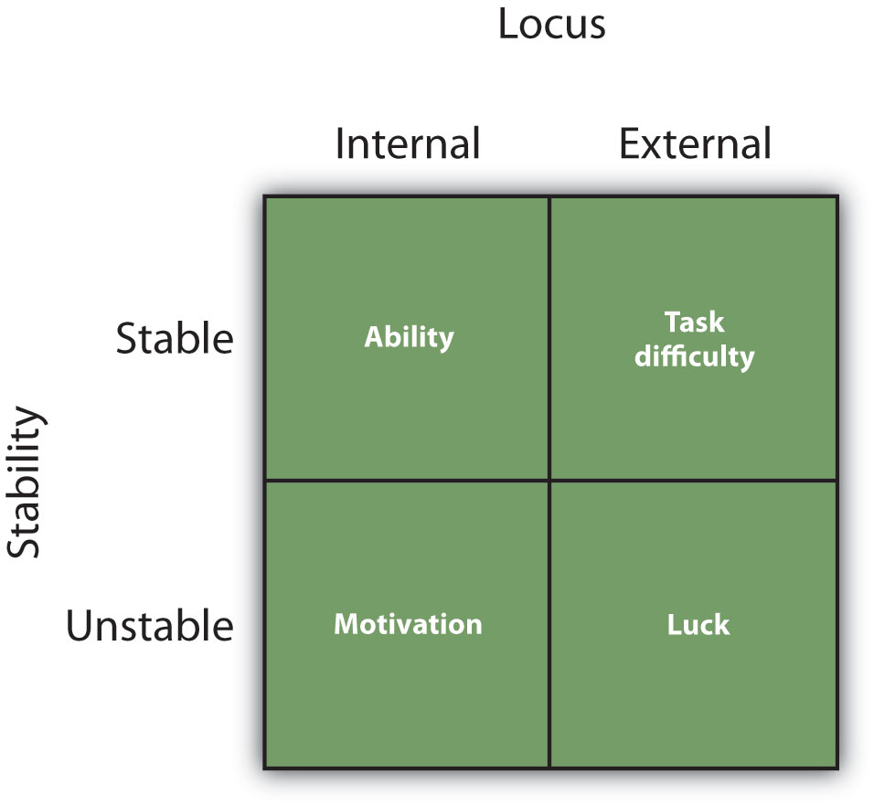

Slide 8
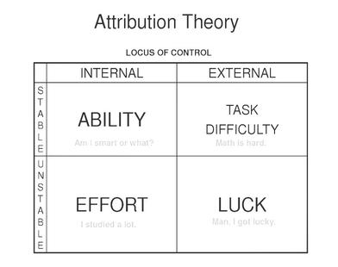
Weiner’s attribution Model - 1971
Looks at the reasons given by coaches and players themselves to account for successes and failures in sport|
Locus of causality – the perceived cause of success/failure (i.e. outside the performers control or within the performer's control)
Stability – degree of permanence (stable is permanent and unchangeable, unstable is temporary and changeable)
Strong link between attribution and achievement motivation

Slide 9
Attribution Theory
Locus of causality
Attribution = Attribution theory identifies the reasons (attributions) given by performers to explain success and failure.
Locus of causality = identifies the perceived cause of success or failure (external/internal).
Stability = refers to the degree of permanence associated with the attribution factor.
Control is also in the theory (3rd)
Internal
External
Ability
Task difficulty
Effort
Luck
Stable
Stability
Unstable

Slide 10
An important assumption of attribution theory is that people will interpret their environment in such a way as to maintain a positive self-image. That is, they will attribute their successes or failures to factors that will enable them to feel as good as possible about themselves. In general, this means that when learners succeed at an academic task, they are likely to want to attribute this success to their own efforts or abilities; but when they fail, they will want to attribute their failure to factors over which they have no control, such as bad teaching or bad luck.
The basic principle of attribution theory as it applies to motivation is that a person's own perceptions or attributions for success or failure determine the amount of effort the person will expend on that activity in the future.
There are four factors related to attribution theory that influence motivation in education: ability, task difficulty, effort, and luck. In terms of the characteristics discussed previously, these four factors can be analyzed in the following way:
Ability is a relatively internal and stable factor over which the learner does not exercise much direct control.
Task difficulty is an external and stable factor that is largely beyond the learner's control.
Effort is an internal and unstable factor over which the learner can exercise a great deal of control.
Luck is an external and unstable factor over which the learner exercises very little control.
Note that it is the learner's perception that determines how attributions will influence future effort. A learner may believe that he is a "lucky person" - and for him luck would be an internal and stable characteristic over which he exercises little control. In other words, for this person "luck" is really what the preceding list calls an "ability" or personality characteristic. Likewise, a person may believe that she expended a great deal of effort, when in fact she did not, or that an objectively easy task was difficult. The basic principle of attribution theory as it applies to motivation is that a person's own perceptions or attributions for success or failure determine the amount of effort the person will expend on that activity in the future.

Slide 11
Attribution Retraining
Involves changing the performer’s perception of the causes of failure. For example, the performer may have believed that poor ability was the cause of their failure but this can be changed so the performer believes that a lack of effort was the reason for their failure.
Ability is an internal factor and is permanent and stable whereas, effort is viewed as an external factor, one that can be changed because it is unstable. Effort is a valuable attribution as it can be controlled by the performer.
Attribution retraining involves directing the reason for failure onto an unstable, controllable factors. This process can be justified because it will help to raise the performer’s confidence which will in turn promote the likelihood of lifelong sport participation.

Slide 12
Attribution retraining
= changing the performers perception of the causes of failure.
INVOLVES FOCUSING THE REASON FOR FAILURE ONTO INTERNAL, UNSTABLE AND CONTROLLABLE FACTORS
Raises confidence
Convert avoidance behaviour into approach behaviour
Encourage mastery orientation within an individual
Promotes HABL and lifelong participation

Slide 13
Why use it?
Can help raise confidence
Convert avoidance behavior into approach behavior and encourage mastery orientation.
This will therefore promote lifelong sport participation.

Slide 14
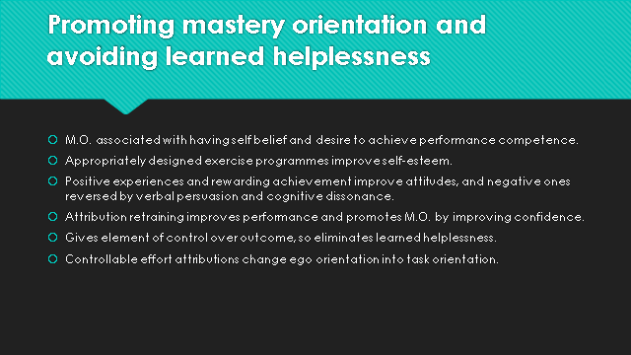

Slide 16

Coach:
We didn't lose the game; we just ran out of time. Vince Lombardi
High Achievers:
‘If you even dream of beating me you'd better wake up and apologize’
Muhammad Ali

Slide 17
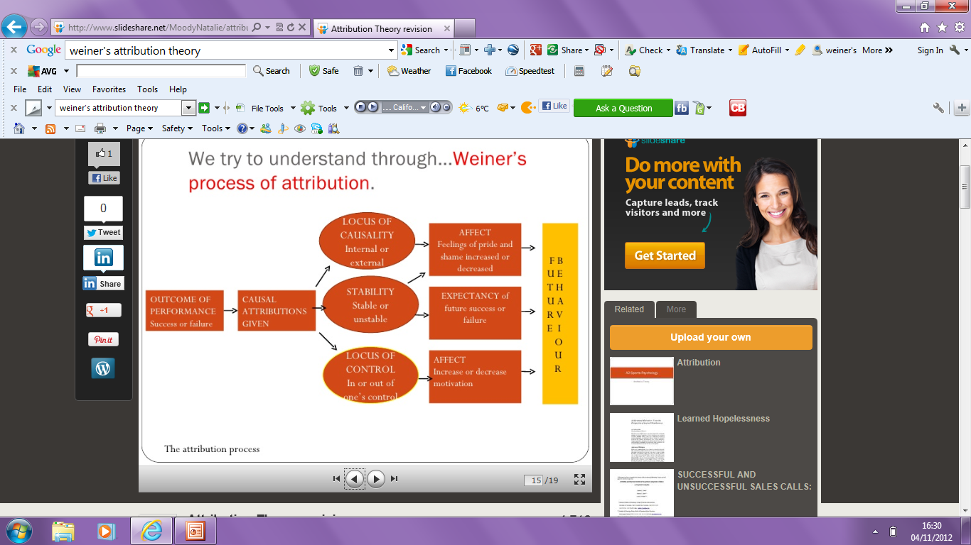

Slide 18
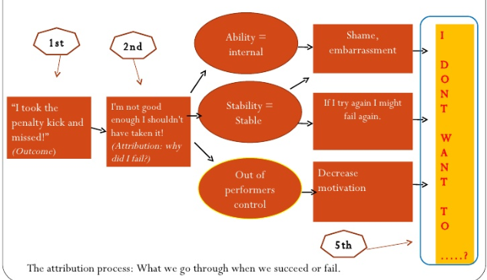
Sporting example:

Slide 19
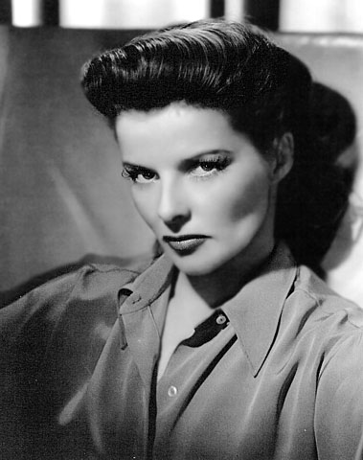
We are taught you must blame your father, your sisters, your brothers, the school, the teachers - but never blame yourself. It's never your fault. But it's always your fault, because if you wanted to change you're the one who has got to change.
Katharine Hepburn

Slide 20

Shallow men believe in luck. Strong men believe in cause and effect.
Ralph Waldo Emerson

