Slide 1
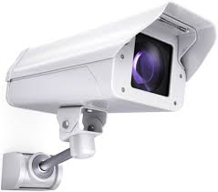
C apitel Letters
C overed bullet points?
T enses
V erbs (word order & conjugation)

