Slide 1
Grammar Entension

Slide 2
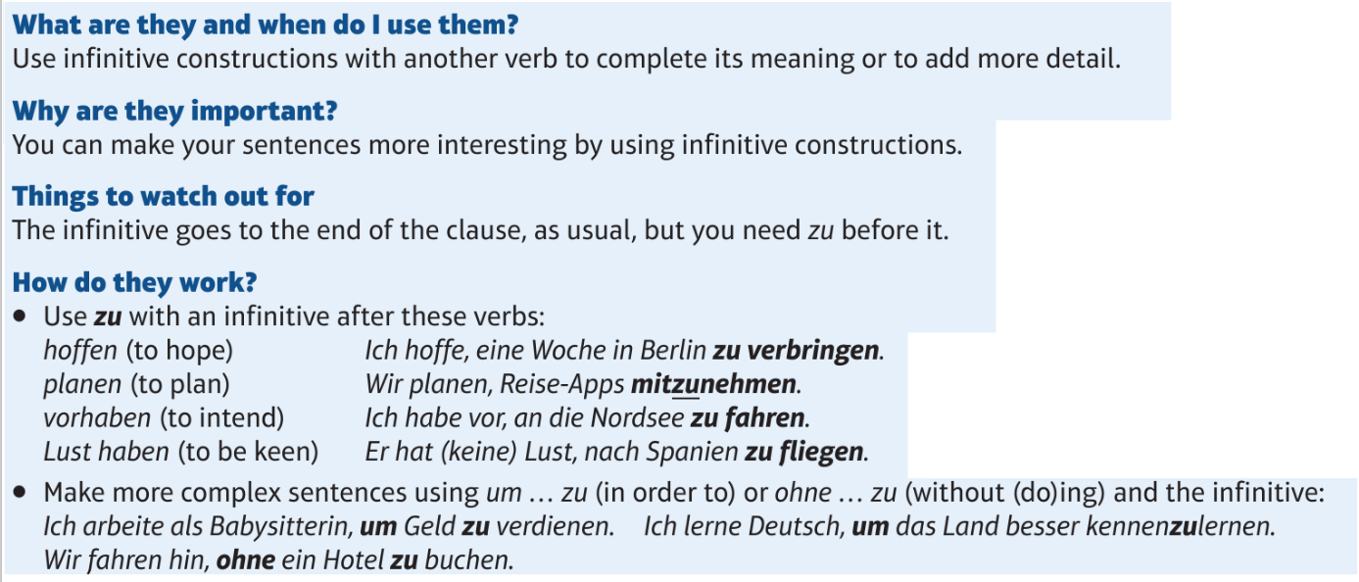
Infinitive Constructions

Slide 3
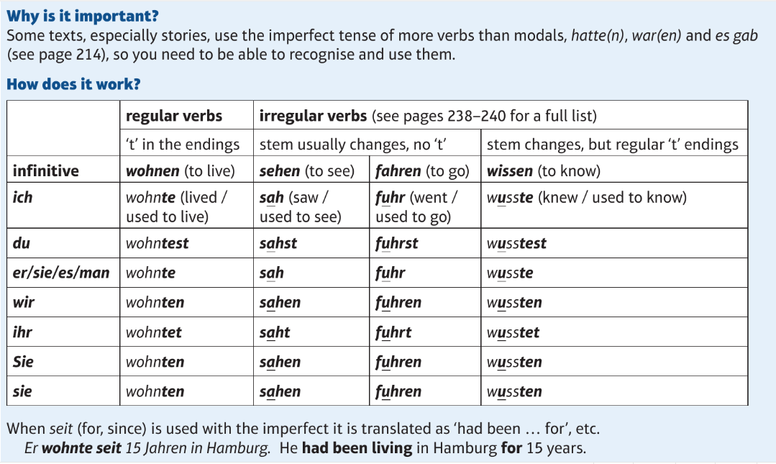
Imperfect Tense 2

Slide 4
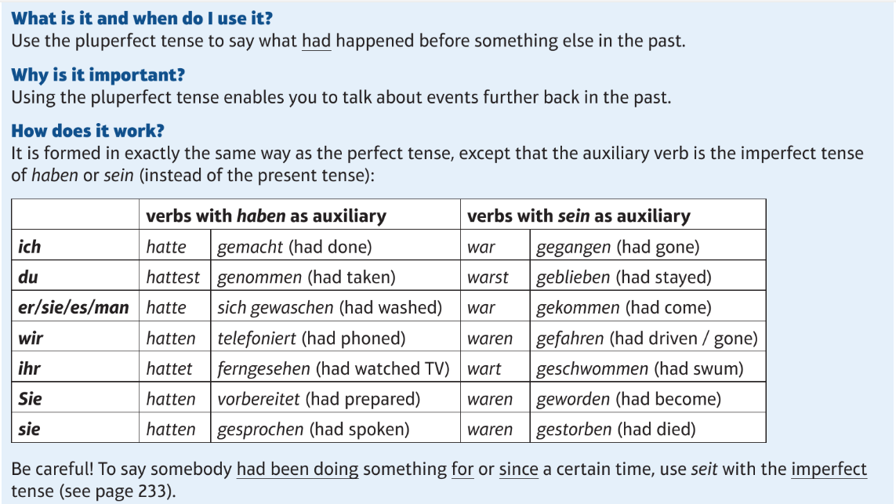
Pluperfect

Slide 5
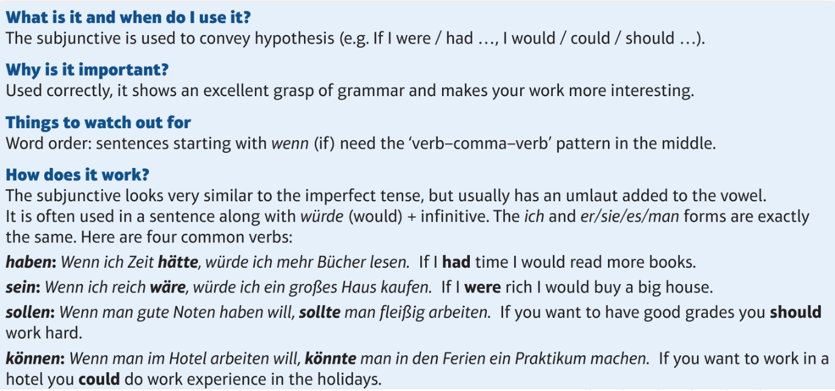
Subjunctive

Slide 6
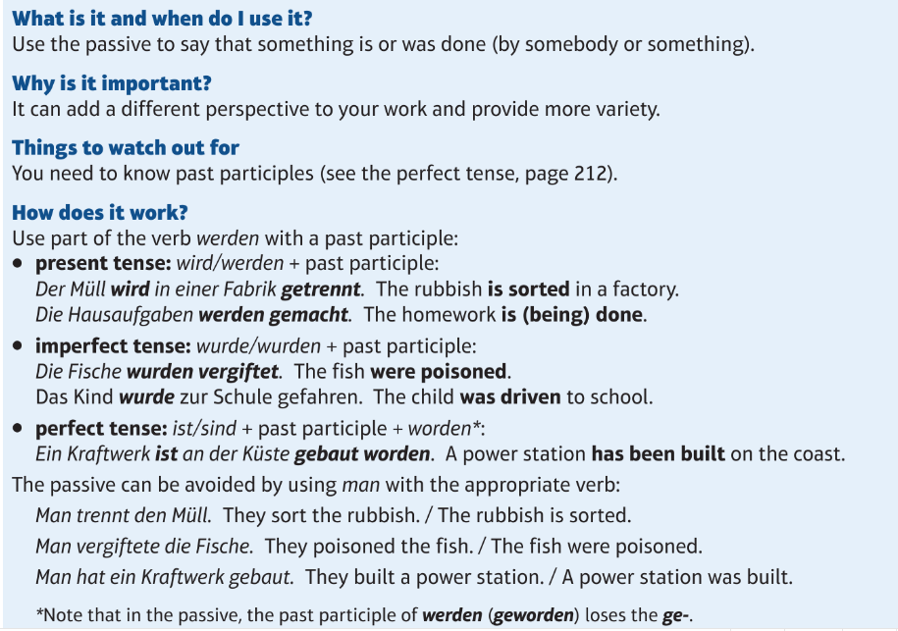
Passive

