Slide 1
Speaking Exam
Foundation vs Higher
Timings

Slide 2
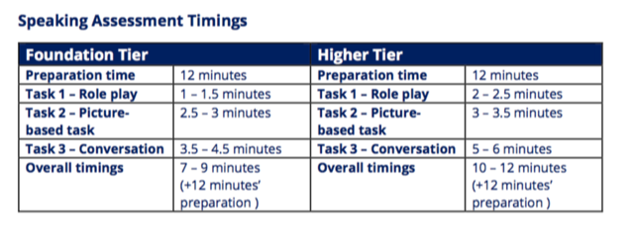

Slide 3
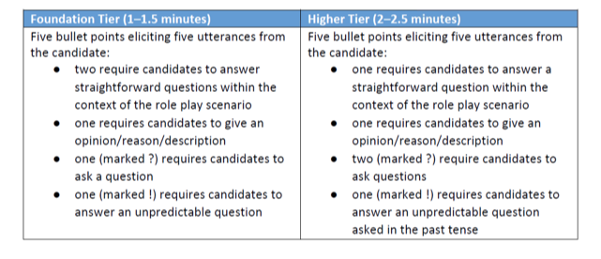
Role Play

Slide 4
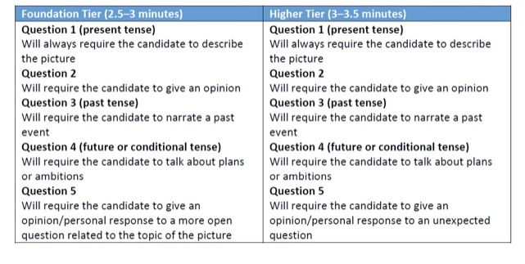
Picture

Slide 5
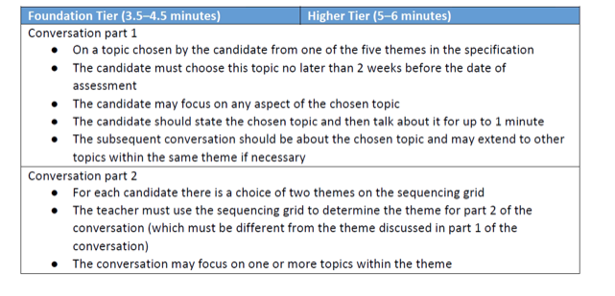
Conversation x2

