Slide 1
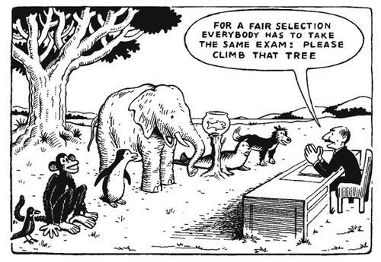
Notes:
Sure you’ve all seen this / something like this before. Personal Best actually the secondary motto at my old school.

Slide 2
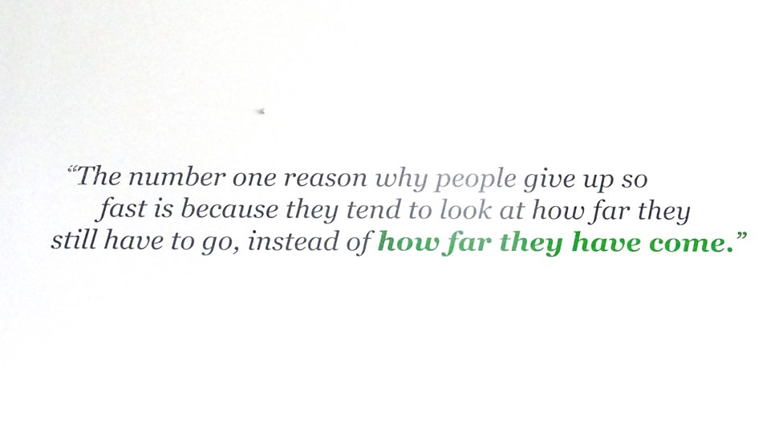
Notes:
Sometimes a block on even getting started.

Slide 3
1867 - Dr. William G. Bonwill invented the dental mallet.
1883 - Oscar Hammerstein patented the first cigar-rolling machine.
Notes:
Because I’m a history teacher, thought I’d look and see if there was anything inspiring for you that happened on this day in history. I found these….

Slide 4
1997 - In Ireland, divorce became legal.
1998 - Britain's House of Lords agreed to give a monarch's first-born daughter the same claim to the throne as any first-born son. This was the end to 1,000 years of male preference.
Notes:
This was as good as it got and, for some, actually major steps / advances. Got me thinking that Personal Best takes many forms

Slide 5
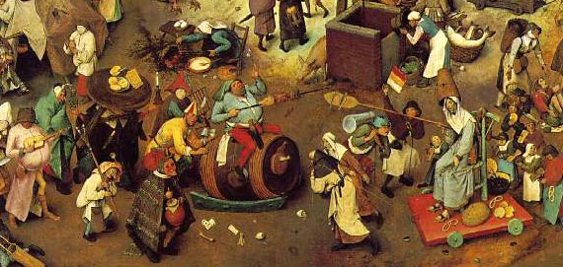
Notes:
Anyone know what this depicts / who painted it? Pieter Bruegel the Elder: The Fight Between Carnival and Lent (detail), 1559

Slide 6
Link with theme is we’re entering a time of self-reflection
Not going to go into too much detail as know you get meaning of Lent and Easter assemblies etc but.
Significance of lent
Pancake flipping contest?

Slide 7
The most common things being given up for Lent in 2016 are:
1. Chocolate
2. Social Networking
3. Alcohol
4. Twitter
5. Facebook
6. School
7. Meat
8. Sweets
9. Coffee
10. Fizzy drinks
Certain vices like alcohol, swearing and sugary drinks nearly always feature in the list - which is compiled every year - but trends and news events do influence people's choices.
In 2013, giving up "twerking" reached 34 but had fallen out of the top 100 a year later, the International Business Times reports.
Similarly "horse meat" was a new joke entrance in 2013 but has since disappeared completely.

Slide 8
Giving Up Something, Or Not Giving Up Something, for Lent
By William B. Bradshaw
And now, finally to my proposal of what all of us could and should give up during the Lenten Season. In recent years, the emphasis on giving up something during Lent has gradually been changing to focusing on positive behavioral changes. My proposal for the Lenten season is in keeping with this new trend.
I propose giving up the practice of focusing on the faults of other people and, instead, looking for their good qualities.
I am not suggesting that we just suppose that everyone around us can be trusted and we need not worry about our personal safety or the security of personal belongings. That would be foolish. I am referring to our fascination with reading, hearing, and talking about the bad, the ugly, the unsavory.
All newscasts that I am aware of start out with murders, thefts, sexual abuses, ISIS executions, fires, wrecks, divorces of famous people, and other sad situations. In most newspapers, the lead stories usually deal with shocking and tragic events. As the old newsroom saying goes, “If it bleeds, it leads.” But it doesn’t have to be that way. My proposal for Lent is that we have a major change in attitude.
How many times at the local coffee shop do we overhear people say: “Just wait until I tell you about the most wonderful thing that happened to me this morning”; or “I’m so excited about the extraordinary way our boss treats us”; or “Wait until I tell you about the superb way our neighbor treats his wife”; or “Our neighbors have the most well-behaved teenagers”; or “My husband does the most marvelous things for me”; or “The government is being so careful with how it spends our tax dollars”; and so forth. We seldom hear comments like that. Instead, we hear about the immoral, unfortunate, and sad things.
But regardless of how miserable people can be, it is usually possible to find some good in them. The same holds true with tragic events: usually we can find something good to come out of them.
By giving up our inclination to find fault with others, perhaps other people will reciprocate by treating us in the same way. That could make all of us a lot happier and life more productive. Let’s all of us—Christians of all varieties—give it a try during this Lenten Season. And it wouldn’t hurt for nonbelievers to join in.
For those of you who have an aversion to being positive, I refer you to Confucius (551 BC-479 BC), the Chinese philosopher, teacher, and political figure remembered for his popular statements of principle. Confucius says: “When you have faults, do not be afraid to abandon them.”
Follow William B. Bradshaw on Twitter:

Slide 9
