Slide 1
Changing Places
Relationships and connections

Slide 2
What you need to know: content
The demographic, socio-economic and cultural characteristics of places as exemplified by the 'home' place (this may be a locality, neighbourhood or a small community) and at least one further contrasting place
Factors (shifting flows of and connections between people, resources, money and investment and ideas) that have shaped and continue to shape the characteristics of place at all scales from local to global, including MNC fast-food chains
The way in which continuity and change of these local to global factors affect learner's own lives and the lives of others
As exam success will depend on you being able to make copious reference to your home place it would be helpful to start to keep work relating to your home place together

Slide 3
What you need to know: specialised concepts
Adaptation – the ability to respond to changing events and to reduce current and future vulnerability to change
Attachment – the linkages between individuals and places
Globalisation – impact of world development on nations, regions and localities
Identity – how people view changing places from different perspectives and experiences
Inequality – social inequalities between people and places: income and wealth inequality as a threat to society
Interdependence – links between the economy and society: relations of mutual dependence and interdependence are worldwide and part of the world economy, trade, communications and production
Representation – how places are portrayed by formal and informal agencies: people represent what they see and experience; how people are represented in a political sense; how place is represented in literature, art and the media
Sustainability – linked to rebranding, marketing and place making
Thresholds – the minimum demand or population needed to support the provision of a good or service: the tipping point for change within places.

Slide 4
What do Geographers mean by ‘place’?
Why do we need to know?
“Geography is the study of Earth's landscapes, peoples, places and environments”
Royal Geographical Society
A definition:
“A portion of geographic space whose identity is viewed as being distinctive in some way”
…but how big?
“A distinctive locality at a geographical scale somewhere between a street and a city or region”

Slide 5
A Geographical idea of place
For A Level Geography, a place has:
A physical site
A boundary or edge
A cultural landscape – with landmarks
An economic function
People who live and/or work there, use it, engage with it…
Connections with other places (e.g. inputs/outputs…)

Slide 6
How do Geographers describe places?
Use of key words…see handout

Slide 7
What makes places distinct?
All places have stories comprised of many different chapters
Each chapter derives from historical periods of varying lengths of time
In each chapter there are different sets of networks and connections with other places
Layers build up and the accumulated history is visible in a place’s cultural landscape
How would you categorise your home place?
Does it have identity, personality, a unique location?
Where are its edges?
List all the things that make it distinct
Try and identify some of the different historical chapters
How is it changing?

Slide 8
What makes places distinct?
Read the handout about Arundel in West Sussex and the Lake District
How is Arundel similar to and different from your home place?
How could you categorise these in a geographical way?

Slide 9
What makes places distinct?
What are the socio-economic and demographic characteristics of your ‘home’ place? How are these characteristics represented using maps and statistical data? What impressions do you get from these sources? Do they tell the whole story about your ‘home’ place?
The Office for National Statistics Neighbourhood Statistics (ONS) website “contains a wealth of Official Statistics, including data from the 2001 and 2011 Censuses”: www.neighbourhood.statistics.gov.uk/dissemination
Other websites use the ONS data too, but also compile data from other sources e.g.:
CheckMyStreet: https://www.checkmystreet.co.uk/
StreetCheck: https://www.streetcheck.co.uk/
UK Local Area: http://www.uklocalarea.com/
Zoopla: http://www.zoopla.co.uk/ and Rightmove: http://www.rightmove.co.uk/ are a little more narrow in their focus…

Slide 10
Continuity and Change
In some ways, places can remain virtually the same over long periods of time – and in other ways, change significantly in a matter of years. Different people will have different views and feelings about this continuity and change
Read the section about John Rebanks’ memories of life in the Lake District
Why do different people have different views of a place? What does the extract from James Rebank’s book, The Shepherd’s Life, suggest?
Can you identify or suggest technological, economic, demographic and political factors that have brought about the changes noted by Rebanks?
What things have remained the same in your ‘home’ place.
Look at the article about continuity and change in a contrasting place and do the activities.

Slide 11
Factors that change places
Handout
NB If you are struggling to find information about the factors affecting the changing identity of your ‘home’ place, then you might want to use Salisbury.
There’s quite a good Wikipedia entry – though there’s a heavy focus on the cathedral, etc…
A very detailed history of various aspects of Salisbury life up to 1962 can be found here: http://www.british-history.ac.uk/vch/wilts/vol6
Details about buildings of note: http://h2g2.com/approved_entry/A26151734

Slide 12
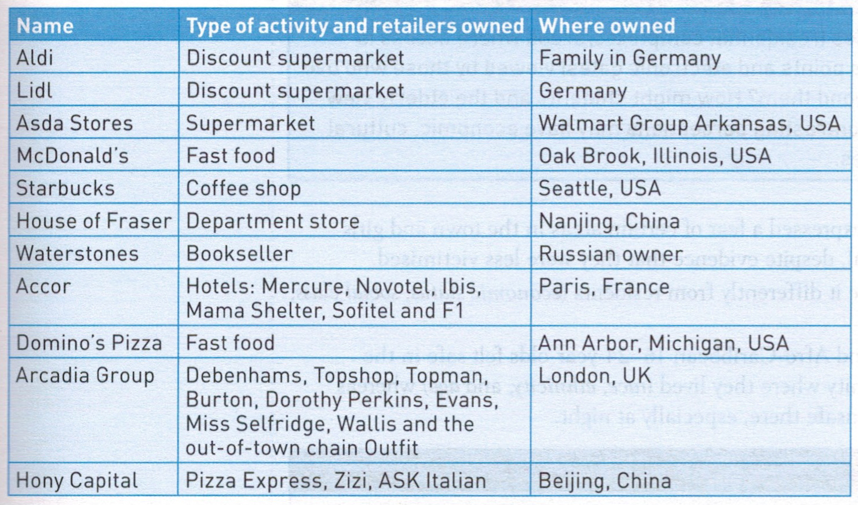
Factors that change places
Events and decisions at a global level can affect people at a local level

