Slide 1
Changing Places
1.3.8: Rural management and the challenges of continuity and change

Slide 2
What you need to know: content
Managing rural change and inequality in diverse communities including issues of housing, transport and service provision, including broadband provision
On-going challenges in rural places where regeneration / rebranding are absent or have failed or have created conflict
New challenges of managing change in some rural communities associated with counter-urbanisation and second home ownership, and possible actions

Slide 3
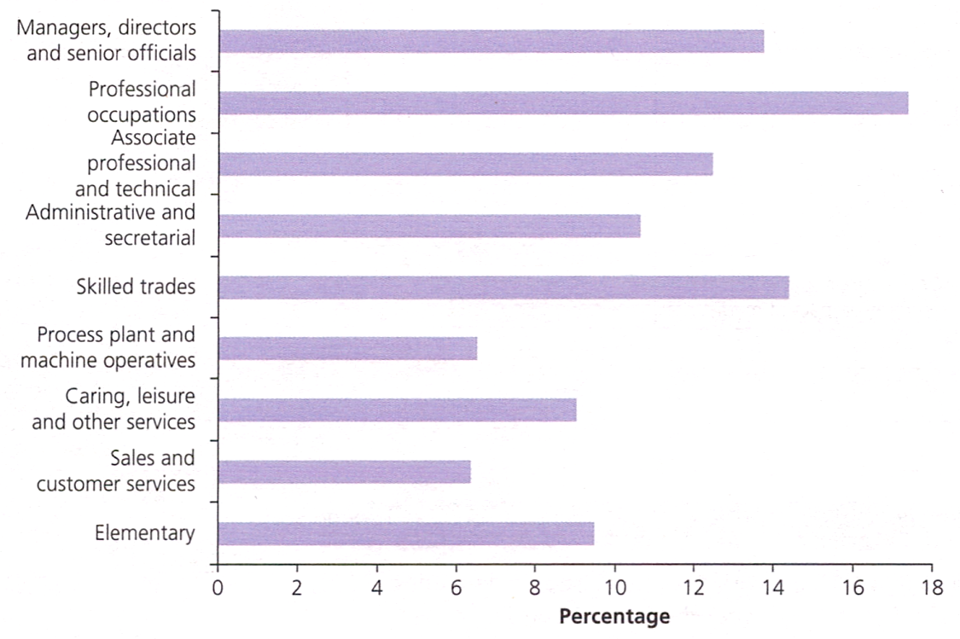
Managing Rural Change
What are the processes of change affecting rural areas?
Counter-urbanisation
= the movement of people from urban to rural (and large urban to small urban)
Reasons?
Wealthy moving from deprived urban (e.g. Burnley in Lancs) to wealthy rural (e.g. Ribble Valley) – impacts on these urban areas?
[Graph] c. 1/3 employed in high-status, high-salary jobs
Majority of migrants to rural areas come from urban, but in parts of Wales & Scotland, ¼ of migrants are rural-rural and often higher earners than urban-rural migrants
Main impacts on areas fringing (major) urban settlements, esp. where transport links good/fast encouraging commuting (e.g. M4/ M3/M20/M40 or high speed rail…)
Occupations of rural residents aged 16-74 in England & Wales, 2011

Slide 4
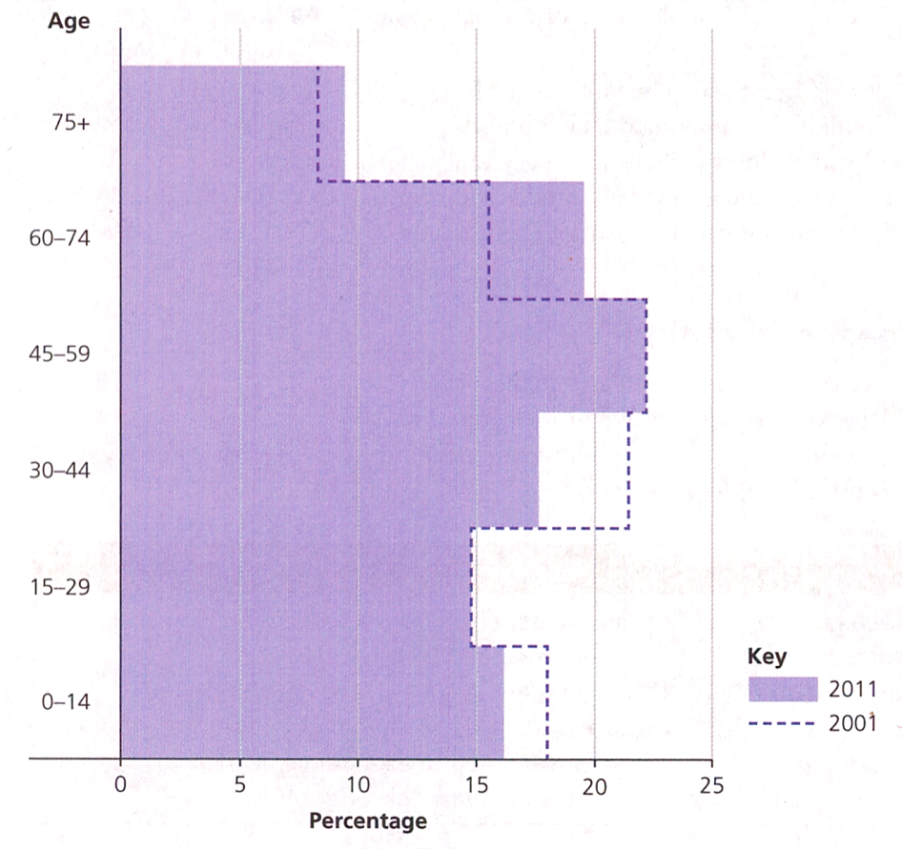
Managing Rural Change
What are the processes of change affecting rural areas?
Demographic change – ageing populations
Mean age of rural residents: 42 (2001), 45 (2011)
14% of all one-person households in rural areas were aged 65+ (2011)
Reasons?
Wealthy ‘baby-boomers’ retiring to countryside
Many returning to place of birth – estimated to be as high as 18% of all movements into rural Wales
Age profile of resident population of rural areas,
2001 and 2011

Slide 5
Managing Rural Change
Issues?
Increase in second-home ownership – what and why?
Decline in / changed focus of service provision esp. health/transport/education/retailing – what/why?
The above can lead to:
Conflict between newcomers with urban mentality and long-term residents with rural mentality
Increased inequality between urban/rural and between wealthy newcomers/less wealthy long-term residents
Rural poverty, deprivation & exclusion (including in-work poverty)
With a partner discuss why the above problems can arise in rural areas
These issues will vary in relation to proximity to major urban settlements

Slide 6
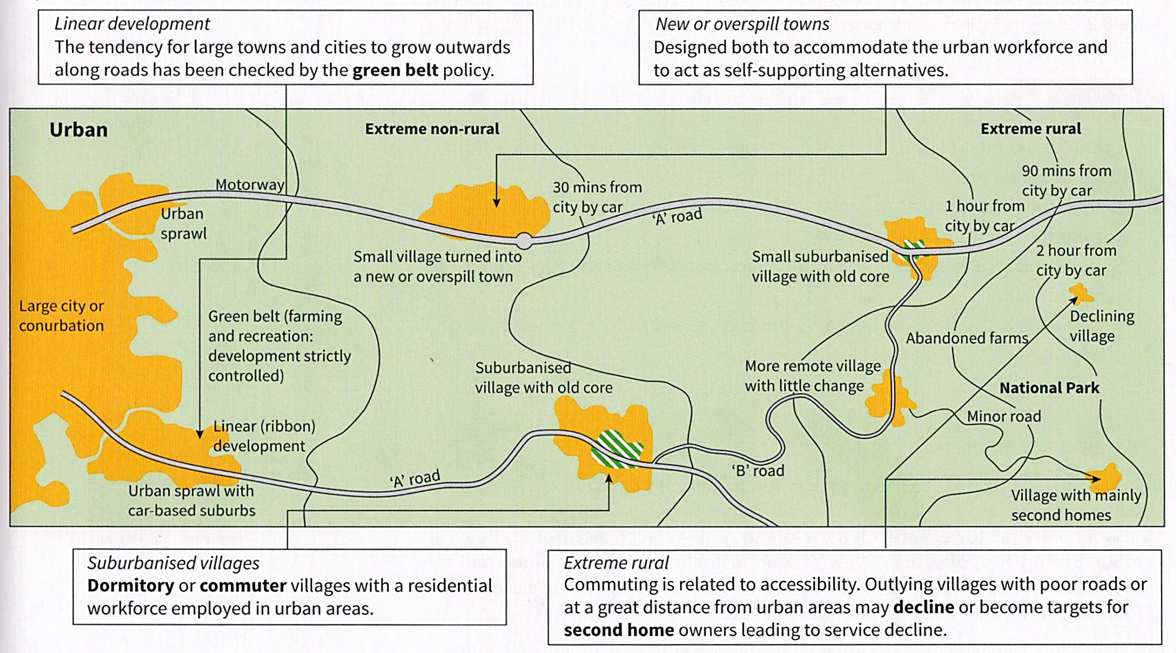
1
2
3
4
Come up with some suitable annotations for each of the text boxes to suggest why these features have been identified.

Slide 7
Managing rural change & inequality in diverse communities
Issue: Second-homes
Scale:
Cornwall has greatest number of holiday homes (23k) - 11.2% of houses in Cornwall in 2011 did not have a usual resident, and the vast majority of these will be second and holiday homes (https://www.cornwall.gov.uk/media/17171641/bn11-second-and-holiday-homes-v2-dec-15.pdf)
Other concentrations: Gwynedd (7.8k); North Norfolk (4.8k); South Hams, Devon (3.7k); South Lakeland (4.7k)
St Ives, Cornwall (pop >11k): >25% houses in town and district are second homes – in May 2016 > 80% of residents voted for a ban on new homes being sold as second-homes (decision upheld by High Court when challenged by a Penzance architectural firm)…a number of Cornish villages are considering similar bans… opportunities for further reading…

Slide 8
Managing rural change & inequality in diverse communities
Issue: Second-homes
Negative Impacts:
Reduces availability and affordability of housing for local residents especially those on low incomes
In five parishes in Cornwall, where second homes accounted for > 35% of all housing, the average house price was 87% above the Cornwall average (46% where second home ownership 20-30% and 23% where second home ownership 10-20%). (https://www.cornwall.gov.uk/media/17171641/bn11-second-and-holiday-homes-v2-dec-15.pdf)
Holiday homes not always occupied, so can have serious impact on viability of services – why?
Positive Impacts:
Can contribute to the conservation of the rural housing stock
Bring empty and redundant properties back into use
Enhance the visual quality of rural areas
Which do you consider to be the more important impacts – and why?

Slide 9
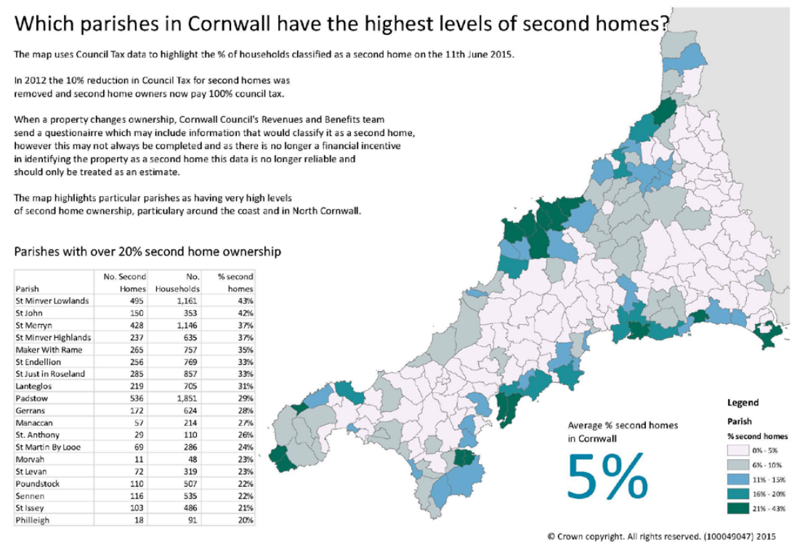
What type of map is this?
Comment on the pattern of second home ownership in Cornwall.
Suggest reasons for this pattern.
What issues might this pattern produce?
(https://www.cornwall.gov.uk/media/17171641/bn11-second-and-holiday-homes-v2-dec-15.pdf)

Slide 10
Managing rural change & inequality in diverse communities
Issue: Second-homes
Further reading:
https://www.theguardian.com/society/2016/may/31/uk-readers-on-the-problem-of-second-homes
http://www.lakedistrict.gov.uk/__data/assets/pdf_file/0005/410873/Review-of-second-home-data-and-assessment-of-effects-on-rural-communities.pdf
Identify some of the conflicts described in these resources
How are these conflicts being addressed?
Why do you think some councils/authorities have felt the need to manage/control second home ownership?
Fieldwork opportunities?

Slide 11
Managing rural change & inequality in diverse communities
Issue: Transport and service provision, including broadband
Rural dwellers travel further than urban dwellers and mainly by car (59% of journeys)
11% don’t have access to a car (28% in urban areas) – reasons for these differences?
1/3 rural residents find public transport inadequate (irregular service, timetable doesn’t match requirements…) – why is this more likely/an issue in rural areas?
How and why might these be exacerbated by rural populations ageing?

Slide 12
Managing rural change & inequality in diverse communities
Issue: Transport and service provision, including broadband
Despite ageing populations, rural dwellers are generally healthier now than in past (why?)
But 20% of rural residents live > 4km from a GP surgery (c.f. 2% in urban areas).
45% of rural households are > 8km from a hospital compared (c.f. 3% of urban households)
An estimated 300-500 village shops close each year
Loss of Post Offices and pubs as well as health services and primary schools (latter as result of ageing population) – Why are these services important?
Cost of goods and services in rural areas often higher than in urban areas – explain
Some chains have opened village stores (e.g. Coop, BF) but spending doesn’t stay in the village – why not, and why is this an issue?
Notes:
Health data: http://www.rsnonline.org.uk/services/rural-idyll-masks-poor-rural-health

Slide 13
Managing rural change & inequality in diverse communities
Issue: Transport and service provision, including broadband
Study by the British Chambers of Commerce (published 27/03/17) shows that firms in rural areas are at least twice as likely to have unreliable connections (30%) as those in towns (15%), inner cities (13%), and suburban areas (12%).
243 rural banks closed in 2014 due to success of online banking: a double whammy for rural areas where access to broadband is often limited (see above + Digital Exclusion in previous lesson)
How can these lead to rural poverty/deprivation/exclusion?
Notes:
BCC study: http://www.rsnonline.org.uk/services/rural-businesses-lack-reliable-broadband-%E2%80%93-study

Slide 14
Managing rural change & inequality in diverse communities
Issue: Transport and service provision, including broadband
Further reading:
Rural Services Network (various articles/links): http://www.rsnonline.org.uk/
The State of Rural Services 2016 (Summary) Report by Rural England (Independent Research, Networking and Information Exchange across Rural England):
https://ruralengland.org/wp-content/uploads/2017/01/SORS-2016-summary-report.pdf
Superfast Broadband in Blaenau Ffestiniog:
http://gov.wales/newsroom/science-and-technology/2016/11001754/?lang=en
New health centre in Blaenau Ffestiniog:
http://gov.wales/newsroom/health-and-social-services/2016/160324centre/?lang=en
Which do you consider to be the more important impacts – and why?

Slide 15
Ongoing Challenges
Where regeneration/rebranding absent/has failed/has created conflict
Many of the challenges facing small rural communities are being addressed by the communities themselves, e.g. community-run shops (average of 22 have opened per year since 2010) often staffed by volunteers (not always successfully – e.g. Dinton)
Examples of the above in Blaenau Ffestiniog?
Are there opportunities for second home ownership?
GISDA – Youth Centre at Blaenau Ffestiniog

Slide 16
Impacts of Rural Change
Use your class notes, notes from reading and the handouts to identify economic and social impacts of counterurbanisation.
Which do you think are some of the more and least important ones? Justify your ideas.

Slide 17
Managing Rural Change
Bans/restrictions on purchase of second homes by non-locals (e.g. St Ives)
Factoring-in % second home ownership when identifying housing needs in rural areas
Part-ownership schemes with housing associations (e.g. Holsworthy Community Property Trust, Devon)
Community property development schemes (e.g. Lindisfarne), such as Community Land Trusts (CLTs) – there’s one for Sixpenny Handley and Shrewton
Since 1 April 2013 councils are no longer obliged to apply a 10% reduction on Council Tax for second-homes. This additional revenue could be ring-fencing to be used directly for community improvement
Increase Council Tax on second homes (300%?)
Remove Capital Gains Tax breaks that have encouraged second-home ownership
Pressure groups and networks to help rural communities, e.g. Rural Services Network
New legislation (e.g. the Buses Bill)
Grants e.g. Community Transport Grant (Dorset): up to £5000 (50% match-funding) to help communities set up and operate their own rural transport schemes (vehicle purchase, IT, marketing, and training of staff/volunteers)
Notes:
http://www.rsnonline.org.uk/services/funds-available-for-dorset-rural-transport

Slide 18
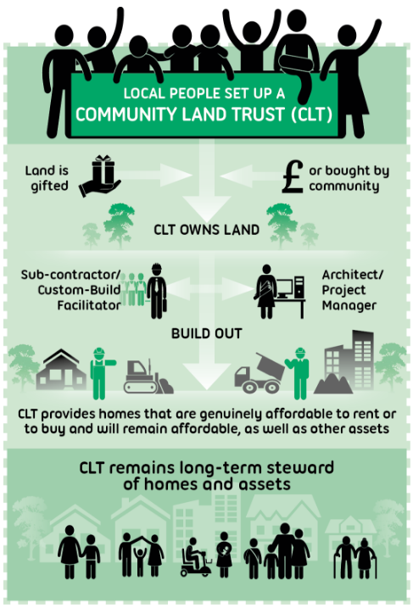
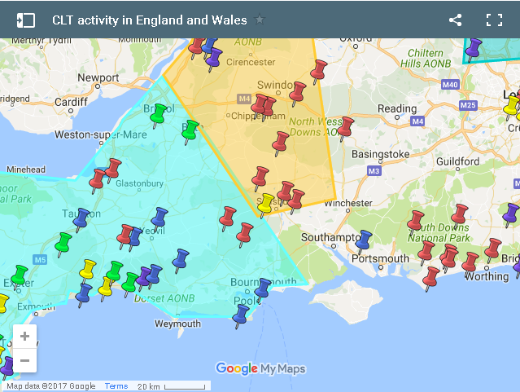
Community Land Trusts
http://www.communitylandtrusts.org.uk/

Slide 19
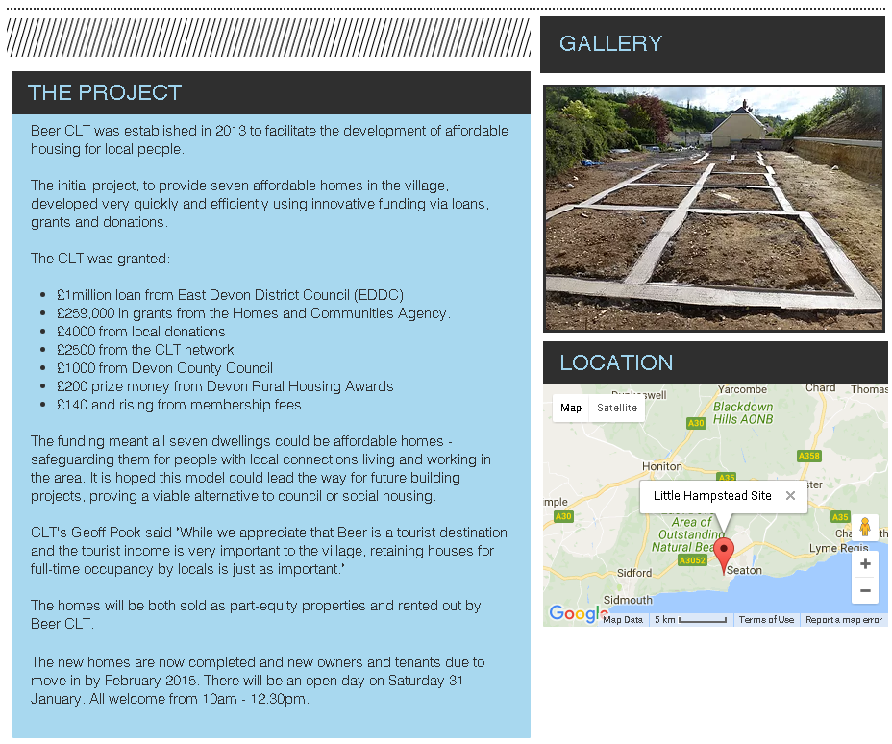
Beer CLT, East Devon
http://www.beerclt.org/

