Slide 1
Assessment
Narrative Writing: Write the opening to a novel or a short story inspired by Charles Dickens

Slide 2
How does Dickens appeal to the senses in this description?
Sight
Smell
Sound
Touch
What other techniques does he use?

Slide 3
Varying Sentences
Simple Sentences – a sentence that contains one clause:
My hands were shaking.
Compound Sentences – a sentence that joins two main clauses together using a connective:
My hands were shaking and a bead of sweat ran down my cheek.
Complex Sentences – a sentence that contains two clauses however the subordinate clause is reliant on the main clause:
Although my hands were shaking and sweat ran down my cheek, I forced myself to continue

Slide 4
Varying Sentence Openings
Start with a verb (“-ing”)
Smashing against the bottom of the rocks, the waves sent white foam shooting into the air.
Start with “as” or “while” (prepositions – you can also use prepositions like under, behind, before etc …)
As the skies darkened, raindrops began to pour down.
While the gulls screamed overhead, a lonely dog raced along the wet sand.
Start with an adjective
Grotesque images danced before my eyes.
Start with an adverb
Silently, he crept towards the exit

Slide 5
Notes:
Pdf of this in the folder

Slide 6
Moral messages
What moral messages could you include in a story set in the Victorian era?
Would these messages differ from the messages Dickens might wish to convey to a modern audience? If so, why? If not, why not?

Slide 7
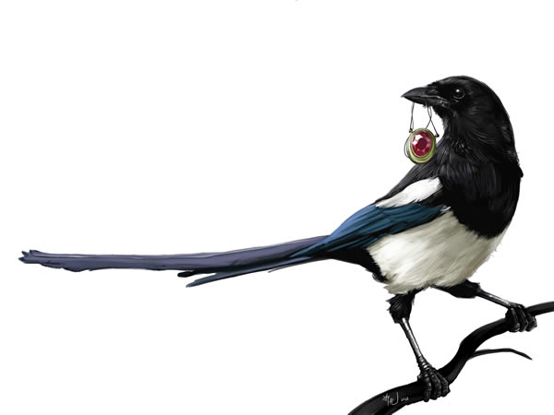
Magpie interesting words or phrases from the extracts studied
Consider interesting words and phrases that you could incorporate into your own Dickensian style tale
Divide the words into those describing
themes, character and setting

Slide 8
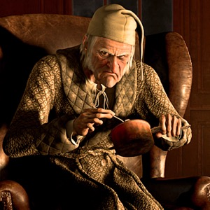
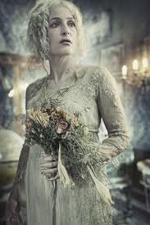
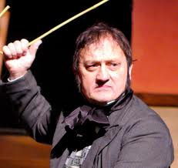
HW: Create your own Victorian character on paper
Consider:
Personality- good & bad points
Appearance- adult or child
Job/role
Family/relationships
What sophisticated & Dickensian vocabulary could you use to describe them? Include a picture

Slide 9
Write a paragraph describing your character
What sophisticated vocabulary & language/literary techniques could you use to describe them?

Slide 10
Dickens' style of writing
Dickens was once a newspaper reporter; his descriptions show a wonderful eye for detail.
Great Expectations had to fill ten columns of All Year Round each week, for 36 weeks. Dickens' style of writing therefore 'filled space', and included lots of repetition and long lists.
Dickens loved words, and liked to produce a 'pretty piece of writing' in different styles. He included lots of powerful adjectives, and is famous for his use of metaphors and similes. His descriptions often present people, their surroundings, and even the weather, in ways which reinforce each other, so that a certain 'feel' is built up through the passage.
From the early 1850s, Dickens gave public readings of his novels. His writing is rhythmic and designed to be read out loud. He loved to make young women in his audience laugh or weep, so many of his characters are either hilariously comic or heart-breakingly sentimental.
Dickens was a master of dialect and used what is called 'substandard' speech to add to the picture of a character he was building up.
In 1857, Dickens wrote and acted in a play called The Frozen Deep. Critics believe this helped him to write the brilliant sections of dialogue in Great Expectations. Dickens is famous for his exaggeration, which critics have linked to his love of the stage.

Slide 11
Plot Structure Basics
Plot is the arrangement of events in a literary work.!
There are six main components to plot, and you can understand them better if you think of them in a figure like this:
Climax
Rising Action
Falling Action
Exposition
Resolution
Conflict is the problem at the root of the story.
Map the plot of “The Black Veil” onto this structure.
Notes:
Handout of this slide available in folder- or you could ask them to draw the diagram

Slide 12
Elements of Plot
Exposition – The situation is explained and characters introduced.
Rising Action – Events moving toward a high point of action.
Conflict – A struggle develops between two opposing forces.
Climax – Events reach a turning point.
Falling Action – events following the climax that lead to the ending.
Resolution – The outcome of the conflict is settled.
From Prentice Hall’s Timeless Voices, Timeless Themes Bronze Level p. 665

Slide 13
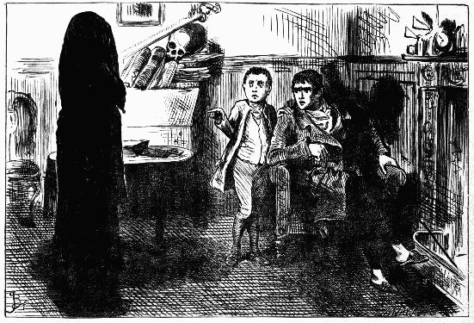
Technique focus: pathetic fallacy and foreshadowing
Read the opening to “A Black Veil”
How does Dickens use language to create tension and suspense?
Identify 3 quotations that add to the mysterious and sinister atmosphere; “explode” them
Notes:
See next slide for guidelines about exploding quotations

Slide 14
Structure: punctuation and paragraphing
How does the use of dashes and exclamation marks in the story show the emotions of the characters?
Comment on the effect of the variety of paragraph lengths at moments of tension within the story
How effective are the first and last lines of the story? Justify your response
with close reference to the text

Slide 15
Case Study: punctuation for effect.
Effect of the exclamation mark after a minor sentence?
Oh! but he was a tight-fisted hand at the grindstone, Scrooge! a squeezing, wrenching, grasping, scraping, clutching, covetous old sinner! Hard and sharp as flint, from which no steel had ever struck out generous fire; secret, and self-contained, and solitary as an oyster.
Effect of exclamation mark?
Effect of a long list punctuated by commas?
Effect of the semi-colon?
Extract from “A Christmas Carol” by Charles Dickens

Slide 16
Comment on the effects of the punctuation in this passage.
What is the effect of the exclamation marks? Where do they come in the sentence? Why? How do they affect the tone of the text?
What is the effect of the dashes? Think about how smoothly the passage reads. How would it affect the text if they were not there?
True!—nervous—very, very dreadfully nervous I had been and am! but why will you say that I am mad? The disease had sharpened my senses—not destroyed—not dulled them.
Extract from “Tell-Tale Heart” by Edgar Allen Poe

Slide 17
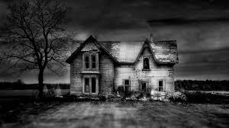
Practising How to write vividly
technique | example
Ellipsis/dashes/ exclamation marks for effect
Appeal to the senses
Short sentence for impact.
Sense of being foreboding
Metaphor/ Simile
Personification
Mood/atmosphere
Show-not-tell
Pathetic fallacy
Emotive language

Slide 18
Planning your own story
Setting
Plot
(Structure)
Characters
Genre
Mood/
atmosphere
Themes/
message
Techniques
What “magpied” vocabulary could you use to create a Dickensian feel to your story?
How will you open and close your narrative?

Slide 20
SPaG

