Slide 1
Charles Dickens: master storyteller
Assessment focus: narrative writing

Slide 2
Which is the most effective opening line? Why?
All happy families are alike; each unhappy family is unhappy in its own way. | Marley was dead, to begin with. There is no doubt whatever about that. | As Gregor Samsa awoke one morning from uneasy dreams he found himself transformed in his bed into a monstrous vermin | It was the best of times, it was the worst of times, it was the age of wisdom, it was the age of foolishness
It was the day my grandmother exploded. | All children, except one, grow up. | The past is a foreign country; they do things differently there. | It was a bright cold day in April, and the clocks were striking thirteen.
What makes an enticing hook at the start of a story?
Notes:
Top to bottom, left to right:
Tolstoy- Anna Karenina
Dickens- A Christmas Carol
Kafka- Metamorphosis
Dickens- A tale of 2 cities
Iain Banks- The Crow Road
Barrie- Peter Pan
Huntley- the Go-between
Orwell-1984

Slide 3

How do good writers make their writing interesting?
Add to your list as we discuss
your ideas
Notes:
Characteristation, description of setting, language, structure, plot, creation of tension/suspense, mood/atmosphere, sentence/paragraph structure etc

Slide 4
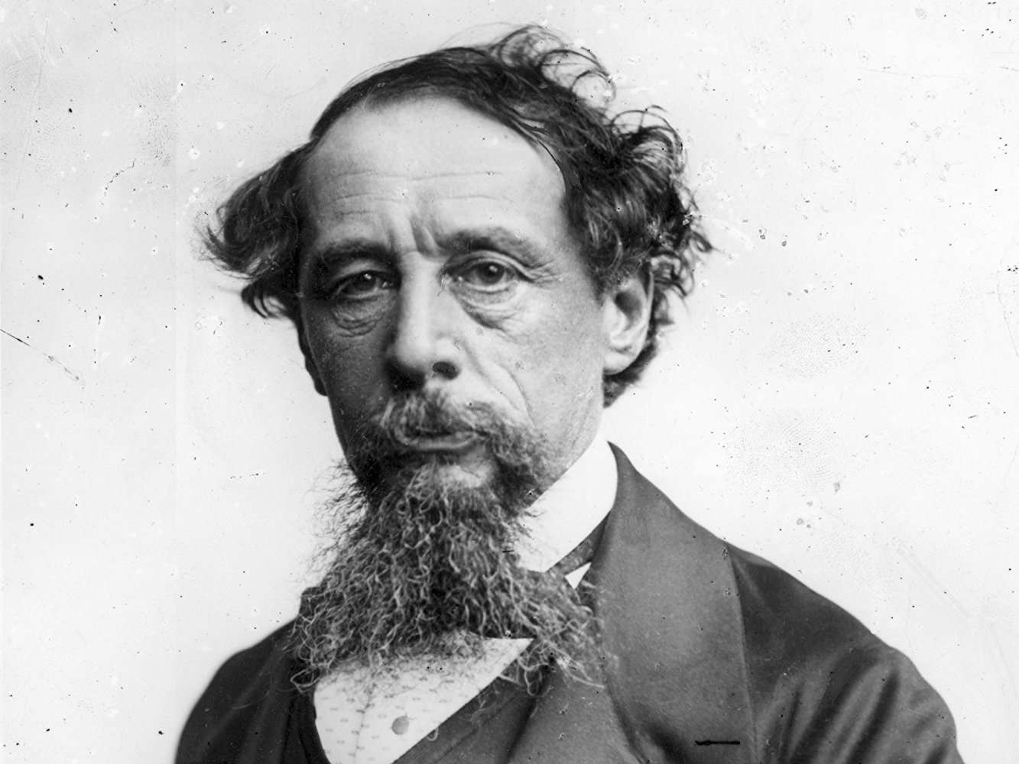
HW: Research Dickens
His childhood
His family
His work
Life in London in
Victorian times
His concerns about the
plight of the poor and
needy
Notes:
Question worksheet available in folder if wanted

Slide 5
How does Dickens appeal to the senses in this description?
Sight
Smell
Sound
Touch
What other techniques does he use?

Slide 6
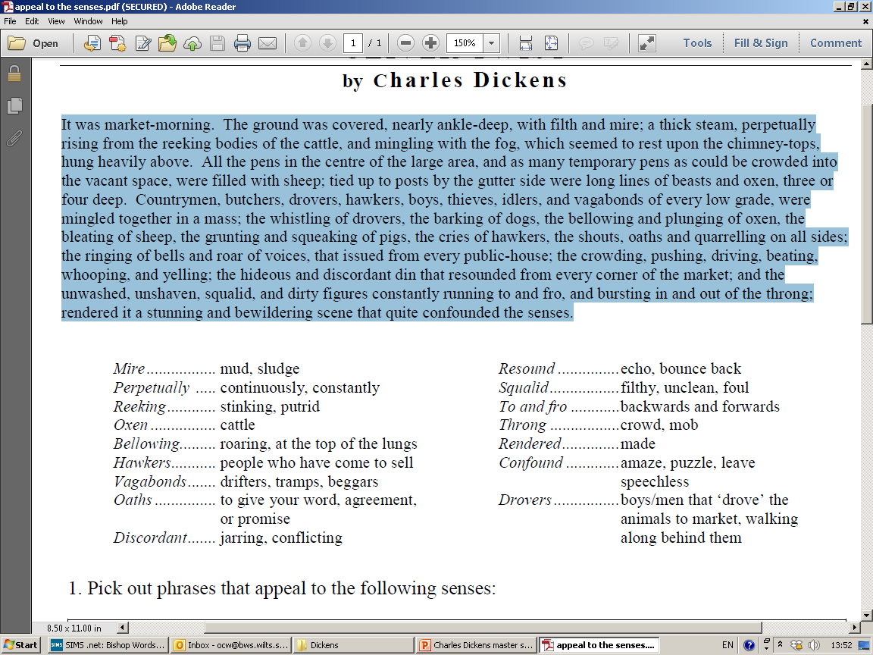

Slide 7
Write 5-6 sentences to appeal to the senses of your reader
Ideas if you’re stuck:
  A Saturday lunchtime in a crowded fast-food restaurant
  A football match
  A beach on August bank holiday weekend
  A music festival
  Banned phrases: (All)I could see/taste/ hear/ feel…
  Challenge: make sure you vary your sentence types/starters

Slide 8
Varying Sentences
Simple Sentences – a sentence that contains one clause:
My hands were shaking.
Compound Sentences – a sentence that joins two main clauses together using a connective:
My hands were shaking and a bead of sweat ran down my cheek.
Complex Sentences – a sentence that contains two clauses however the subordinate clause is reliant on the main clause:
Although my hands were shaking and sweat ran down my cheek, I forced myself to continue

Slide 9
Varying Sentence Openings
Start with a verb (“-ing”)
Smashing against the bottom of the rocks, the waves sent white foam shooting into the air.
Start with “as” or “while” (prepositions – you can also use prepositions like under, behind, before etc …)
As the skies darkened, raindrops began to pour down.
While the gulls screamed overhead, a lonely dog raced along the wet sand.
Start with an adjective
Grotesque images danced before my eyes.
Start with an adverb
Silently, he crept towards the exit

Slide 10
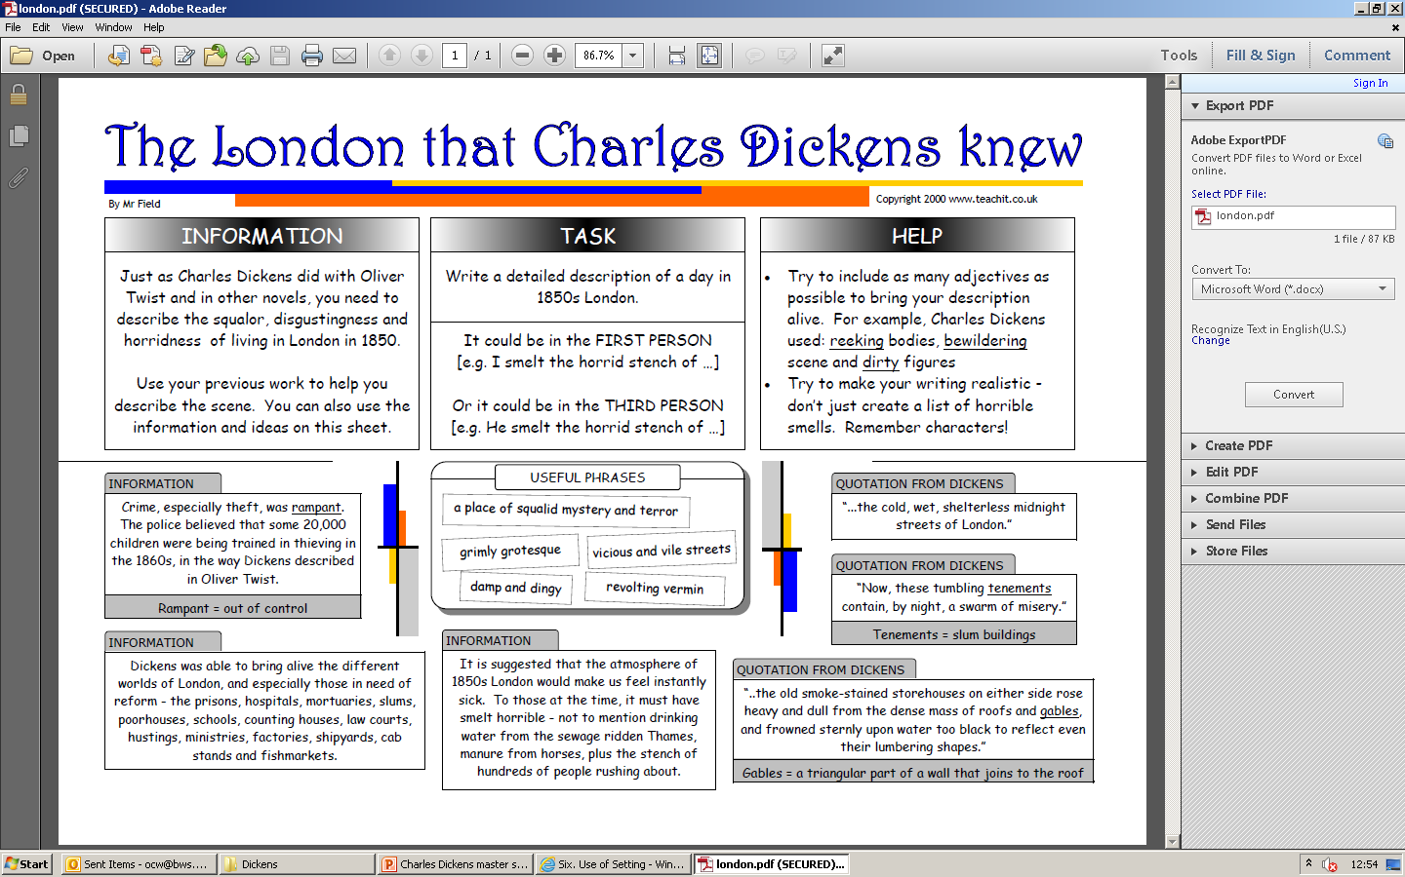
Notes:
Pdf of this in the folder

Slide 11
Read “Christmas at the Cratchits’”
How does Dickens create an atmosphere of warmth and goodwill in this extract from A Christmas Carol?
How could you change the following to create a gloomy and depressing atmosphere?
  “There never was such a goose. Bob said he didn’t believe there ever was such a goose cooked. Its tenderness and flavour, size and cheapness, were the themes of universal admiration. Eked out by apple-sauce and mashed potatoes, it was a sufficient dinner for the whole family; indeed, as Mrs Cratchit said with great delight (surveying one small atom of a bone upon the dish), they hadn’t ate it all at last”
Notes:
Q1- setting, characters’ response to each other, descriptions of food, fire etc

Slide 12
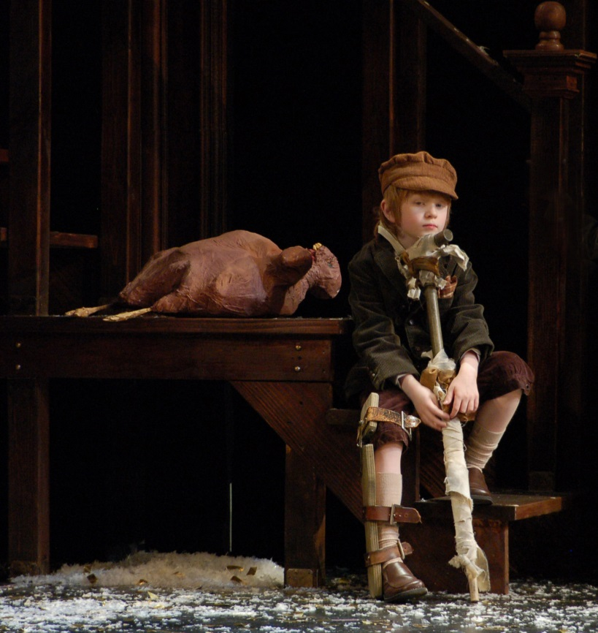
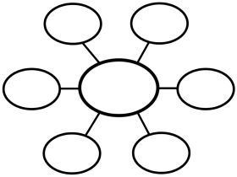
How does Dickens evoke sympathy for Tiny Tim in the reader?

Slide 13
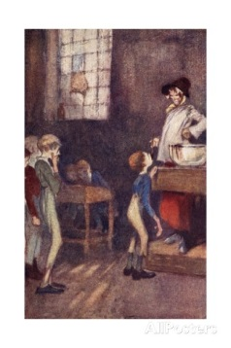
Dickens was concerned with promoting social reform
Read the extract from Nicholas Nickleby “Wackford Squeers: headmaster of Dotheboys Hall”
How is this moral viewpoint evident in the language he uses to describe the situation for the students at Dotheby’s Hall?
How does Dickens use the characters
of Wackford Squeers and Nicholas
Nickleby to exemplify what he thought
needed changing in society?

Slide 14
How does the writer portray the suffering of the pupils in this extract?
But the pupils--the young noblemen! How the last faint traces of hope, the remotest glimmering of any good to be derived from his efforts in this den, faded from the mind of Nicholas as he looked in dismay around! Pale and haggard faces, lank and bony figures, children with the countenances of old men, deformities with irons upon their limbs, boys of stunted growth, and others whose long meagre legs would hardly bear their stooping bodies, all crowded on the view together; there were the bleared eye, the hare-lip, the crooked foot, and every ugliness or distortion that told of unnatural aversion conceived by parents for their offspring, or of young lives which, from the earliest dawn of infancy, had been one horrible endurance of cruelty and neglect. There were little faces which should have been handsome, darkened with the scowl of sullen suffering; there was childhood with the light of its eye quenched, its beauty gone, and its helplessness alone remaining; there were vicious-faced boys, brooding, with leaden eyes, like malefactors in a gaol; and there were young creatures on whom the sins of their frail parents had descended, weeping even for the mercenary nurses they had known, and lonesome even in their loneliness. With every kindly sympathy and affection blasted in its birth, with every young and healthy feeling flogged and starved down, with every revengeful passion that can fester in swollen hearts, eating its evil way to their core in silence, what an incipient Hell was breeding here!

Slide 15

Moral messages
What moral messages could you include in a story set in the Victorian era?
Would these messages differ from the messages Dickens might wish to convey to a modern audience? If so, why? If not, why not?

Slide 16
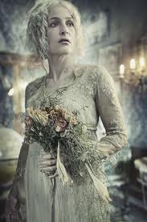
“Broken-hearted vengeance: Miss Havisham”
Focus on the description of Miss Havisham on pp.62-3:
How does Dickens use language to create a positive impression of Miss Havisham?
How is that contrasted with the reality of her appearance?
Comment on the effects on the reader of this quotation: “she sat, corpse-like…the frillings and trimmings on her bridal dress looking like earthy paper” (p.67)

Slide 17
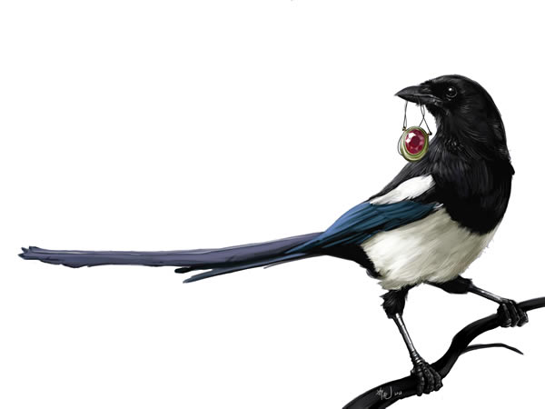
Magpie interesting words or phrases from the extracts studied
Consider interesting words and phrases that you could incorporate into your own Dickensian style tale
Divide the words into those describing
themes, character and setting

Slide 18
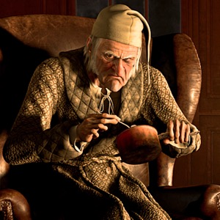
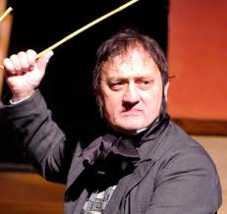
HW: Create your own Victorian character on paper
Consider:
Personality- good & bad points
Appearance- adult or child
Job/role
Family/relationships
What sophisticated & Dickensian vocabulary could you use to describe them? Include a picture

Slide 19
Write a paragraph describing your character
What sophisticated vocabulary & language/literary techniques could you use to describe them?

Slide 20
Magpie interesting words or phrases from the extracts studied
Consider interesting words and phrases that you could incorporate into your own Dickensian style tale
Divide the words into those describing
themes, character and setting

Slide 21
HW: Read the information about life in the workhouse
Answer the questions in the space provided (you will need to print them from the document on Insight)
Notes:
SET ON INSIGHT AND ATTACH THE BOOKLET AS IT IS A LOT OF PAGES TO PRINT OUT! May need 2 HWs

Slide 22
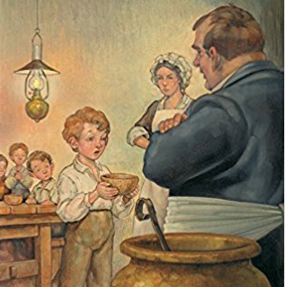
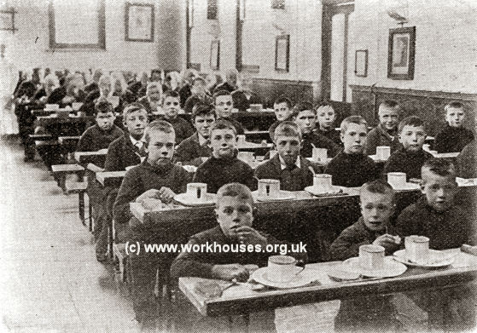
The Poorhouse: Oliver Twist
How does Dickens’ account of Oliver Twist’s experiences compare to the account you read?
Make a list of the ways Oliver’s experiences differ from your childhood
Using sophisticated vocabulary, write a Dickensian description of an aspect of your life that differs from Oliver Twist’s childhood: e.g. home, schooling, employment, access to food

Slide 23
Dickens' style of writing
Dickens was once a newspaper reporter; his descriptions show a wonderful eye for detail.
Great Expectations had to fill ten columns of All Year Round each week, for 36 weeks. Dickens' style of writing therefore 'filled space', and included lots of repetition and long lists.
Dickens loved words, and liked to produce a 'pretty piece of writing' in different styles. He included lots of powerful adjectives, and is famous for his use of metaphors and similes. His descriptions often present people, their surroundings, and even the weather, in ways which reinforce each other, so that a certain 'feel' is built up through the passage.
From the early 1850s, Dickens gave public readings of his novels. His writing is rhythmic and designed to be read out loud. He loved to make young women in his audience laugh or weep, so many of his characters are either hilariously comic or heart-breakingly sentimental.
Dickens was a master of dialect and used what is called 'substandard' speech to add to the picture of a character he was building up.
In 1857, Dickens wrote and acted in a play called The Frozen Deep. Critics believe this helped him to write the brilliant sections of dialogue in Great Expectations. Dickens is famous for his exaggeration, which critics have linked to his love of the stage.

Slide 24
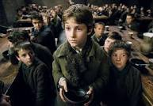
Writer’s techniques: How does Dickens use sentence structure to create an effect? Identify examples of emotive language which conveys the boys’ hunger.
The room in which the boys were fed was a large stone hall, with a copper at one end: out of which the master, dressed in an apron for the purpose, and assisted by one or two women, ladled the gruel at meal-times. Of this festive composition each boy had one porringer, and no more- except on occasions of great public rejoicing, when he had two ounces and a quarter of bread besides. The bowls never wanted washing. The boys polished them with their spoons till they shone again; and when they had performed this operation (which never took very long, the spoons being nearly as large as the bowls), they would sit staring at the copper, with such eager eyes, as if they could have devoured the very bricks of which it was composed; employing themselves, meanwhile, in sucking their fingers most assiduously, with the view of catching up any stray splashes of gruel that might have been cast thereon. Boys have generally excellent appetites. Oliver Twist and his companions suffered the tortures of slow starvation for three months: at last they got so voracious and wild with hunger, that one boy, who was tall for his age, and hadn't been used to that sort of thing (for his father had kept a small cookshop), hinted darkly to his companions, that unless he had another basin of gruel per diem, he was afraid he might some night happen to eat the boy who slept next him, who happened to be a weakly youth of tender age. He had a wild, hungry eye; and they implicitly believed him.
Notes:
The poorhouse p.115-124

Slide 25
Magpie interesting words or phrases from the extracts studied
Consider interesting words and phrases that you could incorporate into your own Dickensian style tale
Divide the words into those describing
themes, character and setting

Slide 26
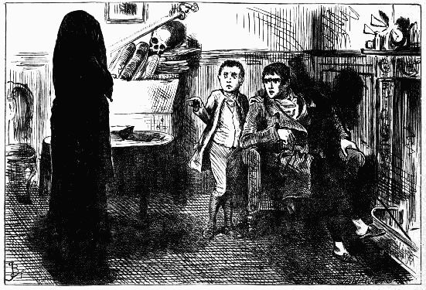
The Black Veil
A Short Story

Slide 27
Plot Structure Basics
Plot is the arrangement of events in a literary work.!
There are six main components to plot, and you can understand them better if you think of them in a figure like this:
Climax
Rising Action
Falling Action
Exposition
Resolution
Conflict is the problem at the root of the story.
Map the plot of “The Black Veil” onto this structure.
Notes:
Handout of this slide available in folder- or you could ask them to draw the diagram

Slide 28
Elements of Plot
Exposition – The situation is explained and characters introduced.
Rising Action – Events moving toward a high point of action.
Conflict – A struggle develops between two opposing forces.
Climax – Events reach a turning point.
Falling Action – events following the climax that lead to the ending.
Resolution – The outcome of the conflict is settled.
From Prentice Hall’s Timeless Voices, Timeless Themes Bronze Level p. 665

Slide 29
Technique focus: pathetic fallacy and foreshadowing
Read the opening to “A Black Veil”
How does Dickens use language to create tension and suspense?
Identify 3 quotations that add to the mysterious and sinister atmosphere; “explode” them
Notes:
See next slide for guidelines about exploding quotations

Slide 30

Detailed analysis
Who Says it?
Character? Narrator?
What is happening at the time?
Does this quotation link one character/event to another?
What does it show about the character?
Exploding Quotations!
What does it mean metaphorically?
What does it tell you about events in the story?
How does it fit in with other themes or ideas in the story?
What is the effect on the reader?
How does it work?
Is it a comparison?
Does it give a strong picture?
What technique does the writer use?

Slide 31
Structure: punctuation and paragraphing
How does the use of dashes and exclamation marks in the story show the emotions of the characters?
Comment on the effect of the variety of paragraph lengths at moments of tension within the story
How effective are the first and last lines of the story? Justify your response
with close reference to the text

Slide 32
Case Study: punctuation for effect.
Effect of the exclamation mark after a minor sentence?
Oh! but he was a tight-fisted hand at the grindstone, Scrooge! a squeezing, wrenching, grasping, scraping, clutching, covetous old sinner! Hard and sharp as flint, from which no steel had ever struck out generous fire; secret, and self-contained, and solitary as an oyster.
Effect of exclamation mark?
Effect of a long list punctuated by commas?
Effect of the semi-colon?
Extract from “A Christmas Carol” by Charles Dickens

Slide 33

Comment on the effects of the punctuation in this passage.
What is the effect of the exclamation marks? Where do they come in the sentence? Why? How do they affect the tone of the text?
What is the effect of the dashes? Think about how smoothly the passage reads. How would it affect the text if they were not there?
True!—nervous—very, very dreadfully nervous I had been and am! but why will you say that I am mad? The disease had sharpened my senses—not destroyed—not dulled them.
Extract from “Tell-Tale Heart” by Edgar Allen Poe

Slide 34
Magpie interesting words or phrases from the short story
Consider interesting words and phrases that you could incorporate into your own Dickensian style tale
Divide the words into those describing
themes, character and setting

Slide 35
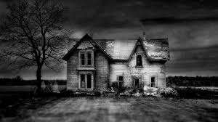
Practicing How to write vividly
technique | example
Ellipsis/dashes/ exclamation marks for effect
Appeal to the senses
Short sentence for impact.
Sense of being foreboding
Metaphor/ Simile
Personification
Mood/atmosphere
Show-not-tell
Pathetic fallacy
Emotive language

Slide 36
Assessment
Narrative Writing: Write the opening to a novel or a short story inspired by Charles Dickens

Slide 37
Planning your own story
Setting
Plot
(Structure)
Characters
Genre
Mood/
atmosphere
Themes/
message
Techniques
What “magpied” vocabulary could you use to create a Dickensian feel to your story?
How will you open and close your narrative?

Slide 38
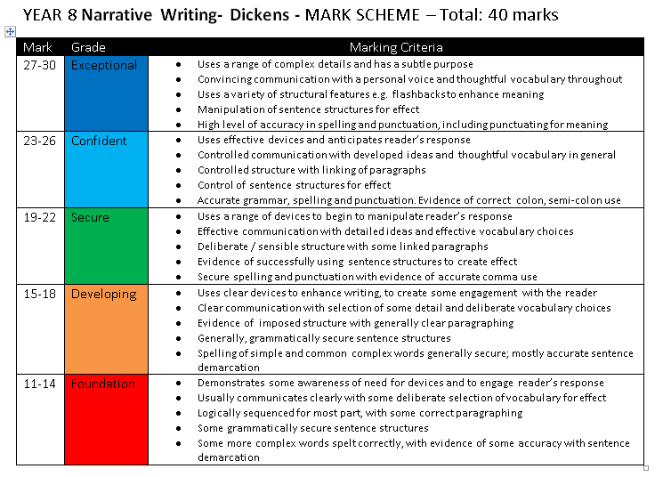

Slide 39
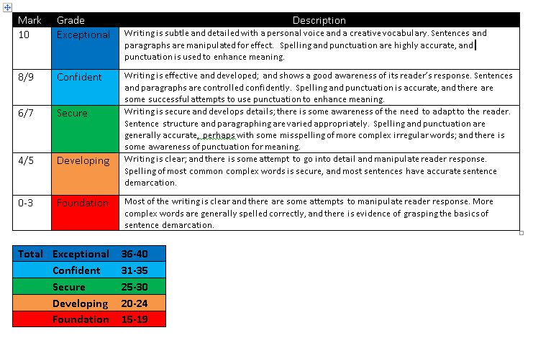
SPaG

