Slide 1
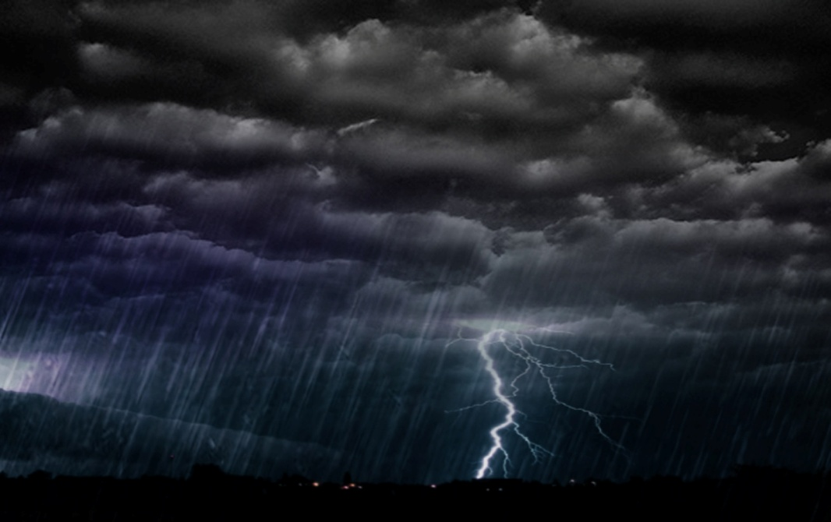
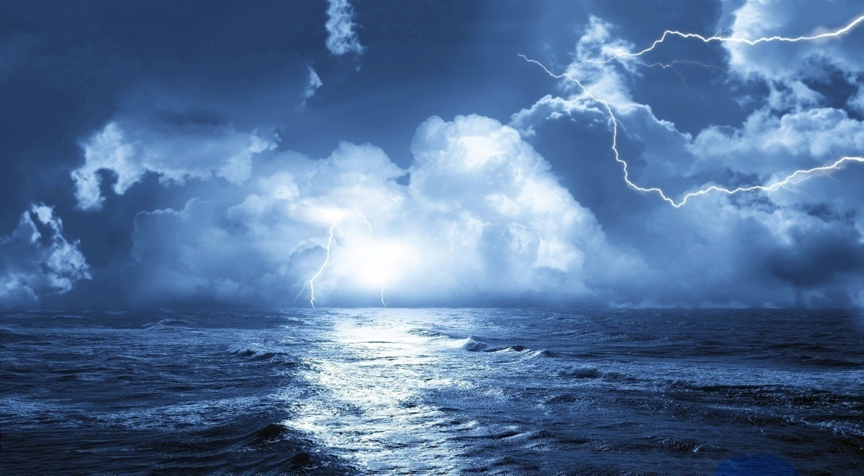
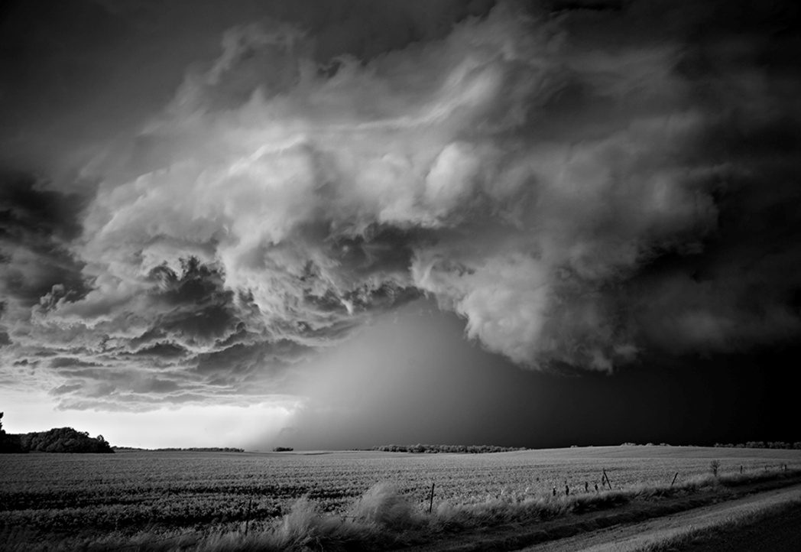
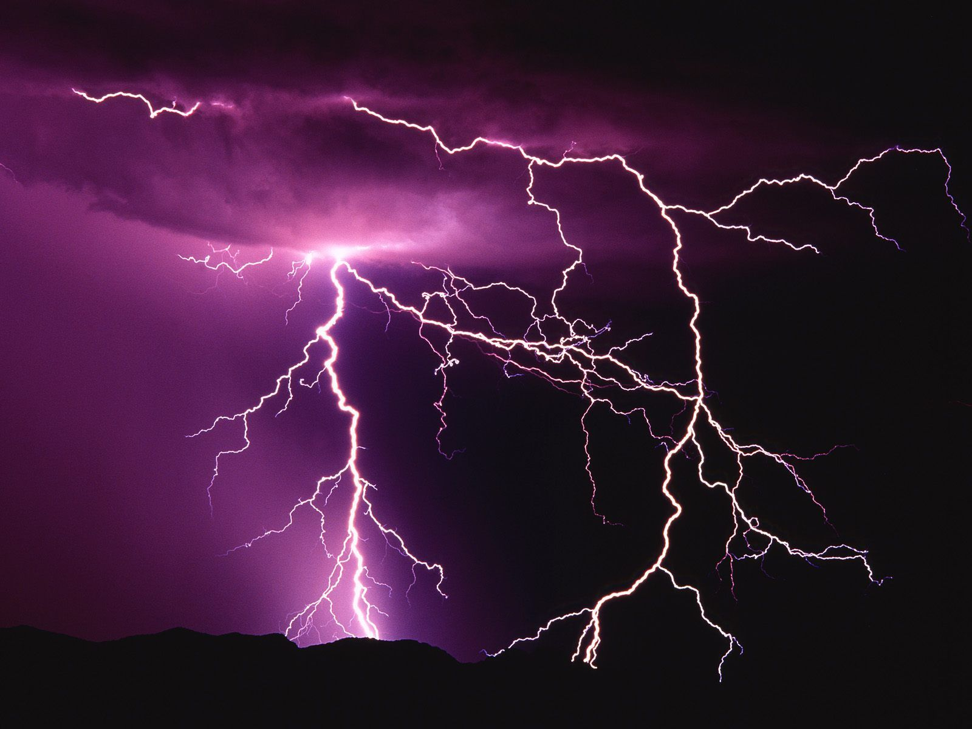
How many similes / metaphors / personification can you think of to describe a storm?
Challenge – can you link your examples to the theme of power and conflict? 

Slide 2
Storm on the Island
a air and are as be begins blast blows bombarded branches build but can cat chorus cliffs comfortably company dives down earth empty exploding fear flung forgetting full gale good has hay hits house houses huge I in invisibly is Island it just know leaves like listen lost mean might natural never no nor nothing on or our prepared prove pummels raise rock roof salvo savage sea see shelter sink sit slate so space spits spray squat stacks stooks storm strafes strange tame that the them there thing think this tight to too tragic trees troubled turned us very walls we what when which while wind windows with wizened you your
How many categories can you group the words into?
e.g. strength

Slide 3
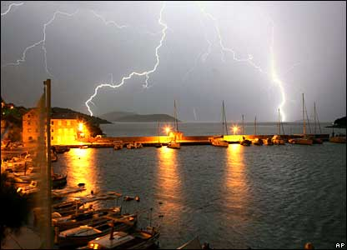
First Impressions
Draw a picture of how Heaney presents the island.
Notes:
Students should realise there isn’t much in the poem to help them do this – a lot of the poem is about what is not there. Students to then list examples of things which are absent or negative.

Slide 4

KEY IDEAS
What do you think are the 6 key ideas presented in the poem?
Draw an image to represent each key idea and find a quotation to support your statement.
Challenge – explain which one of your key ideas is most important and why
Notes:
Depending on ability – key idea worksheet could be given out to support ideas

Slide 5
HIDDEN MEANING
The first 8 letters of the title spell ‘Stormont’.
This is where the Northern Ireland Executive meet; a building which has long been associated with politics.
Does this add a different dimension to the poem and its meaning? Can you link the idea of a storm and its effect to politics?
Notes:
On another level Storm on the Island refers to the troubles in Northern Ireland that took place in the latter years of the twentieth century. Images of terrorist violence can be found throughout the poem. Words such as blast, exploding, fear, bombarded don’t just describe the literal storm but also represent the storm of violence happening in Northern Ireland during the Troubles. The first 8 letters of the poem spell out the word Stormont – the name of the Government buildings of Northern Ireland in Belfast. The word island also has an obvious phonetic similarity to the word Ireland. Therefore the poem works on two levels: as a description of a storm and as an extended metaphor for the political situation in Northern Ireland.

Slide 6

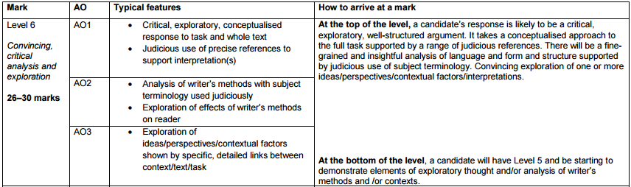
How does Heaney use language and structure to convey ideas about power?
Notes:
Using the mark scheme, create a success criteria for the question

Slide 7
How does Heaney use language and structure to convey ideas about power?
semantic field
military imagery
pronouns
repetition
blank verse
monosyllabic
present tense
personification
alliteration
assonance
Notes:
Depending on ability:
Provide grid for students (technique, evidence, analysis) – some could be completed
students to write example response in groups
students to independently write response

