Slide 1
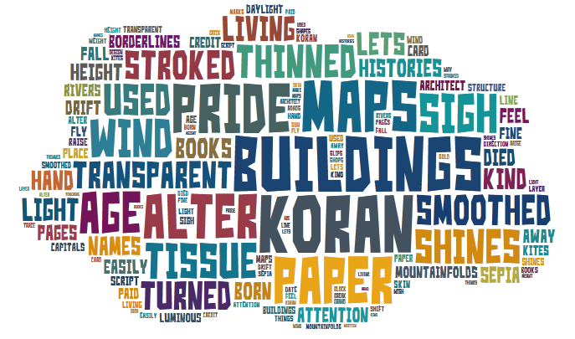
What do you think the poem could be about?
Challenge – annotate how the words could link to power and conflict

Slide 2
TISSUE
What are the connotations of this word?
Does the title of the poem help our understanding?

Slide 3
Strongly Disagree
Strongly Agree
0
10
It concerns what is real and what is imaginary.
The poem sets a solid world against a transparent one.
The writer desires a different, freer, lighter world.
The writer admires things that are beautiful but not permanent.
The poem is a dream.
There is a conflict in the writer’s mind beneath a calm surface.
Challenge – find a quotation to support each statement
Notes:
Students to draw arrow in books and place statements on the continuum.
Feedback – for each statement, ask for a student from each table to stand at front in continuum. Discuss placement and different ideas.

Slide 4
BOOKS
BANKS
How could the poem link to power and conflict?
ARCHITECT
BORDERS
???
BUILDINGS
Notes:
Students to brainstorm how ideas in the poem could relate to power and conflict. Encourage students to add quotations to support their ideas.

