Slide 1
What kind of person…
Is willing to go somewhere dangerous and life-threatening, knowing they might die?
Will purposefully do a job that could kill them?

Slide 2
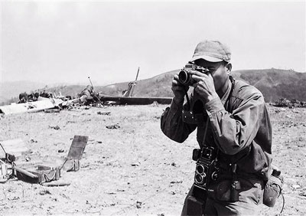
The photos we see on newspaper front pages, in Sunday supplements, on the news or in magazines, are taken by real people. These people place their lives in danger, to help us – the public- visualise the horrors of war elsewhere; wars not on our doorstep.
These people are War Photographers.

Slide 3
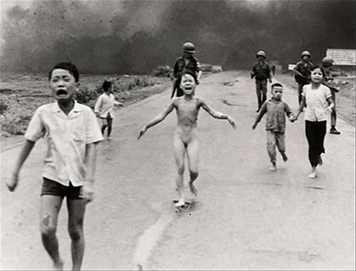
Vietnam War – how do we feel seeing this?

Slide 4
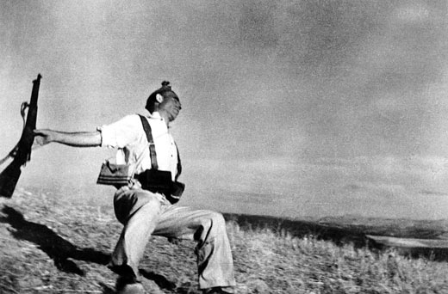
Falling soldier, Spanish Civil War

Slide 6
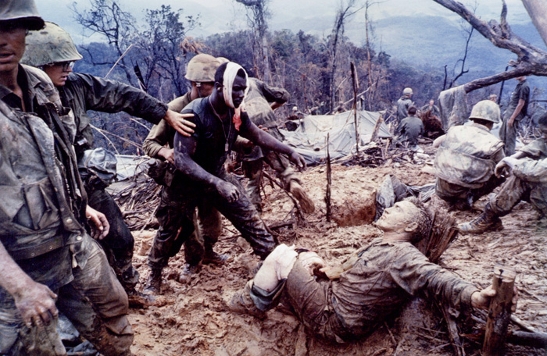
Vietnam War: 1956 – 1975 (18 years)

Slide 7
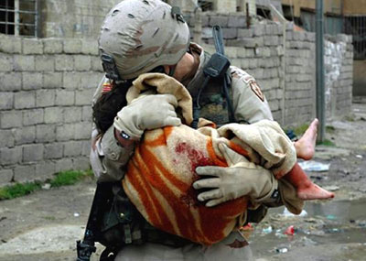
Iraq, 2005

Slide 8
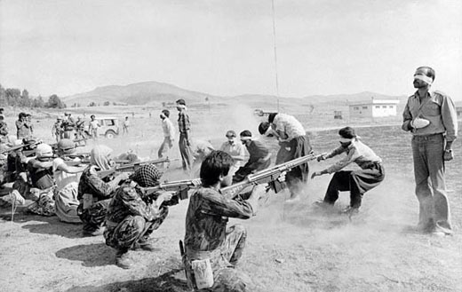
Iran, 1979

Slide 9
What was Duffy’s inspiration?
The poem comes from Carol Ann Duffy’s friendship with Don McCullin and Philip Jones Griffiths, two well-respected stills photographers who specialised in war photography.
Duffy is fascinated by what makes someone do such a job and how they feel about being in situations where a choice often has to be made between recording horrific events, and helping.

Slide 10
Exploring the Poem
We are going to explore the first stanza of the poem together, then you will be allocated to a group and a stanza to analyse in as much depth as possible before feeding back to each other in your groups.

Slide 11
Contrast to what?
Sibilance – what is the effect?
What are the connotations of the colours?
In his darkroom he is finally alone
with spools of suffering set out in ordered rows.
The only light is red and softly glows,
as though this were a church and he
a priest preparing to intone a Mass.
Belfast. Beirut. Phnom Penh. All flesh is grass.
regularity/order – reflects structure
Suggestion of graves/bodies
Isaiah 40:6 – Bible. shortness of life conveyed – but ironically sounds peaceful
Literal or list of horror; what is the effect of the caesura?
Simile – devotion to the pictures, he has escaped but the victims can’t.

Slide 12
Ambiguity – chemicals/solutions to war (there are no solutions)
Alliteration – conveys evil he’s witnessed
He has a job to do. Solutions slop in trays
beneath his hands which did not tremble then
though seem to now. Rural England. Home again
to ordinary pain which simple weather can dispel,
to fields which don’t explode beneath the feet
of running children in nightmare heat.
Why did they not tremble then? Why now?
CONTRAST to war zones - suggests peaceful, idyllic life
Contrast: barefoot children running in grass for fun/those running from war – end of innocence and, possibly, life. He is affected emotionally too.
True meaning to the poem.
Is he a hero?
Cannot compare to pain of war

Slide 13
Ambiguous: Literal – developing the photo. Figurative – person in pain
Something is happening. A stranger’s features
faintly start to twist before his eyes,
a half-formed ghost. He remembers the cries
of this man’s wife, how he sought approval
Without words to do what someone must
and how the blood stained into foreign dust.
Metaphor – 1. image on photo, 2. death
He’s haunted by the past.
Photographer’s dilemma – has a job to do. His duty to report on the crimes of war.

Slide 14
Photo
Good/evil
right/wrong
3. Truth/lies
Trivialises; we are only moved momentarily
Contrast to war zone – readers wash away the truth
A hundred agonies in black-and-white
from which his editor will pick out five or six
for Sunday’s supplement. The reader’s eyeballs prick
with tears between the bath and pre-lunch beers.
From the aeroplane he stares impassively at where
He earns his living and they do not care.
Chooses photos to suit the article; don’t convey the full horror of war
Leaving to another assignment; poem is cyclical; unceasing wars
Who are they?
Suggests they are used for entertainment –
Criticises us, the reader

Slide 15
Structure
4 stanzas
6 lines per stanza
Regular rhyme scheme – ABBCDD
Rhyming couplets end each stanza
EFFECT ?
Creates order in the chaos of war
Like the photographer – ordering the photos, making sense of the chaos
The couplets help to create a serious moral message about the crimes of war
Our understanding of the photographer and the poet’s message develops just as the photos develop

Slide 16
How does Duffy try to make us relate to/understand overseas conflicts?

Slide 17
Point It can be difficult for us to relate to suffering in faraway countries and so to make us feel angry and guilty about it, Duffy has to use some disturbing and powerful images, images we would rather not think about, or really see. She says...

Slide 18
Evidence to support 'Fields which don't explode beneath the feet Of running children in a nightmare heat.

Slide 19
Explanation/Analysis This image is effective because we would normally think of 'running children' in 'fields' as an image of fun. We also associate children with innocence, and the idea of them being hurt brings out our protective instincts. Duffy does not tell us what these children are running from, some kind of 'nightmare heat', leaving it up to us to imagine our worst fears. In effect, this image is what happened before the images we have all seen on our TV's of children badly burnt, without legs or arms. We know while they are 'running' what will happen to them.

Slide 20
FOCUS ON IMAGERY: In small groups, select one of the following and create a short analytical paragraph, applying the PEE principle. Maximum 10 minutes.
“how the blood stained into foreign dust”
“a hundred agonies in black-and-white”
“A stranger’s features faintly start to twist before his eyes, a half-formed ghost.”
“The reader’s eyeballs prick/ with tears between the bath and pre-lunch beers”

Slide 21
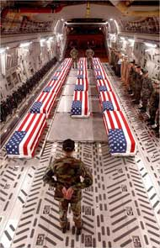
What are YOUR thoughts?
You are now going to discuss and reflect on the ideas that you gathered through our analysis of ‘War Photographer’. As you are doing so, think about:
-what did you find to be the most interesting key words/phrases? Why?
-what ideas did your group come up with that you found the most interesting and why?
-Were there any ideas that were brought up that you were unsure of, or had a different opinion on? If so-why? Can your partner offer an interpretation?

