Slide 1
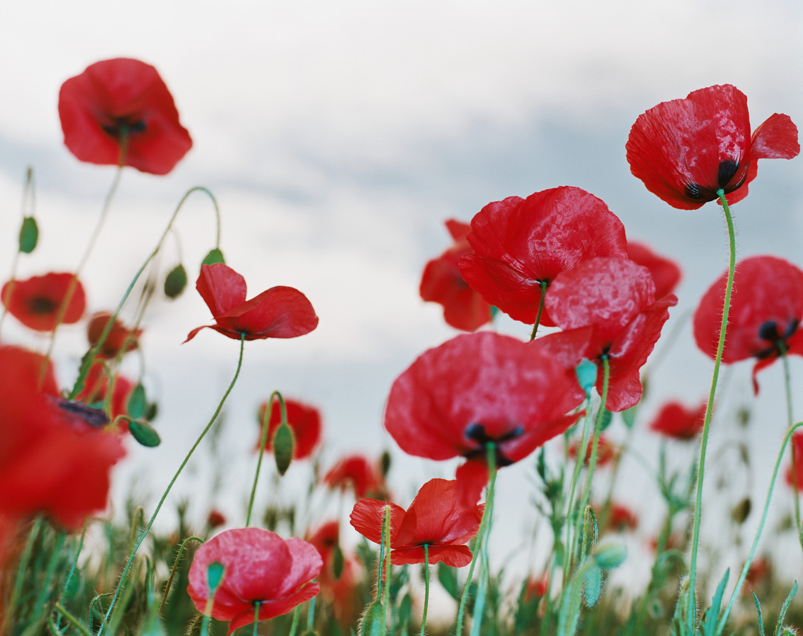
Poppies – Jane Weir
Objective:
To be able to recognise and comment on the use of poetic devices in the poem Poppies.
Challenge:
To explain how language devices contribute to the writer’s meaning
Starter:
What do you think and feel when you see this particular flower?
What do you already know about what this flower stands for?
What could the colour red symbolise?
Challenge:
On the basis of these ideas, what do you think the poem ‘Poppies’ will be about? Be sure to explain your ideas using formal language.

Slide 2
Task : With a partner, find out what the following words mean (use dictionaries or try breaking them down and discuss what you think that they might mean) and write down their definitions. You have FIFTEEN minutes.
armistice | lapel | spasms
blockade | steeled | intoxicated
reinforcements | blackthorns | ornamental
Challenge Activity : Choose two words that you think have interesting connotations and explore what these connotations might tell you about the subject of the poem.

Slide 3
Reading the poem
Read the poem carefully while you listen to the reading.
What are your initial reactions to the meaning?

Slide 4
Task: Find the language devices
In your pairs, using your notes from last lesson find examples of imagery and other poetic devices in the poem.
Annotate these examples on your sheets and be prepared to feedback your ideas.
If you get stuck, use the support station.
You may find examples of:
Imagery
Personification
Metaphors
Similes
Alliteration
Verbs
Extension: what do you think the effect of this language is?

Slide 5
Support Station find hints and tips here if you’re stuck! You can also turn to a learning leader

Slide 6
Ominous reminder that war kills
Three days before Armistice Sunday
and poppies had already been placed
on individual war graves. Before you left,
I pinned one onto your lapel, crimped petals,
spasms of paper red, disrupting a blockade
of yellow bias binding around your blazer.
Sellotape bandaged around my hand,
I rounded up as many white cat hairs
as I could, smoothed down your shirt’s
upturned collar, steeled the softening
of my face. I wanted to graze my nose
across the tip of your nose, play at
being Eskimos like we did when
you were little. I resisted the impulse
to run my fingers through the gelled
blackthorns of your hair. All my words
flattened, rolled, turned into felt,
What technique has been used?
She is emotionally wounded. He may actually be wounded
Representing uniform. School? Army?
Still treated like a child
Contrast with harsh reality. Wishing for him to be young again
What technique has been used?
What technique has been used here?

Slide 7
Sudden movement suggests breaking a boundary
What technique has been used here?
slowly melting. I was brave, as I walked
with you, to the front door, threw
it open, the world overflowing
like a treasure chest. A split second
and you were away, intoxicated.
After you’d gone I went into your bedroom,
released a song bird from its cage.
Later a single dove flew from the pear tree,
and this is where it has led me,
skirting the church yard walls, my stomach busy
making tucks, darts, pleats, hat-less, without
a winter coat or reinforcements of scarf, gloves.
On reaching the top of the hill I traced
the inscriptions on the war memorial,
leaned against it like a wishbone.
The dove pulled freely against the sky,
an ornamental stitch. I listened, hoping to hear
your playground voice catching on the wind.
What is this symbolic of?
What is this symbolic of?
Sewing imagery. Nervous feelings of anxiety.
Reminder of the risks her son faces
Something small and beautiful in a vast space. Represents?
Links leaving to go to the army with leaving to go to school.

Slide 9
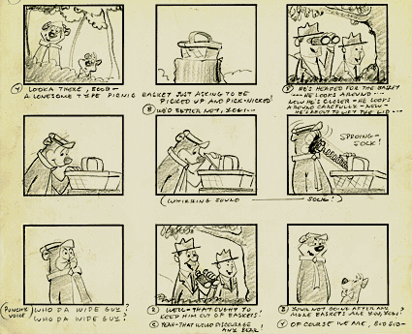
Homework: Create a Photo story or story board
The poem, Poppies is rich in imagery.
Create a storyboard (on paper) for the poem or a movie version.
Due:

Slide 10
Who is Jane Weir? A Very Brief Biography
.
Weir currently lives in Derbyshire and Manchester, where she writes and runs her own textile and design business
She describes herself as Anglo-Italian
She was born in 1963 on a council estate on the outskirts of Manchester
She is a textile designer, writer and poet
She has also written about the poet Charlotte Mew and the writer Katherine Mansfield and, more recently, a poetic biography of two highly respected women textile designers.
As an adult, she has lived ‘all over the place’, including in Belfast, Northern Ireland during the Troubles (in the 1980s).
Her publications have been diverse and include a pamphlet called Alice (2006) which was based on the life of an early 20th century political activist, Alice Wheeldon.

Slide 11
“Poppies” – “a multisensory explosion”
Weir’s poem ‘Poppies’ was commissioned by Carol Ann Duffy as part of a collection of ten contemporary war poems which were published in the Guardian in 2009, as part of a response to the escalating conflict in Afghanistan and the Iraq inquiry.
Weir describes being surprised by the ‘overwhelming response’ she had from readers across Europe to ‘Poppies’.

Slide 12
“Poppies” – “a multisensory explosion”
“Poppies” – “a multisensory explosion”
She commented in an interview that, ‘I wrote the piece from a woman's perspective, which is quite rare, as most poets who write about war have been men. As the mother of two teenage boys, I tried to put across how I might feel if they were fighting in a war zone.’

Slide 13
“Poppies” – “a multisensory explosion”
Weir has acknowledged that ‘A lot of my poems are narrative driven or scenarios’, and in ‘Poppies’ she tells the ‘story’ of a mother’s experience of pain and loss as her son leaves home to go to war.

Slide 14
“Poppies” – “a multisensory explosion”
‘I was thinking of Susan Owen [mother of World war One soldier ad poet, Wilfred]… and families of soldiers killed in any war when I wrote this poem. This poem attempts on one level to address female experience and is consciously a political act.’
Susan Owen
Wilfred Owen

Slide 15
Content and Meaning
Objective: To understand the content and meaning of the poem by looking closely at the words and imagery
AO1 – Respond to texts critically and imaginatively

Slide 16
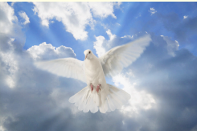
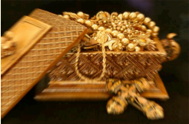
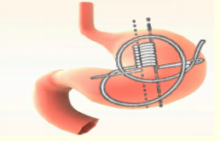
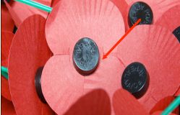
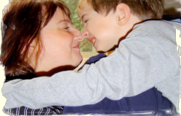
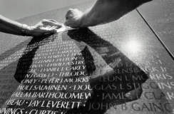
Starter: Look at the images below …
1
2
3
4
5
6
Can you find the quotation they refer to?

Slide 17
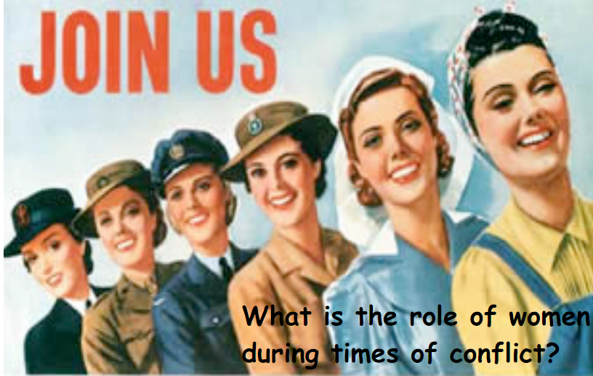
Question:
How does the poet make use of gender stereotypes in the poem?
(use the text to back up your ideas)

Slide 19
Task: Select some of the images below and use them to write your own piece of creative writing.

